Slide 1

CC
CC
Assessing Security Levels & Functional Interoperability
Cybersecurity Vehicle Forum
May 2025
WEI YUAN
PUBLIC

Slide 2
AGENDA
00
01
02
03
Context
Attack Potential & Attack Methods
SESIP Assurance Levels & Protection Profiles
Final thoughts

Slide 3

Context
Context
Attack Potential & Attack Methods
SESIP Assurance Levels & Protection Profiles
Final thoughts

Slide 4
00
Context
Automotive Security Today
📈 Growth of Connected Vehicles
The number of connected vehicles is rapidly increasing.
Projections indicate that over 327 million connected vehicles will be in service by 2027, encompassing advanced mobility platforms such as autonomous vehicles and electric vertical take-off and landing vehicles.
This surge significantly expands the number of vehicle endpoints exposed to potential cyberattacks.
🔓 Expanded Attack Surfaces
Modern vehicles integrate numerous electronic control units (ECUs) and communication interfaces, including Bluetooth, Wi-Fi, and cellular networks. This complexity introduces multiple potential entry points for cyberattacks.
Infotainment systems: Vulnerable to control override and injection attacks.
Telematics units: Susceptible to unauthorized remote access.
On-Board Diagnostics (OBD-II) ports: Can be exploited for direct access to vehicle networks.
⚠️ Escalating Cybersecurity Challenges
The automotive industry faces significant cybersecurity threats, including compromised safety, privacy breaches, financial losses, and reputational damage.
Automotive cybersecurity market is projected to grow from $3.9 billion in 2023 to $5.9 billion by 2025, reflecting the industry's response to these escalating threats.

Slide 5



00
Context
Automotive Cybersecurity from a different view
ENISA's Attack Methodology
EUCC Scheme and CC evaluation methodology.
Experience in Technical Domains for SCSD and HWSB.
Set of State of the Art (SoTA) documentation.
SESIP Methodology and Protection Profiles
Pragmatic (and industry friendly) view of CC
Granularity to reinforce Composition and Reusability
Compliance demonstration (with requirements mappings) against industry proposals.

Slide 6
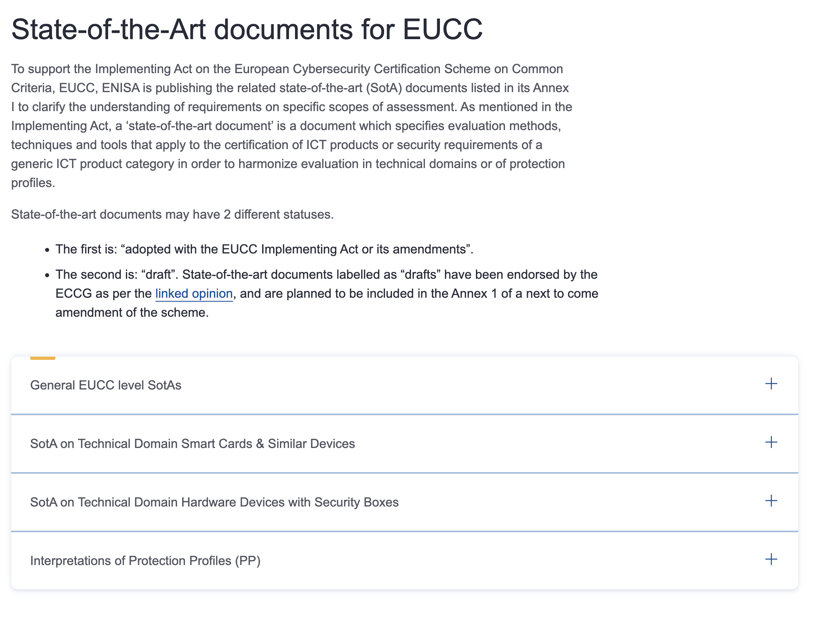
00
Context
Automotive Cybersecurity from a different view
ENISA's Attack Methodology
EUCC Scheme and CC evaluation methodology.
Experience in Technical Domains for SCSD and HWSB.
Set of State of the Art (SoTA) documentation.
SESIP Methodology and Protection Profiles
Pragmatic (and industry friendly) view of CC
Granularity to reinforce Composition and Reusability
Compliance demonstration (with requirements mappings) against industry proposals.
https://certification.enisa.europa.eu/certification-library/eucc-certification-scheme_en

Slide 7
00
Context
Automotive Cybersecurity from a different view
ENISA's Attack Methodology
EUCC Scheme and CC evaluation methodology.
Experience in Technical Domains for SCSD and HWSB.
Set of State of the Art (SoTA) documentation.
SESIP Methodology and Protection Profiles
Pragmatic (and industry friendly) view of CC
Granularity to reinforce Composition and Reusability
Compliance demonstration (with requirements mappings) against industry proposals.

Slide 8
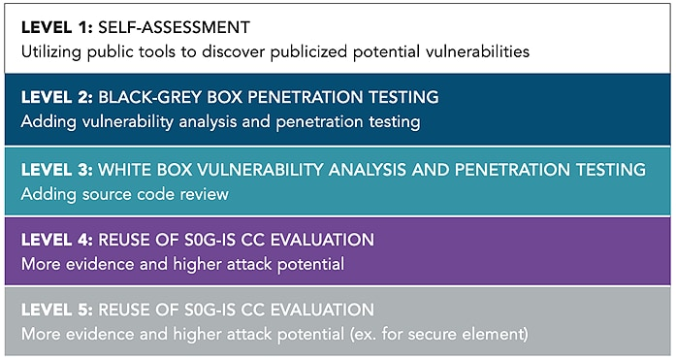
00
Context
Automotive Cybersecurity from a different view
ENISA's Attack Methodology
EUCC Scheme and CC evaluation methodology.
Experience in Technical Domains for SCSD and HWSB.
Set of State of the Art (SoTA) documentation.
SESIP Methodology and Protection Profiles
Pragmatic (and industry friendly) view of CC
Granularity to reinforce Composition and Reusability
Compliance demonstration (with requirements mappings) against industry proposals.
https://www.nxp.com/company/about-nxp/smarter-world-blog/BL-SESIP-SYSTEM

Slide 9
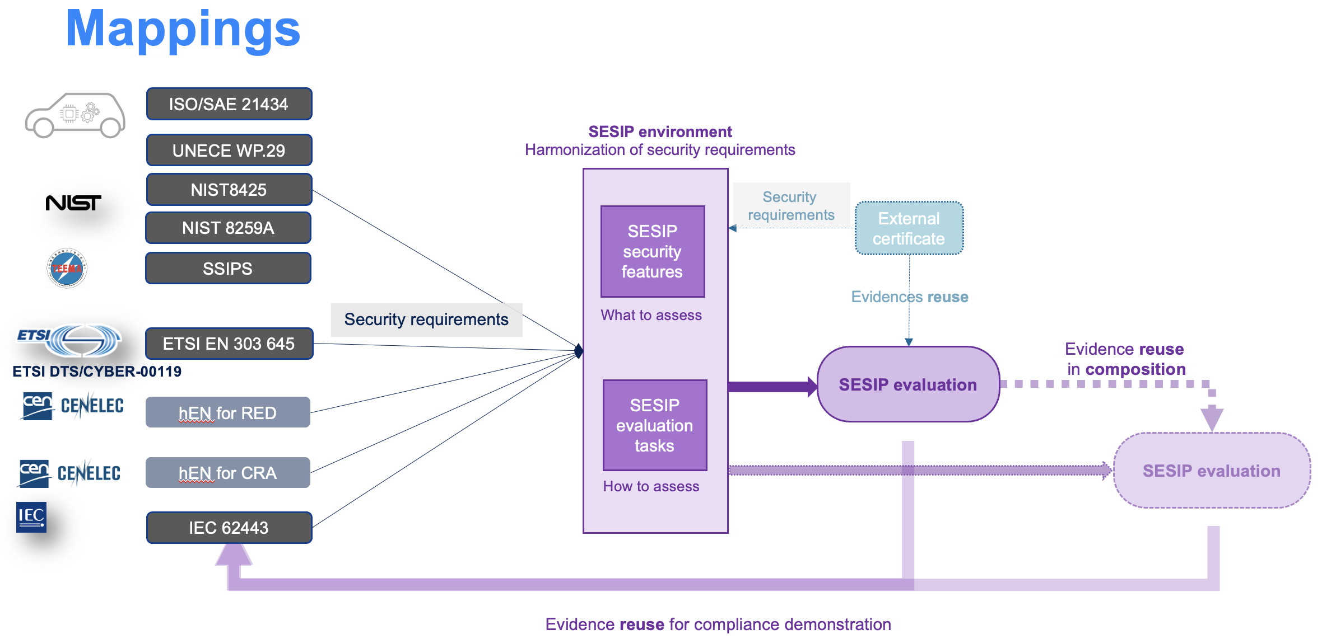
00
Context
Automotive Cybersecurity from a different view
ENISA's Attack Methodology
EUCC Scheme and CC evaluation methodology.
Experience in Technical Domains for SCSD and HWSB.
Set of State of the Art (SoTA) documentation.
SESIP Methodology and Protection Profiles
Pragmatic (and industry friendly) view of CC
Granularity to reinforce Composition and Reusability
Compliance demonstration (with requirements mappings) against industry proposals.
SESIP Methodology and Protection Profiles
Pragmatic (and industry friendly) view of CC
Granularity to reinforce Composition and Reusability
Compliance demonstration (with requirements mappings) against industry proposals.
https://globalplatform.org/specs-library/?filter-committee=sesip&filter-document_types=859

Slide 10
Attack Potential & Attack Methods
Context
Attack Potential & Attack Methods
SESIP Assurance Levels & Protection Profiles
Final thoughts

Slide 11
01
Attack Potential & Attack Methods
Applus+ experience on automotive penetration testing
Traditional pentest request:
Typically, software attacks methods in scope
Sometimes, hardware attacks methods considered in TARAs, but removed from scope
Very Limited budget without priorization of attack vectors
Code Injection
Broken Access Control
Fuzzing
Cryptographic Failures
Vulnerable and Outdated Components
Security Misconfiguration
Code Review

Slide 12
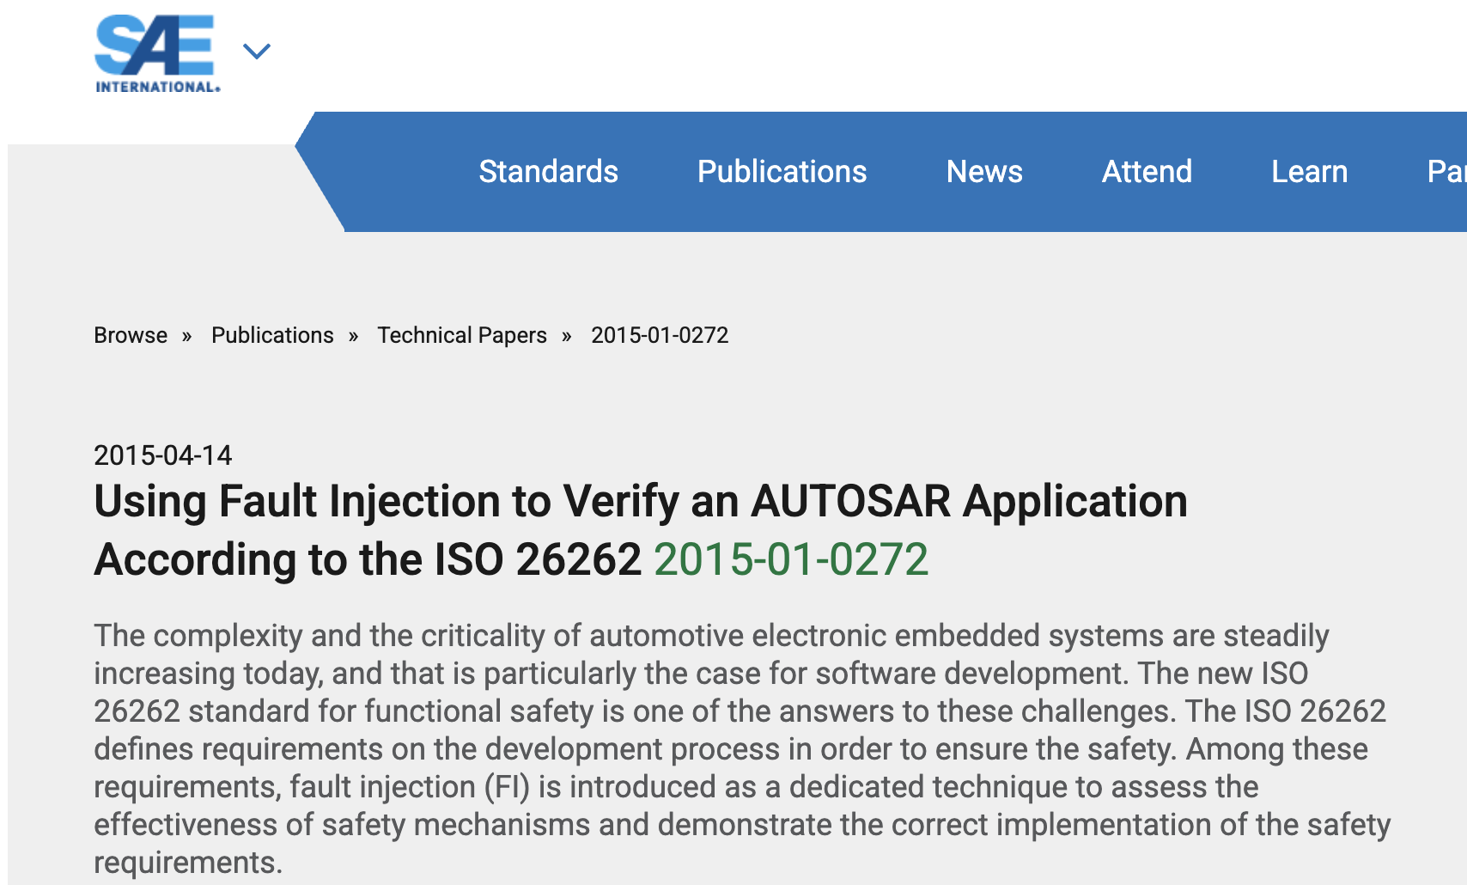
01
Attack Potential & Attack Methods
Applus+ experience on automotive penetration testing

Slide 13
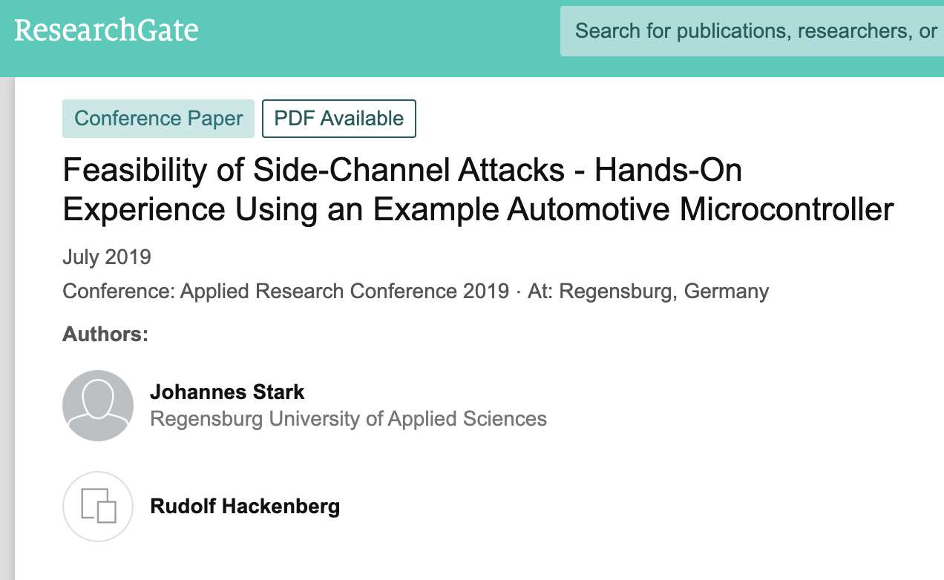
01
Attack Potential & Attack Methods
Applus+ experience on automotive penetration testing

Slide 14

01
Attack Potential & Attack Methods
Applus+ experience on automotive penetration testing

Slide 15

01
Attack Potential & Attack Methods
ENISA SoTA: Application of attack potential to hardware devices with security boxes (HWSB)
Hardware Security Boxes and Automotive Parallels:
Hardware security boxes and ECUs share attack exposure definition.
ENISA attack potential model is mature and effective

Slide 16
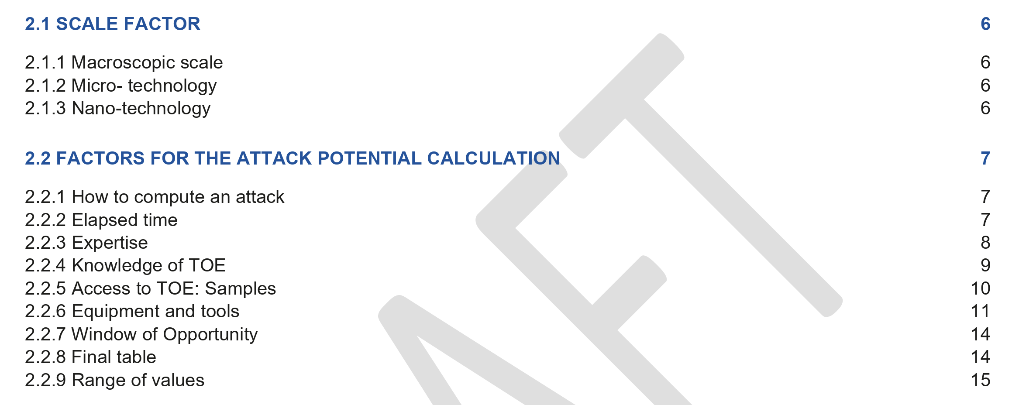
01
Attack Potential & Attack Methods
ENISA SoTA: Application of attack potential to hardware devices with security boxes (HWSB)
Hardware Security Boxes and Automotive Parallels:
Hardware security boxes and ECUs share attack exposure definition.
ENISA attack potential model is mature and effective

Slide 17
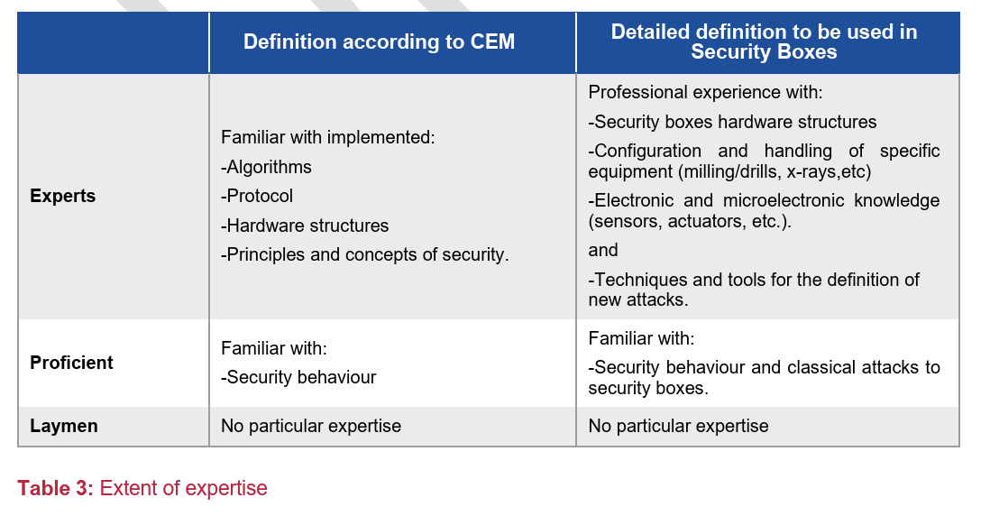
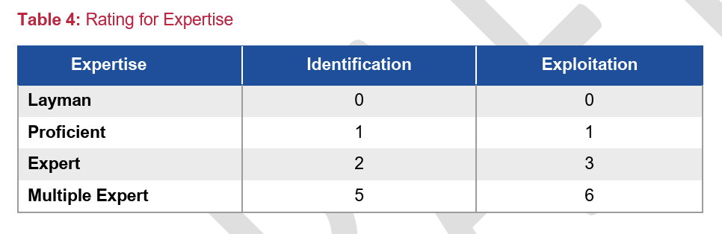
01
Attack Potential & Attack Methods
ENISA SoTA: Application of attack potential to hardware devices with security boxes (HWSB)
Hardware Security Boxes and Automotive Parallels:
Hardware security boxes and ECUs share attack exposure definition.
ENISA attack potential model is mature and effective

Slide 18
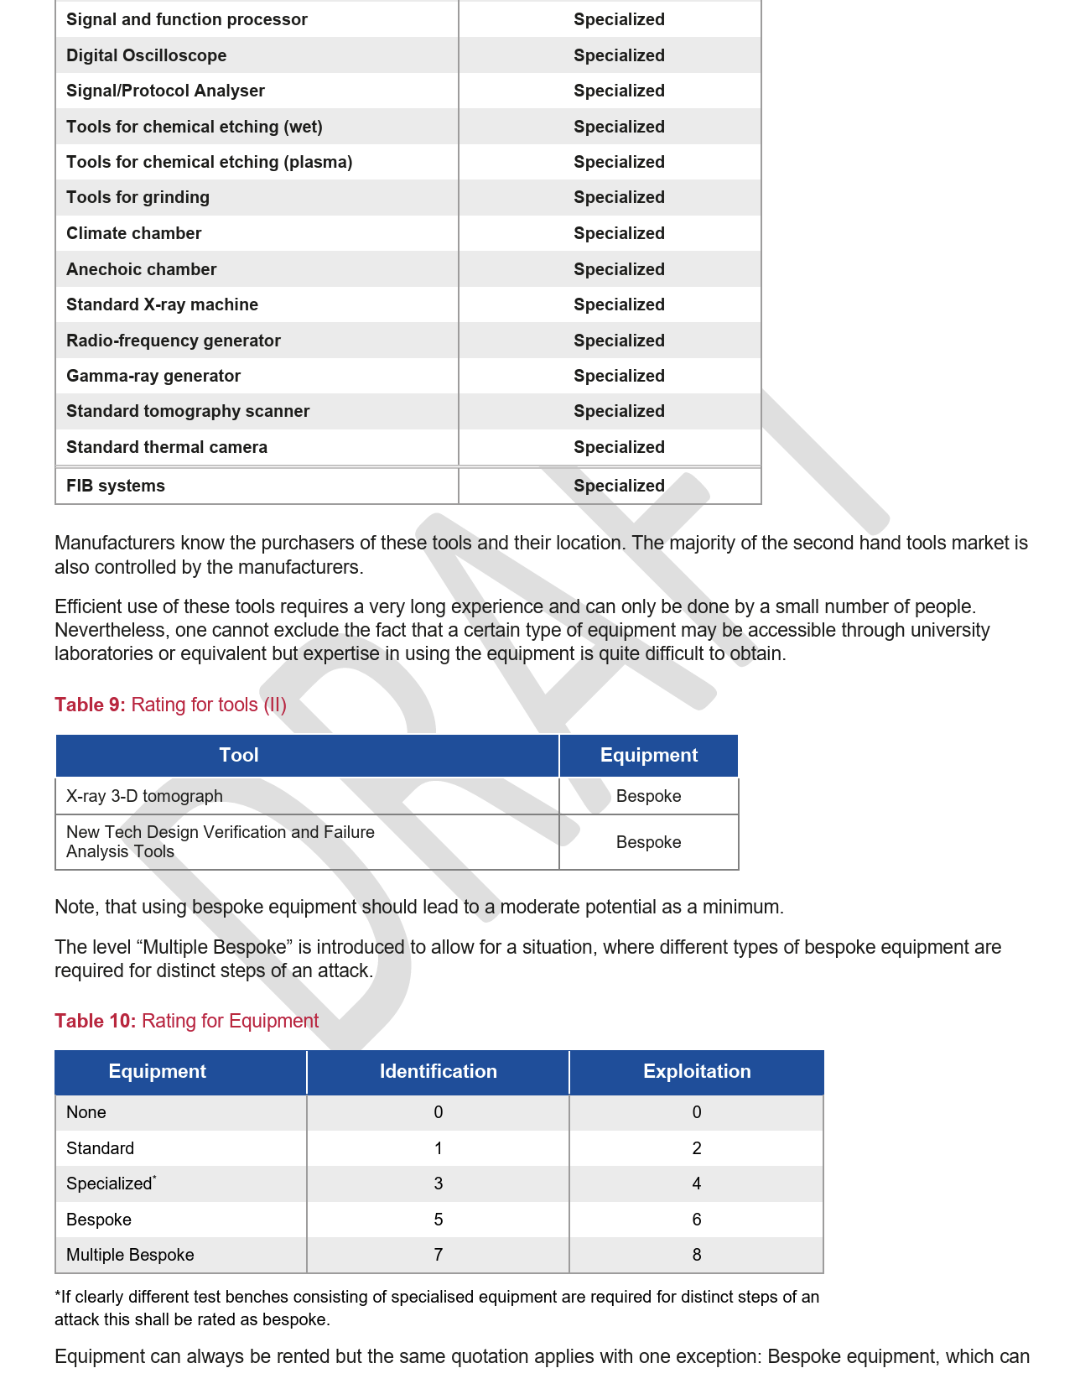
01
Attack Potential & Attack Methods
ENISA SoTA: Application of attack potential to hardware devices with security boxes (HWSB)
Hardware Security Boxes and Automotive Parallels:
Hardware security boxes and ECUs share attack exposure definition.
ENISA attack potential model is mature and effective

Slide 19
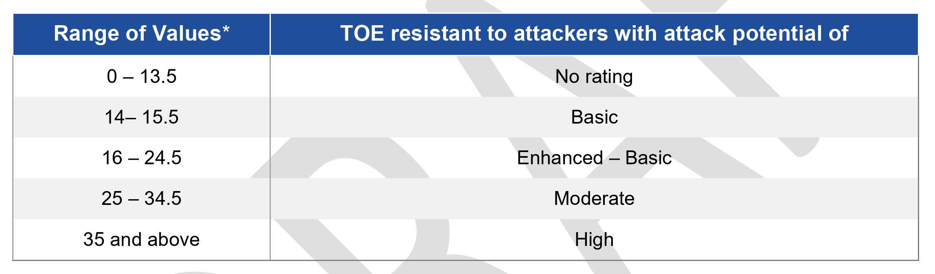
01
Attack Potential & Attack Methods
ENISA SoTA: Application of attack potential to hardware devices with security boxes (HWSB)
Hardware Security Boxes and Automotive Parallels:
Hardware security boxes and ECUs share attack exposure definition.
ENISA attack potential model is mature and effective

Slide 20
01
Attack Potential & Attack Methods
ENISA SoTA: Application of attack potential to hardware devices with security boxes (HWSB)
Attack potential rating example
Attack scenario:
Target:
  Bypass FW signature verification during FW update process with the target to load a forged FW with malicious code.
Identification of (potential) vulnerability:
  When wrong FW is processed, different error messages are received.
  The verification of the FW might not be protected against faults.
Attack method:
  Perturbation attack using Voltage glitch

Slide 21
01
Attack Potential & Attack Methods
ENISA SoTA: Application of attack potential to hardware devices with security boxes (HWSB)
Attack potential rating example
 | Identification | Exploitation
Elapsed time | 5 | 2
Expertise | 2 | 2
Knowledge of TOE | 2 | 2
Access to TOE: Samples | 2 | 4
Equipment and tools | 3 | 4
Windows of Opportunity | 0 | 0
Final table | 14 | 14
 | 28 (Moderate resistance)

Slide 22
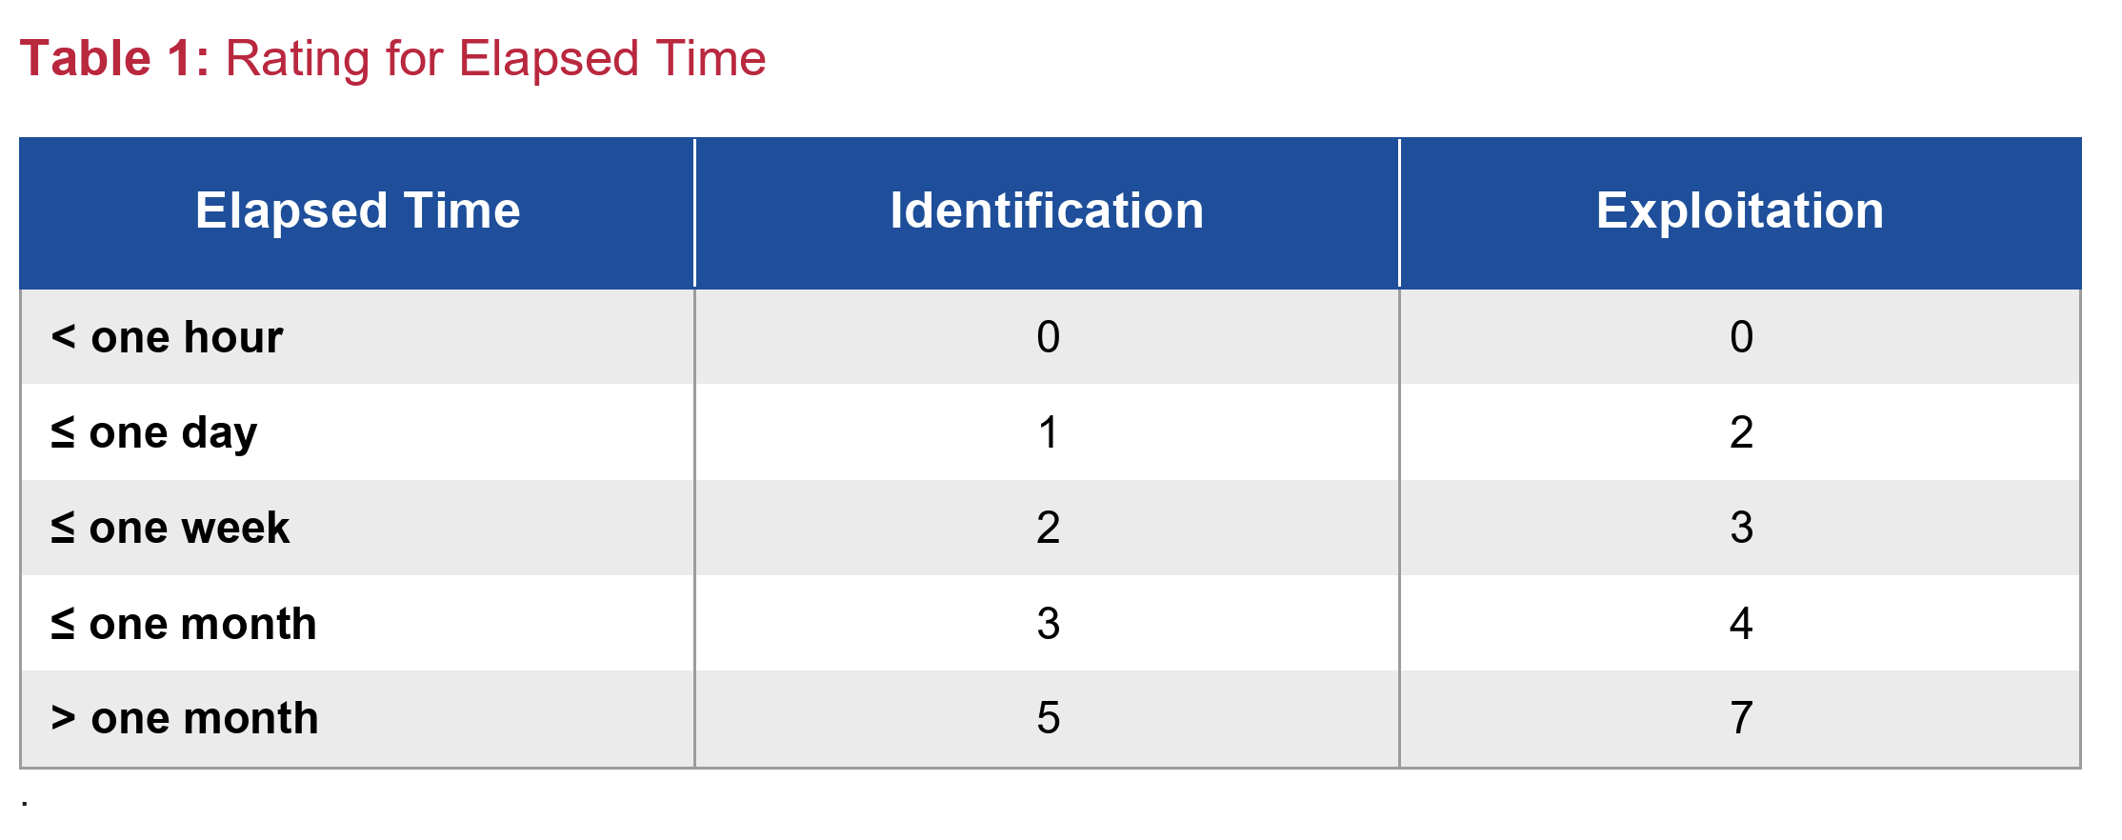
01
Attack Potential & Attack Methods
ENISA SoTA: Application of attack potential to hardware devices with security boxes (HWSB)
Attack potential rating example
 | Identification | Exploitation
Elapsed time | 5 | 2
Expertise | 2 | 2
Knowledge of TOE | 2 | 2
Access to TOE: Samples | 2 | 4
Equipment and tools | 3 | 4
Windows of Opportunity | 0 | 0
Final table | 14 | 14
 | 28 (Moderate resistance)

Slide 23
01
Attack Potential & Attack Methods
ENISA SoTA: Application of attack potential to hardware devices with security boxes (HWSB)
Attack potential rating example
 | Identification | Exploitation
Elapsed time | 5 | 2
Expertise | 2 | 2
Knowledge of TOE | 2 | 2
Access to TOE: Samples | 2 | 4
Equipment and tools | 3 | 4
Windows of Opportunity | 0 | 0
Final table | 14 | 14
 | 28 (Moderate resistance)

Slide 24
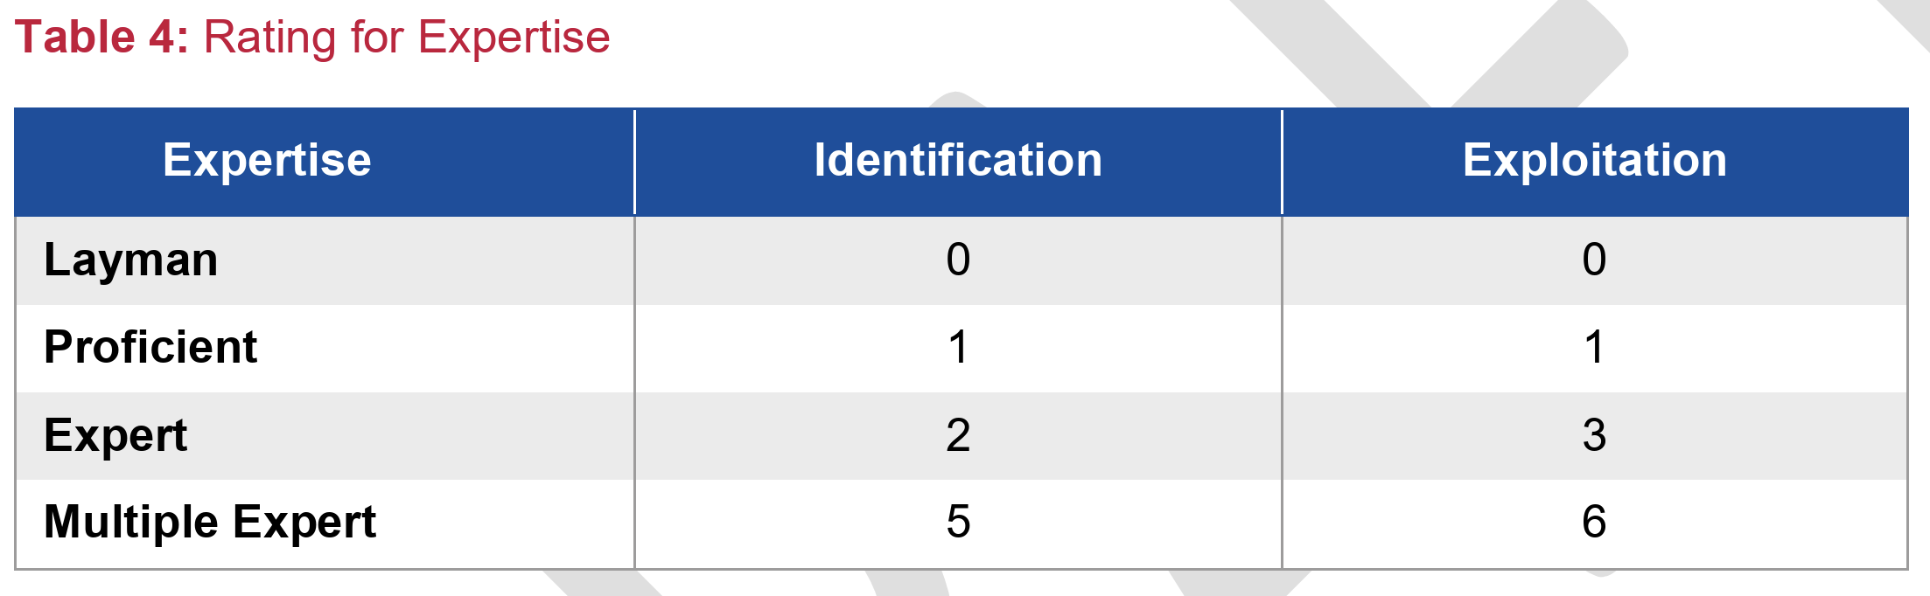
01
Attack Potential & Attack Methods
ENISA SoTA: Application of attack potential to hardware devices with security boxes (HWSB)
Attack potential rating example
 | Identification | Exploitation
Elapsed time | 5 | 2
Expertise | 2 | 2
Knowledge of TOE | 2 | 2
Access to TOE: Samples | 2 | 4
Equipment and tools | 3 | 4
Windows of Opportunity | 0 | 0
Final table | 14 | 14
 | 28 (Moderate resistance)

Slide 25
01
Attack Potential & Attack Methods
ENISA SoTA: Application of attack potential to hardware devices with security boxes (HWSB)
Attack potential rating example
 | Identification | Exploitation
Elapsed time | 5 | 2
Expertise | 2 | 2
Knowledge of TOE | 2 | 2
Access to TOE: Samples | 2 | 4
Equipment and tools | 3 | 4
Windows of Opportunity | 0 | 0
Final table | 14 | 14
 | 28 (Moderate resistance)

Slide 26
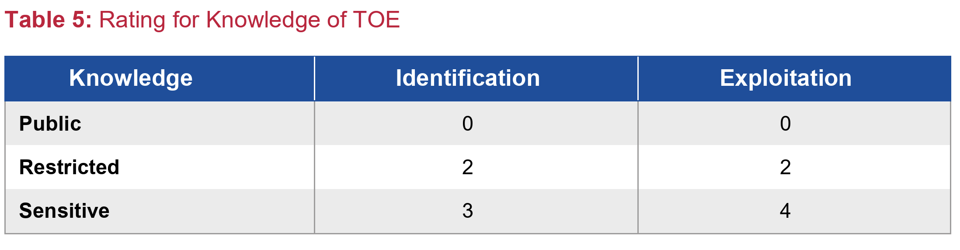
01
Attack Potential & Attack Methods
ENISA SoTA: Application of attack potential to hardware devices with security boxes (HWSB)
Attack potential rating example
 | Identification | Exploitation
Elapsed time | 5 | 2
Expertise | 2 | 2
Knowledge of TOE | 2 | 2
Access to TOE: Samples | 2 | 4
Equipment and tools | 3 | 4
Windows of Opportunity | 0 | 0
Final table | 14 | 14
 | 28 (Moderate resistance)

Slide 27
01
Attack Potential & Attack Methods
ENISA SoTA: Application of attack potential to hardware devices with security boxes (HWSB)
Attack potential rating example
 | Identification | Exploitation
Elapsed time | 5 | 2
Expertise | 2 | 2
Knowledge of TOE | 2 | 2
Access to TOE: Samples | 2 | 4
Equipment and tools | 3 | 4
Windows of Opportunity | 0 | 0
Final table | 14 | 14
 | 28 (Moderate resistance)

Slide 28
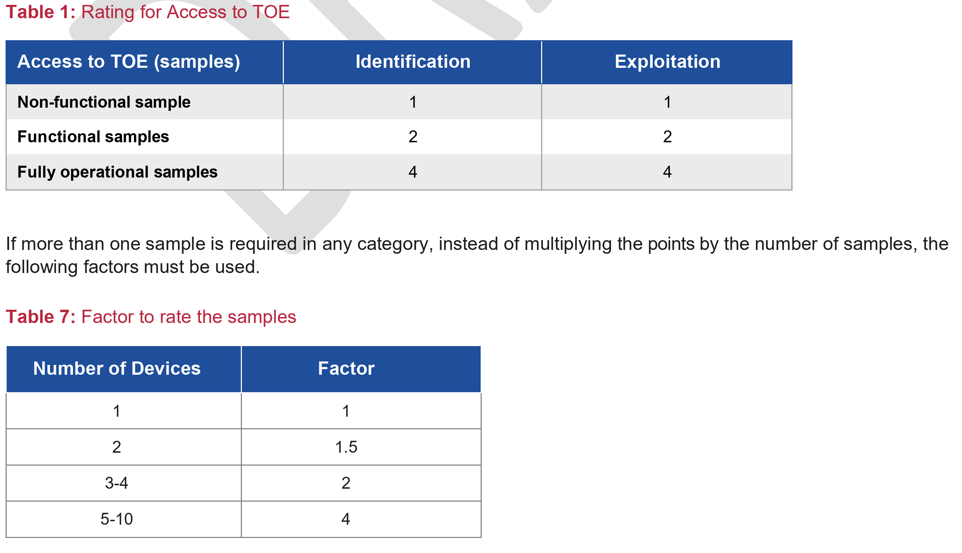
01
Attack Potential & Attack Methods
ENISA SoTA: Application of attack potential to hardware devices with security boxes (HWSB)
Attack potential rating example
 | Identification | Exploitation
Elapsed time | 5 | 2
Expertise | 2 | 2
Knowledge of TOE | 2 | 2
Access to TOE: Samples | 2 | 4
Equipment and tools | 3 | 4
Windows of Opportunity | 0 | 0
Final table | 14 | 14
 | 28 (Moderate resistance)

Slide 29
01
Attack Potential & Attack Methods
ENISA SoTA: Application of attack potential to hardware devices with security boxes (HWSB)
Attack potential rating example
 | Identification | Exploitation
Elapsed time | 5 | 2
Expertise | 2 | 2
Knowledge of TOE | 2 | 2
Access to TOE: Samples | 2 | 4
Equipment and tools | 3 | 4
Windows of Opportunity | 0 | 0
Final table | 14 | 14
 | 28 (Moderate resistance)

Slide 30
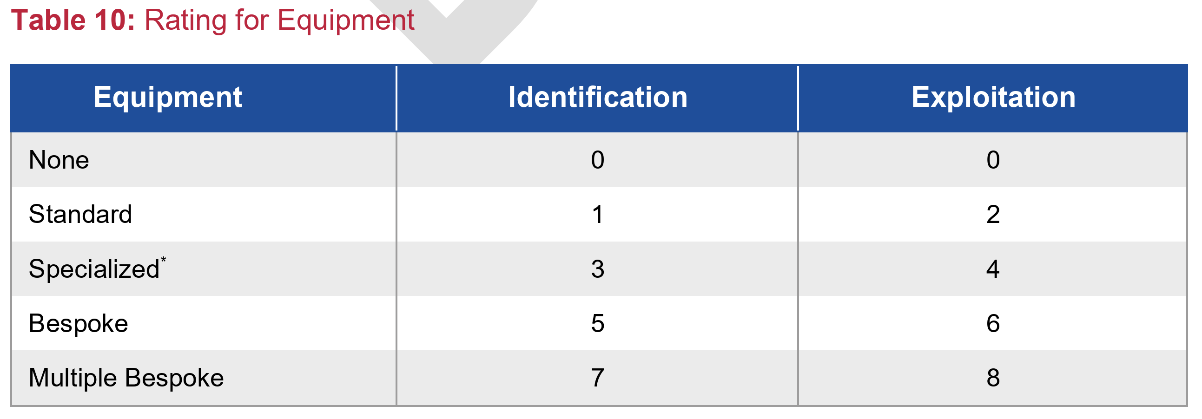
01
Attack Potential & Attack Methods
ENISA SoTA: Application of attack potential to hardware devices with security boxes (HWSB)
Attack potential rating example
 | Identification | Exploitation
Elapsed time | 5 | 2
Expertise | 2 | 2
Knowledge of TOE | 2 | 2
Access to TOE: Samples | 2 | 4
Equipment and tools | 3 | 4
Windows of Opportunity | 0 | 0
Final table | 14 | 14
 | 28 (Moderate resistance)

Slide 31
01
Attack Potential & Attack Methods
ENISA SoTA: Application of attack potential to hardware devices with security boxes (HWSB)
Attack potential rating example
 | Identification | Exploitation
Elapsed time | 5 | 2
Expertise | 2 | 2
Knowledge of TOE | 2 | 2
Access to TOE: Samples | 2 | 4
Equipment and tools | 3 | 4
Windows of Opportunity | 0 | 0
Final table | 14 | 14
 | 28 (Moderate resistance)

Slide 32
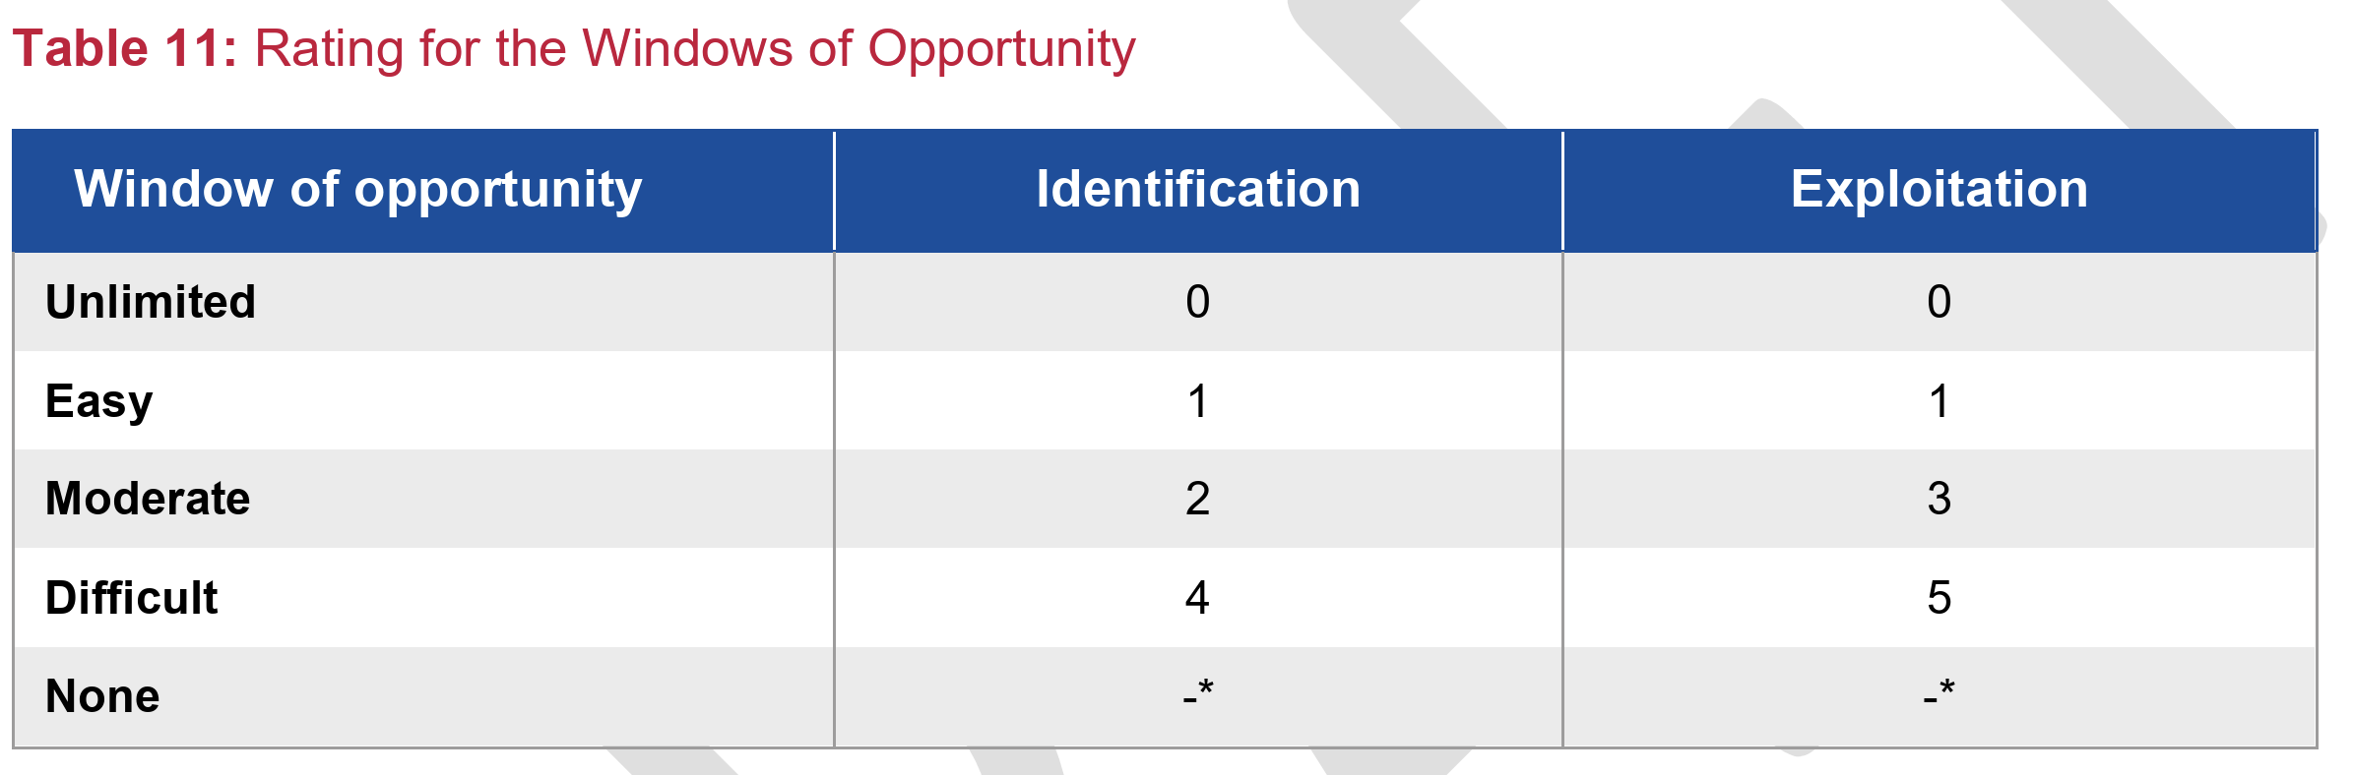
01
Attack Potential & Attack Methods
ENISA SoTA: Application of attack potential to hardware devices with security boxes (HWSB)
Attack potential rating example
 | Identification | Exploitation
Elapsed time | 5 | 2
Expertise | 2 | 2
Knowledge of TOE | 2 | 2
Access to TOE: Samples | 2 | 4
Equipment and tools | 3 | 4
Windows of Opportunity | 0 | 0
Final table | 14 | 14
 | 28 (Moderate resistance)

Slide 33
01
Attack Potential & Attack Methods
ENISA SoTA: Application of attack potential to hardware devices with security boxes (HWSB)
Attack potential rating example
 | Identification | Exploitation
Elapsed time | 5 | 2
Expertise | 2 | 2
Knowledge of TOE | 2 | 2
Access to TOE: Samples | 2 | 4
Equipment and tools | 3 | 4
Windows of Opportunity | 0 | 0
Final table | 14 | 14
 | 28 (Moderate resistance)

Slide 34
01
Attack Potential & Attack Methods
ENISA SoTA: Application of attack potential to hardware devices with security boxes (HWSB)
Attack potential rating example
 | Identification | Exploitation
Elapsed time | 3 | 2
Expertise | 2 | 0
Knowledge of TOE | 2 | 2
Access to TOE: Samples | 2 | 4
Equipment and tools | 3 | 4
Windows of Opportunity | 0 | 0
Final table | 11 | 12
 | 21 (Enhanced-Basic resistance)

Slide 35
01
Attack Potential & Attack Methods
ENISA SoTA: Application of attack potential to hardware devices with security boxes (HWSB)
Attack potential rating example
 | Identification | Exploitation
Elapsed time | 3 | 2
Expertise | 2 | 0
Knowledge of TOE | 2 | 2
Access to TOE: Samples | 2 | 4
Equipment and tools | 3 | 4
Windows of Opportunity | 0 | 0
Final table | 11 | 12
 | 21 (Enhanced-Basic resistance)

Slide 36
01
Attack Potential & Attack Methods
ENISA SoTA: Application of attack potential to hardware devices with security boxes (HWSB)
Harmonized criteria to rate attack difficulty:
Supports layered defense strategy helping to prioritize testing investment
Easier quantification of cost of the attacks (in USD)
Promotes budget-efficiency while clarifying criteria for laboratories.

Slide 37
SESIP Assurance Levels & Protection Profiles
Context
Attack Potential & Attack Methods
SESIP Assurance Levels & Protection Profiles
Final thoughts

Slide 38
02
SESIP Assurance Levels & Protection Profiles
SESIP contribution for Automotive sector
Objective to reduce the cost, complexity, and effort associated with security evaluations.
Emphasis on modularity and the reuse of certified components.
Modular Evaluation:
Automotive systems comprise various components like ECUs, telematics units, and infotainment systems. SESIP allows for individual evaluation of these components, facilitating targeted security assessments.
Reuse of Certified Components:
Manufacturers can integrate previously certified components into new systems without re-evaluating the entire system, saving time and resources.
Support for ISO/SAE 21434 Compliance:
SESIP's methodology supports compliance with ISO/SAE 21434, the international standard for automotive cybersecurity risk management.

Slide 39
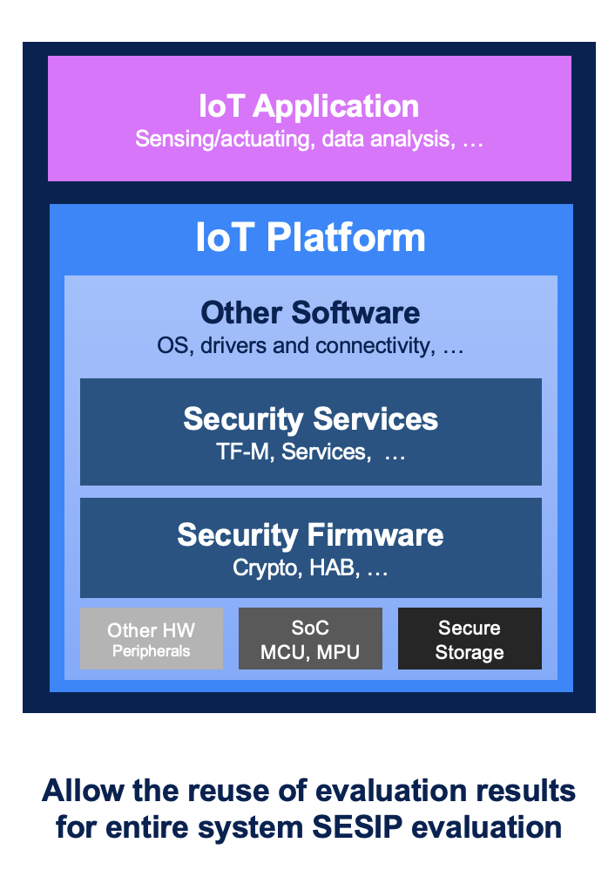
02
SESIP Assurance Levels & Protection Profiles
SESIP contribution for Automotive sector
Modular Evaluation:
Automotive systems comprise various components like ECUs, telematics units, and infotainment systems. SESIP allows for individual evaluation of these components, facilitating targeted security assessments.

Slide 40
02
SESIP Assurance Levels & Protection Profiles
SESIP contribution for Automotive sector
Objective to reduce the cost, complexity, and effort associated with security evaluations.
Emphasis on modularity and the reuse of certified components.
Modular Evaluation:
Automotive systems comprise various components like ECUs, telematics units, and infotainment systems. SESIP allows for individual evaluation of these components, facilitating targeted security assessments.
Reuse of Certified Components:
Manufacturers can integrate previously certified components into new systems without re-evaluating the entire system, saving time and resources.
Support for ISO/SAE 21434 Compliance:
SESIP's methodology supports compliance with ISO/SAE 21434, the international standard for automotive cybersecurity risk management.

Slide 41
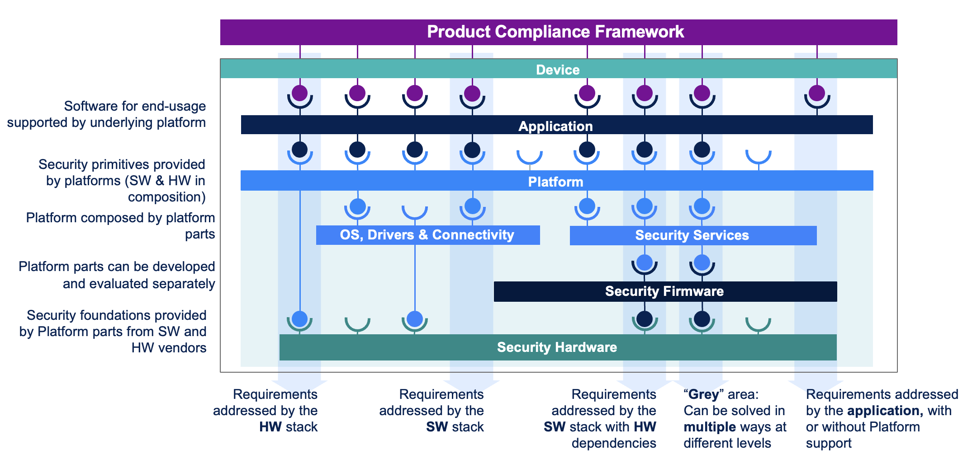
02
SESIP Assurance Levels & Protection Profiles
SESIP contribution for Automotive sector
Reuse of Certified Components:
Manufacturers can integrate previously certified components into new systems without re-evaluating the entire system, saving time and resources.

Slide 42
02
SESIP Assurance Levels & Protection Profiles
SESIP contribution for Automotive sector
Objective to reduce the cost, complexity, and effort associated with security evaluations.
Emphasis on modularity and the reuse of certified components.
Modular Evaluation:
Automotive systems comprise various components like ECUs, telematics units, and infotainment systems. SESIP allows for individual evaluation of these components, facilitating targeted security assessments.
Reuse of Certified Components:
Manufacturers can integrate previously certified components into new systems without re-evaluating the entire system, saving time and resources.
Support for ISO/SAE 21434 Compliance:
SESIP's methodology supports compliance with ISO/SAE 21434, the international standard for automotive cybersecurity risk management.

Slide 43
02
SESIP Assurance Levels & Protection Profiles
SESIP contribution for Automotive sector
Support for ISO/SAE 21434 Compliance:
SESIP's methodology supports compliance with ISO/SAE 21434, the international standard for automotive cybersecurity risk management.

Slide 44
02
SESIP Assurance Levels & Protection Profiles
SESIP Assurance Levels
Adapt SESIP to your risk assessment:
SESIP levels let you tailor assurance to risk
Avoid overengineering: not every ECU needs SESIP 5
Enables scalable security investment based on product criticality
Fragmented and cost-sensitive automotive supply chain, SESIP offers flexibility.
For example, you can assign SESIP 2 for a temperature sensor, and SESIP 3 for a gateway that handles over-the-air (OTA) updates.
This ensures resources are focused where they yield the highest security value. The SESIP model supports iterative and modular certification, reducing total cost of ownership.

Slide 45
02
SESIP Assurance Levels & Protection Profiles
SESIP Assurance Levels
Adapt SESIP to your risk assessment:
SESIP levels let you tailor assurance to risk
Avoid overengineering: not every ECU needs SESIP 5
Enables scalable security investment based on product criticality
Fragmented and cost-sensitive automotive supply chain, SESIP offers flexibility.
For example, you can assign SESIP 2 for a temperature sensor, and SESIP 3 for a gateway that handles over-the-air (OTA) updates.
This ensures resources are focused where they yield the highest security value. The SESIP model supports iterative and modular certification, reducing total cost of ownership.

Slide 46
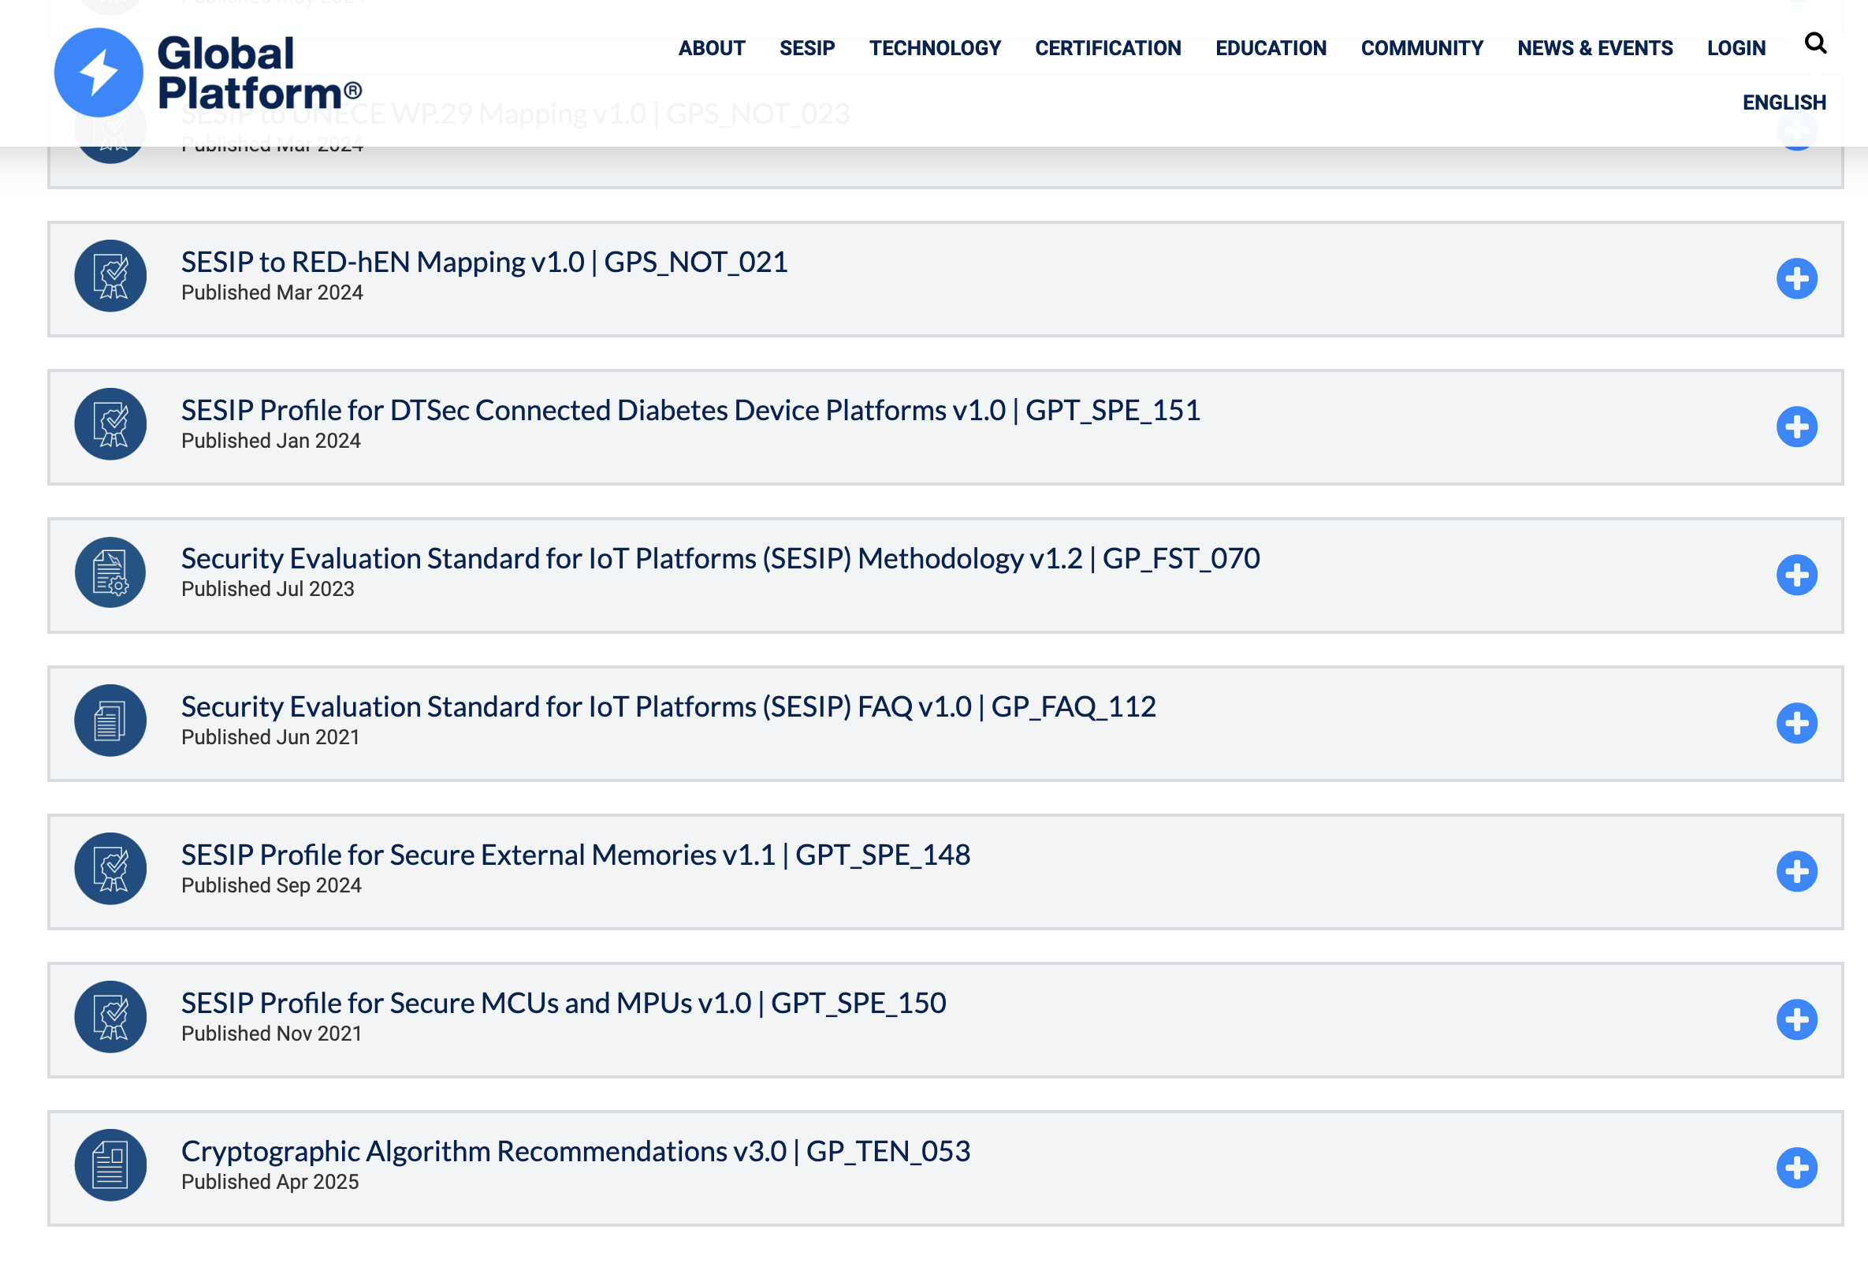
02
SESIP Assurance Levels & Protection Profiles
SESIP Protection Profiles
Why Protection Profiles Matter
Define security objectives and scope early
Enable harmonization across the supply chain
Lower certification cost

Slide 47
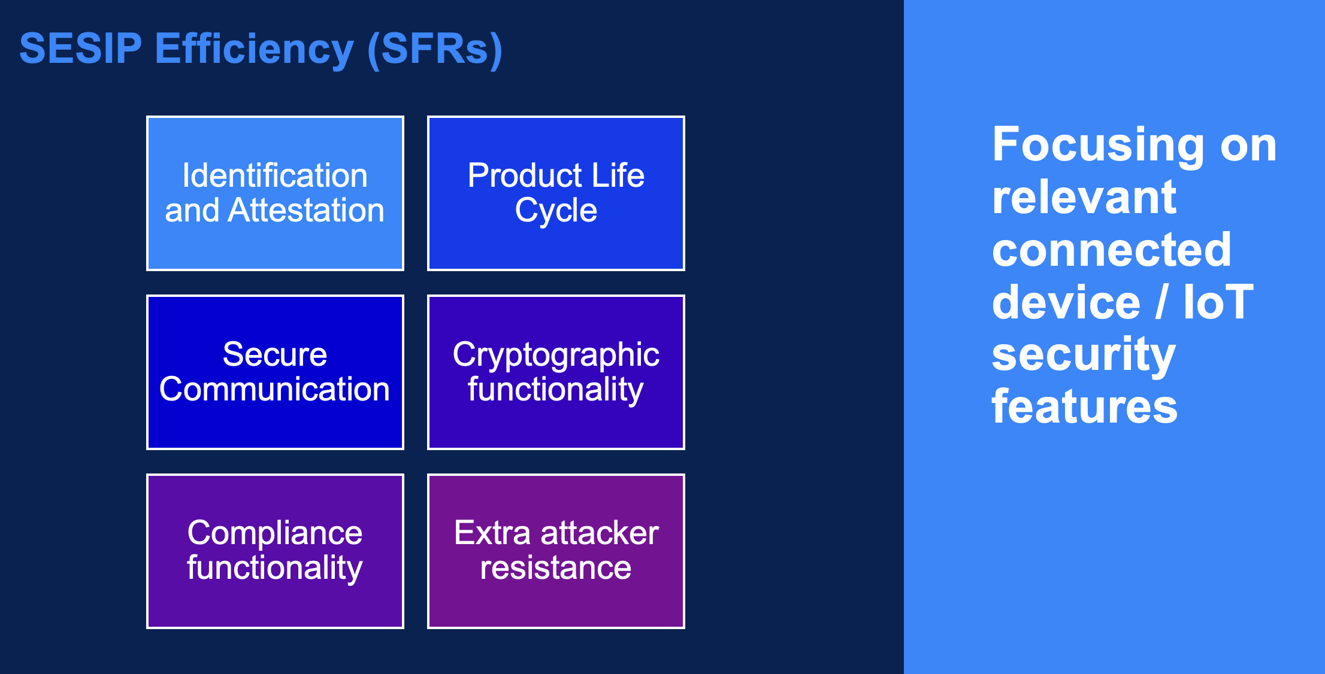
02
SESIP Assurance Levels & Protection Profiles
SESIP Protection Profiles
Why Protection Profiles Matter
Define security objectives and scope early
Enable harmonization across the supply chain
Lower certification cost

Slide 48
02
SESIP Assurance Levels & Protection Profiles
GlobalPlatform role within the certification ecosystem
Continuous work to adapt to industry needs:
Technical working groups to standardize criteria and requirements
  Harmonize criteria for attacks (i.e., minimum/maximum attack scoring for specific attack scenarios)
  Harmonize acceptance on ad-hoc approaches (i.e., test witnessing in vendor facilities)
ITSEFs in alignment with certification bodies to adapt requirements to discuss ad-hoc approaches for specific use cases.
  Workshop to go though implementation instead of in-house code review
  Specific test-setups to facilities exposure of attack surface
  Alternative functional test methods to demonstrate compliance

Slide 49

01
Attack Potential & Attack Methods
SESIP Assurance Levels and Protection Profiles
A common and optimized approach for evaluating the security of connected products:
General model similar to CC
Granularity
Requirement hierarchy
Profiles

Slide 50
Final thoughts
Context
Attack Potential & Attack Methods
SESIP Assurance Levels & Protection Profiles
Final thoughts

Slide 51
03
Final thoughts
Key Takeaways
SESIP Certification:
A common and optimized approach for evaluating the security of connected products
ENISA's Attack Potential Method:
Harmonized criteria to rate attack difficulty

