Slide 1
Cybersecurity Vehicle Forum – Shanghai
15th May 2025
Ana Lattibeaudiere, CEO GlobalPlatform
Gil Bernabeu, CTO GlobalPlatform
Francesca Forestieri, Automotive Lead

Slide 2
Ground Rules for Cybersecurity Vehicle Forum
We aim to create a trusted environment to understand and resolve complex problems and identify future potential synergies.
We have representatives from key players and from key standardisation organisations.
Each speaker is speaking as an expert in the field, and not necessarily speaking on behalf of his company or standards organisation.
Therefore, participants are free to use the information received, but not attribute the affiliation of the speaker(s).
After the Cybersecurity Vehicle Forum, we will post the recording on our website, as well as the relevant slides (as made available by speakers) for your reference.
https://globalplatform.org/blog-overview/

Slide 3




GlobalPlatform
THE standard for managing applications on secure chip technology, with over 20 years of experience
Passports
Identification & Trusted Signature
Internet of Things
Automotive Industry
Financial Industry
Mobile Industry
Mass Market deployment of industries has required: agreed functionality for transactions and transparent robust security to create trust among competitors and in the overall ecosystem
GlobalPlatform Specifications: Royalty Free Use: https://globalplatform.org/specs-library/

Slide 4
GlobalPlatform Members 1/2
Payment Services
American Express​
Cartes Bancaires​
Discover Financial Services​
FeliCa Networks, Inc.​
JCB Co. Ltd.​
Licel Cooperation
Mastercard​
Visa Inc.​
Mobile Device Manufacturers
Apple Inc.​
Honor
Huawei Device Co., Ltd.​
Xiaomi​
Automotive
Tech Providers
CARIAD SE​
ETAS GmbH
Woven​
Mobile Network Operators (MNOs)
AT&T​, Deutsche Telekom
KONA International​,Orange
SK Telink​, Synapse Mobile Networks, T-Mobile​
Semiconductor & Hardware Vendors
Analog Devices Inc. (ADI)​
Arm Limited​
Austriacard
Bundesdruckerei GmbH
Dai Nippon Printing
Eastcompeace Technology Co., Ltd
Feitian Technologies Co., Ltd
Giesecke+Devrient
HID Global
Infineon Technologies AG​
Toshiba
Thales
Ubivelox
Xard Pay
XCure
Valid
Watchdata System
Winbond Technology Ltd.​
WiseSecurity Technology
Zswipe Germany
Kigen Lda
MaskTech Intl GmbH
MK Smart JSC
NXP Semiconductors​
Qualcomm Technologies Inc.​
PQShield
Renesas​
Samsung Electronics​
Shanghai Fudan Microelectronics Group​
Spreadtrum Communications
STMicroelectronics​

Slide 6
GlobalPlatform Members 2/2
OS & Software Platform Providers
CISCO
Google
Oracle​
Rambus
Trustonic​
Linaro​
Public Sector & Government Entities
BSI - Bundesamt für Sicherheit in der Informationstechnik​
Department of Defense (USA)
Institute for Information Industry​
Wuhan University
Consulting & Integration Firms
Digital Cubes
Galitt​
Internet of Trust SAS
Monetech
Nextendis
NthPermutation Security LLC
Safepay Systems
Security, Certification & Testing Labs
Applus+​
BacTech
Beijing Unionpay Card Technology
Beijing ZhiHuiYunCe (DPLS Lab)
Brightsight BV​
CEA - Leti
COMPRION GmbH​
DEKRA​
FIME​
Kaspersky Lab
Keysight
SERMA​
TrustCB
Quarkslab
UL (Underwriters Laboratories)​

Slide 7
GlobalPlatform’s Success in
International Digital Security Services
Secure Component Specifications
Protection Profiles
A mechanism to provide Vendors the ability to make claims regarding their security products
3rd Party Certification
Publicly available on a royalty free basis
"I want" this level of security
Common set of security needs
I “Provide”
Common Criteria definitions source: https://commoncriteriaportal.org/files/ccfiles/CC2022PART1R1.pdf

Slide 8
GlobalPlatform Brings Lessons to Automotive
GlobalPlatform standards create a fertile environment for mass market growth and innovation of services and hardware
High Evolution in Markets over time, with issuance of new services on very short timelines (3-6 months).
With standardised portability and updatability, device product life is extended since it can adapt to requirements of new services.
Synergistic opportunities (also across “Frenemies”) for the development of new services (not everything has to be developed from scratch by a provider)
Services are key dynamic of industry BUT hardware remains a critical base for trust
Based upon GlobalPlatform’s Experience in Over 25 Years with Smart Cards, Mobile, IoT

Slide 9


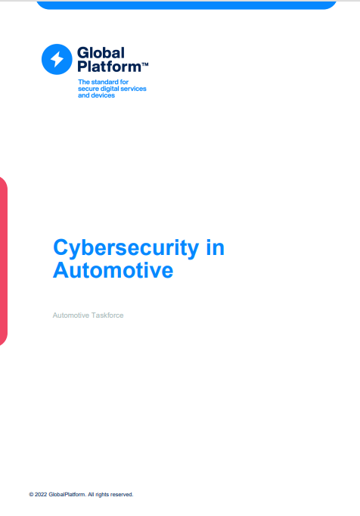
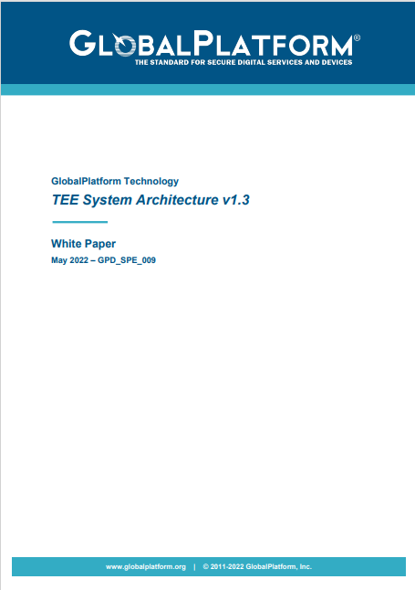
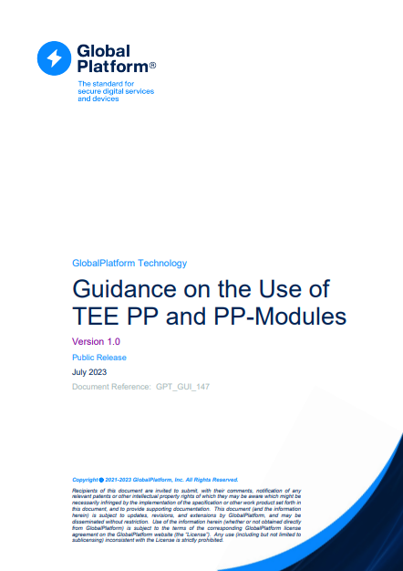
Driving Requirements into GlobalPlatform
Inside GlobalPlatform
Automotive Task Force
Security Task Force
Regional Task Forces
Whitepapers
Trusted Environments & Services Committee
2022
2023
2023
2023
2023
2024
2024
2024
Nov
June
Sept
Oct
Nov
June
Oct
Nov
Munich
Detroit
Tokyo
Beijing
Hamburg
Detroit
Tokyo
Berlin
Secure Element Committee
Specifications
Protection
Profiles
SESIP Committee

Slide 10
GlobalPlatform Technology

Slide 11
GlobalPlatform Foundation Technologies
Trusted Execution Environment
A secure operating system running on a standard CPU alongside regular OS/Applications
Protected against attack by hardware chip features + software mechanisms
Secure Element
A secure enclave protected against physical and software attack
Tamper resistant hardware
Install, update OTA applications (not just keys)
In OVER 192 Million Connected Cars in 2023 (Juniper Research) https://www.juniperresearch.com/press/connected-vehicles-to-surpass-367-million-globally#:~:text=Hampshire%2C%20UK%20–%209th%20January%202023,from%20192%20million%20in%202023
In Over 100 Million Vehicles as of 2023 (Confidential Source)
Isolated Technologies
New Technologies that create isolated execution environments
Hardware
Firmware
Root of trust
Runs a full operating system providing standardized APIs and functions
3rd party Security Certification
Full support for App and OS update over-the-air

Slide 12

Roots of Trust for Secure Software:
Providing OEMs Standardised Management Capabilities
Silicon Roots of Trust
Software Roots of Trust
Car
OEM Manage Objects across different producers
Key management + crypto between hardware and service layers
Plenty of hardware, root of trusts, each with secure crypto
GlobalPlatform provides a bridge between hardware and software security – as well as supporting across multi-tenant service providers. Standardisation of the common security requirements, augments hardware and software with interoperable functionality and transparent security robustness levels.

Slide 13

GlobalPlatform Setting the Standards for Common Security Specifications
Vehicle Services
Automakers & Standardised Auto Solutions
Silicon and Hardware & GlobalPlatform Platform:
OEM Controlled Trusted Applications (using GP standardized APIs)
Broader Vehicle Services (building upon Trusted Applications)
Standardized APIs & Management
State-of-the-art Crypto
Crypto Agility
Update
V2X
IVI
ADAS
…
Key Negotiation
Secure Update
MACsec
Autosar Systems
Secure Component Platform:
Functionally and Security Certified
Hardware

Slide 14
Supporting Software Defined Vehicle Use Cases: Examples of Functional Security Primitives
Device Attestation
Secure Updates
Secure Onboarding and Offboarding
Secure Provisioning and Decommissioning
Secure Communication (Protocols)
Secure Debug and Test
Secure Backup and Recovery
Account Authentication and Management
(Attested) Secure State and Life Cycle Management
Genuine Identification
Secure Initialization
Anomaly Detection and Reaction
Cryptographic Key Generation and Injection
Cryptographic Key and Certificate Store
Secure (Encrypted) Storage
Cryptographic Operation
Cryptographic Random Number Generation
System Event Logging
Silicon Root of Trust
Residual Information Purging
Software Isolation
Monotonic Time
Reliable Control Transfer
Cyber Resilience
https://www.nxp.com/docs/en/white-paper/SEC_PRIMITIVES_WP.pdf

Slide 15
GlobalPlatform & In-Vehicle Multi-Tenant Services
Digital Car Key
General Purpose Security (KeyStore…)
IVI Applications (DRM, Payment…)
V2X Trusted Applications (Comms…)
Government Regulation (Audit, SBOM..)
Mobility as a Service (….)
Multi-Tenant Secured Services
AI/ML
Compute
SAE J3101
Key
Store
Containerized Functions
Safety
Critical
Areas
Containerized
Platform
Security
Containerized
Platform
GPU/AI
General Purpose
Compute
Special Purpose
Embedded
MCU
Notes:
UN Regulation No. 160 - Event Data Recorder (EDR) | UNECE

Slide 16

GlobalPlatform Approach
OEMs and Tier 1s can manage key rotation
2. Trusted Applications/Applets developed/ deployed by the ecosystem, to meet the specific requirements of a particular ECU or a customer solution using standardized APIs
Example Standardized Primary Key Injection
SIM
Sec Boot
ECU ID
DRM
Key
Negotiation
ADAS
FOTA/ SOTA
IDS
Sec Logging
Auth Cmd
Payment
Digital Car Keys
Firewall
SecOC
MACsec
IVI
1. Platform: Standardized APIs & Management command, update, state-of-the-art crypto, crypto agility …
Secure Component Platform:
Functionally and Security Certified
Hardware
This approach fits well with Software Defined Vehicles with upper layer security certification

Slide 17
Securing Any SDV Service with GlobalPlatform
Multiple, Comprehensive Update Features
Multi-Tenant Security Services
Leverages combined expertise of community in deploying security specifications & in addressing emerging threats
Security Assurance of Products Demonstrated by Certification
Agility in Deployment of Common Security Requirements while supporting innovation
Designed To Support Future Cryptographic Requirements & Evolving Regulations
Notes:
Meeting New Extended Service Requirements
Multi-Tenant Security Services, which isolate Intellectual Property & Data between Different Service Providers
Supporting multiples application uses cases, beyond automotive services, fostering easy migration for services in automotive as service platform
Customize through profiles to address specific use cases
Ability to downsize to different needs/limited use cases
Security Assurance of Products
Certification Ready: Security profiles are already available
Laboratories are trained
Certificates are recognized across multiple markets
Agility in Deployment
Portability of Services for Common Security Requirements (Non-differentiator Services)
Seamless Integration into Existing IOT and Payment Ecosystems with strong track records in authentication
Robust Lifecycle Management
Multiple, Comprehensive Update Features
Updatability of Services Over Vehicle Life-Time (including Deployment of Completely New Services/post-production of Firmware/OS/Update with advanced rollback features
Multiple update policies for both over-the-air and @ dealer service stations
Future Cryptographic Requirements
Supporting Agility for Differentiated Regional PQC algorithms
Log new crypto algorithms as needed to allow PQC migration
Increased rigour in more comprehensive identification of security issues from combined industry expertise in the development of security specifications

Slide 18
Automotive GlobalPlatform
Need for New Tools in Automotive to Meet SDV Promises:
Standards, Certification, APIs, Guidelines

Slide 19


Challenges of Automotive Security Market Today
Proprietary Application Ecosystem
Proprietary Key Lifecycle Management (Provisioning And Decommissioning)
Proprietary Implementation of Cryptography
Vendor Lock-In
Lack of Clear Metrics on Security Robustness
Device Identification And Update
Fragmentation of Secure Boot Requirements
Lack of Incremental Build Upon Solutions (each new service requires a new ECU)
Difficulty in managing trust over extended value chain with new service providers (beyond OEMs)
Lack of Clear Metrics on Security Robustness
Device Identification And Update
Fragmentation of Secure Boot Requirements
Lack of Incremental Build Upon Solutions (each new service requires a new ECU)
Difficulty in managing trust over extended value chain with new service providers (beyond OEMs)

Slide 20
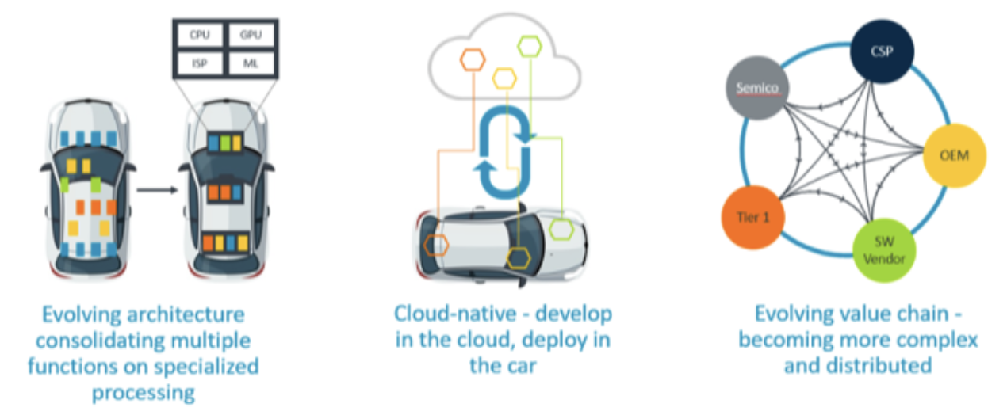
Big Changes are Coming with Software Defined Vehicles
New Architectures, New Services, New Players
More Security Risk
More Attack Vectors
More Attack Types
More Attack Surfaces
More Types of Hackers
https://semiengineering.com/software-defined-cars/

Slide 21
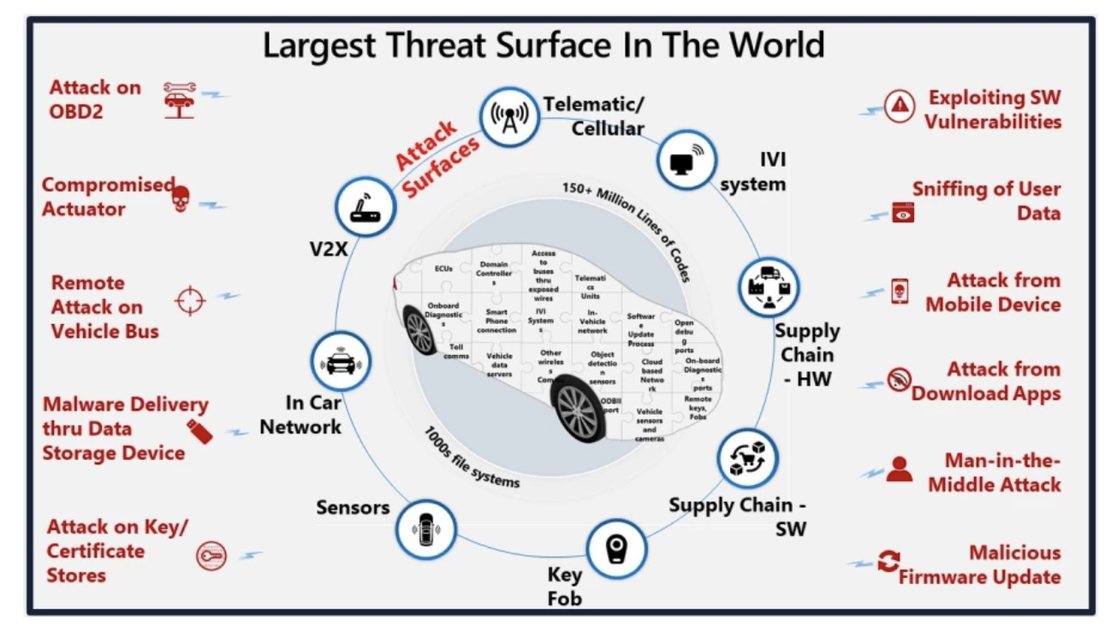
https://www.microsoft.com/en-us/industry/blog/manufacturing-and-mobility/automotive/2023/10/31/the-security-cultural-transformation-of-the-automotive-industry/

Slide 22
Why Robust Security is Needed….Increased Motivation for OEMs on Cybersecurity Spend
High Value of Software Assets of Vehicle
Compliance with Cybersecurity Management Processes for type approval (UNECE 155 64 countries)
Unpaid Feature Enablement
Warranty Fraud

Slide 23

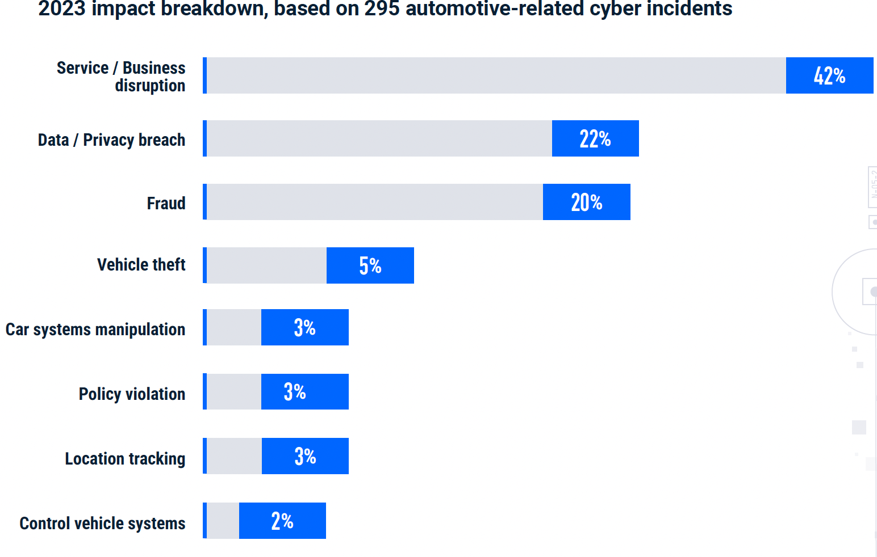
Cyber Incidents Are Expensive
Financial repercussions
Recalls or OTAs
Production shutdowns
Ransomware payments
Damage to brand reputation and customer trust
Large regulatory fines
Source:(Upstream 2024). https://upstream.auto

Slide 24
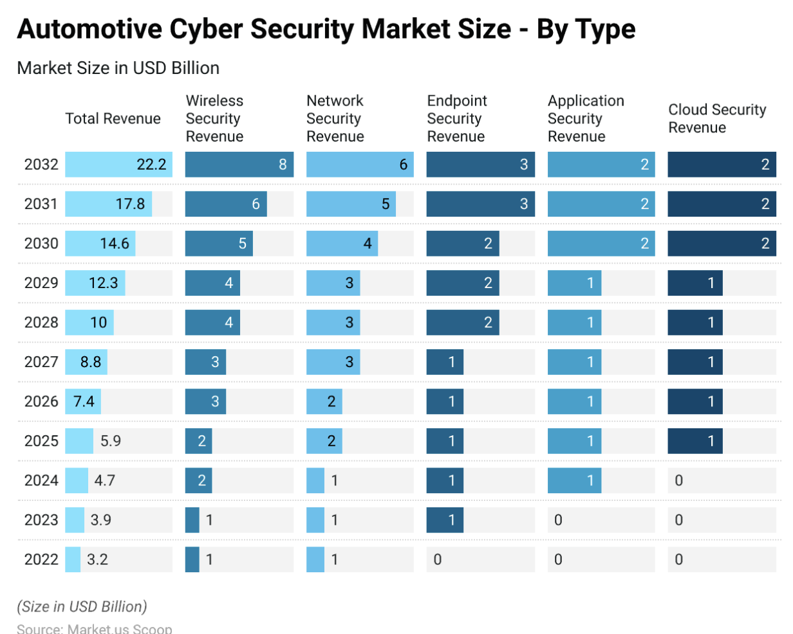
Forecasted Revenue in Cybersecurity by Security Type
Who Pays?
https://scoop.market.us/automotive-cyber-security-statistics/

Slide 25
Different Security Paths by Automotive OEMs
Everyone on their Own
Highest Investment to Protect IP
"Lowest Cost - Minimal Security" -
Implementing Standardisation for Common Automotive Security Requirements
Community determines jointly key features
Community monitors evolving threats and develop solutions to platforms
Individual Vendors focus Engineering on Differentiating Services
"Customers don't pay extra for security"
"We will buy the best security out there"
"We will deal with it later"
Portability of Security Services
But...will that be enough?
will vendor lock-in be a problem?
Low Cost,
High Risk
Potentially Untenable Future
Higher Cost,
Lower Risk Today
Unclear Future
Shared Cost (split between participants)
Lower Risk Today & Future
Provides Needed Future Flexibility

Slide 26
GlobalPlatform Provides Future Proofing of Security Services & Adds Flexibility
Updatability of services over time
Support of Multiple Security Services
Supporting Multi-tenant security services, which protect IP between different service providers and new service development overtime
Portability of services for common requirements
Increased rigour in identification of security issues from combined industry expertise in development of specifications
Easy Integration into existing ecosystems with strong track record in authentication
Unlike traditional automotive HSMs/SHEs, GlobalPlatform offers standard requirements, common APIs, testing suites, and certification of compliance with specifications on security robustness and interoperability
Possibility of reuse, incremental developments across ECU evolution (without having to start over from scratch each time for every new ECU project)

Slide 27
Example of SDV Security Standardisation Benefits
…Resulting in Flexibility & Transparency on Robustness
Open Portable Application Ecosystem
Standardised Key Lifecycle Management (in-house or SaS solutions)
Standardised State of the Art Cryptography
Innovation for non-common security services
Standardised Levels for Security
Certification of Functional and Security Robustness
Device Attestation (secure state and lifecycle) inherited from root of trust
Standardised Secure Boot Requirements
Ability to Incrementally Build Upon Security Applications
More Plug and Play in the Supply Chain, while maintaining High Levels of Trust

Slide 28
Hardware Protected Security Environments
SAE J3101-5

Slide 29


How UNECE 155 Compliance Possible with Process and Product Security
Relevant for 64 Countries
ISO /SAE 21434 and 24089
Cybersecurity Vehicle Management
Compliance with UNECE 155 & 156
Demonstration of Best Practices
SAE J3101 Hardware Protected Security Environments
Process
Product
Compliance
ISO/PAS 5112:2022 - Road vehicles — Guidelines for auditing cybersecurity engineering. Security, safety & risk
ISO/SAE PAS 8475 Road vehicles - Cybersecurity Assurance Levels (CAL) and Targeted Attack Feasibility (TAF) (under development)
ISO/SAE PWI 8477 Road Vehicles Cybersecurity Validation and Verification (under development)

Slide 30
Why Cooperation with SAE on Hardware Protected Security Environments Is Optimal
SAE USA J3101
GlobalPlatform
Defines Common Glossary of Required Hardware Protected Secure Environment Characteristics
Detailed specifications and Implementation guidelines
Cover these HPSE requirements and more
Globally relevant
Certification of components by SE or TEE providers to:
Ensure interoperability/ portability and
Proven security robustness (protection against attack) obtained
Possibility of composite certification

Slide 31
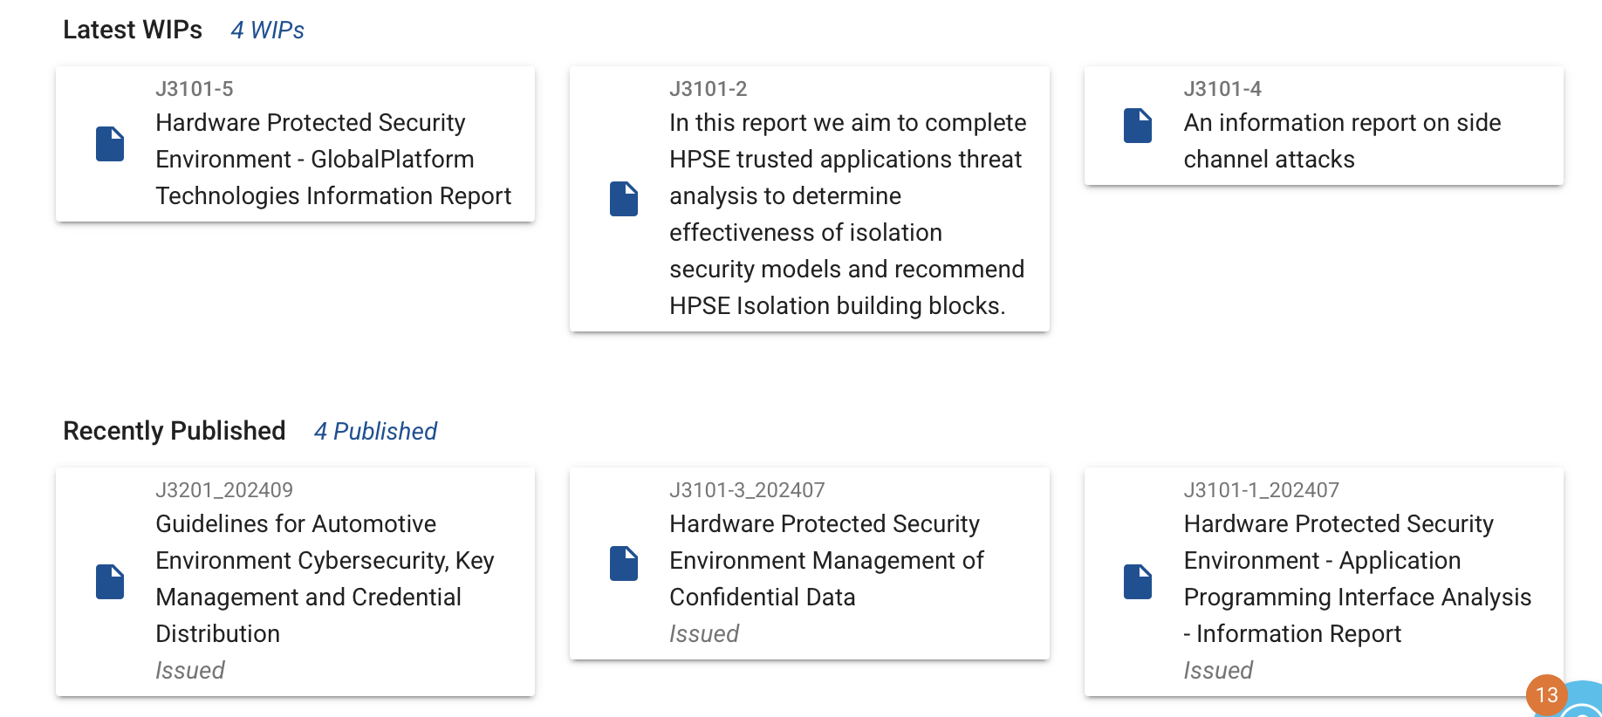
Additional Complementary Standardization Around Hardware Protected
J3101-1: Hardware Protected Security Environments (HPSEs) for Ground Vehicles
Goal:
Provide a common glossary for describing security mechanisms (i.e. hardware root of trust and the hardware-based security primitives) supported in hardware for automotive use cases, along with best practices for using
such mechanisms.

Slide 32

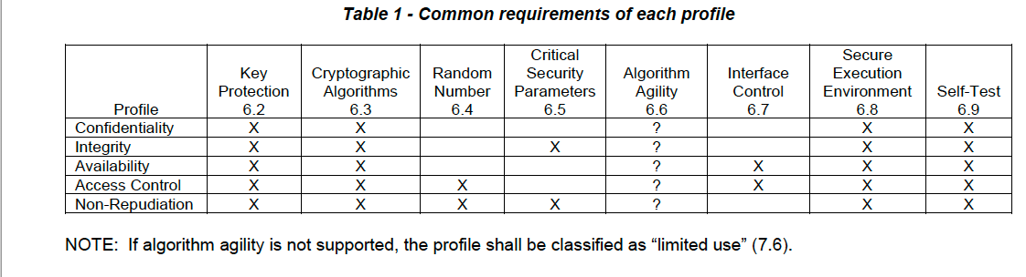
SAE J3101
Hardware Protected Security Environments
Automotive computer systems are required to establish trustworthiness through device identity, sealing, attestation, data integrity, and availability.
These systems must be resilient to a wide range of attacks that cannot be thwarted through software-only security mechanisms.
A hardware root of trust and the hardware-based security primitives are fundamentally necessary to satisfy demands of connected and highly or fully automated vehicles.
Source: SAE, Surface Vehicle Recommended Practice, Hardware Protected Security for Ground Vehicles J3101™ FEB2020, Issued 2020-02

Slide 33
Hardware Protected Security Environments (J3101): Application Use Cases
IPR Protection
Secure Diagnosis at the ECU Level
Secure Logging
Satisfying the requirements of the IP protection use case requires implementation of the base confidentiality profile (7.1).
Implementation of the secure ECU diagnostics use case requires implementation of the following profiles:
Base Confidentiality (7.1):
Additionally, the following profiles should be considered depending on the system implementation:
Base Availability (7.3):
To satisfy the minimum, fundamental secure logging requirements of authentication and non-repudiation, three profiles are required:
Base Confidentiality (7.1)
Base Integrity (7.2)
Non-Repudiation (7.5)
To satisfy additional security objectives which could be specified for certain usages of secure logging, the following additional profiles may be required and should be considered based on the context provided above:
Base Availability Profile (7.3)
High Assurance Level Profile (7.7)
Base Integrity (7.2):
Access Control (7.4):
Assurance Level (7.7):

Slide 34
Methodology –
GlobalPlatform Specifications Assessed
GP TECHNOLOGY | DOCUMENT REFERENCE | TITLE | VERSION | REFERENCE LINK
SE | GPC_SPE_034 | Card Specification [GPCS] | 2.3.1 | https://globalplatform.org/specs-library/card-specification-v2-3-1/
 | GPC_SPE_174 | Secure Element Protection Profile [SE PP] | 1.0 | https://globalplatform.org/specs-library/secure-element-protection-profile/
 |  | GlobalPlatform Card API | 1.7.1 | https://globalplatform.org/specs-library/globalplatform-card-api-org-globalplatform/
TEE | GPD_SPE_009 | TEE System Architecture [TEE Sys Arch] | 1.3 | https://globalplatform.org/specs-library/tee-system-architecture/
 | GPD_SPE_010 | GPD TEE Internal Core API [TEE Core] | 1.3.1 / 1.4 | https://globalplatform.org/specs-library/tee-internal-core-api-specification/
 | GPD_SPE_021 | TEE Protection Profile [TEE PP] | 1.3 | https://globalplatform.org/specs-library/tee-protection-profile-v1-3/
 | GPD_SPE_025 | TEE TA Debug Specification [TEE Debug] | 1.0.1 | https://globalplatform.org/specs-library/tee-ta-debug-specification-v1-0-1/
 | GPD_SPE_120 | TEE Management Framework (TMF) including ASN.1 Profile [TMF] | 1.1.2 | https://globalplatform.org/specs-library/tee-management-framework-including-asn1-profile-1-1-2/
 | GPD_GUI_069 | TEE Initial Configuration [TEE Config] | 1.1 | https://globalplatform.org/specs-library/tee-initial-configuration-v1-1/
 | GPD_GUI_089 | TMF Initial Configuration [TMF Config] | 1.0 | https://globalplatform.org/specs-library/tmf-initial-configuration-v1-0/
SE and TEE | GP_TEN_053 | Cryptographic Algorithm Recommendations [Crypto Rec] | 2.0 | https://globalplatform.org/specs-library/globalplatform-technology-cryptographic-algorithm-recommendations/
 | GP_REQ_025 | Root of Trust Definitions and Requirements [RoT] | 1.1.1 | https://globalplatform.org/specs-library/root-of-trust-definitions-and-requirements-v1-1-gp-req_025/

Slide 35
Coverage Definitions
Yes:
Yes by Trusted Application:
Not Covered
Satisfied by Existing GlobalPlatform Specifications
Innate Characteristic Supported by GlobalPlatform
Detailed Implementation Guidelines Exist
This J3101 requirement is Fully covered by GP compliant platform for Secure Elements or Trusted Execution Environments.
Full alignment is achieved through development of Trusted Applet/ Application running on a GlobalPlatform compliant platform.
Only 3 J3101 requirements are not fully met by GlobalPlatform (TEE) specifications.
Hardware Tamper resistance is not a basic requirement of the TEE Protection Profile (although implementations may address this aspect).
Furthermore, firmware update of the TEE itself is outside the scope of the TEE protection profile but Trusted Application (TA) update is covered by TMF protection profile.

Slide 36
Analysis Results: GlobalPlatform Specifications
Evaluated using Common Criteria (CC) existing Protection Profile

Slide 37
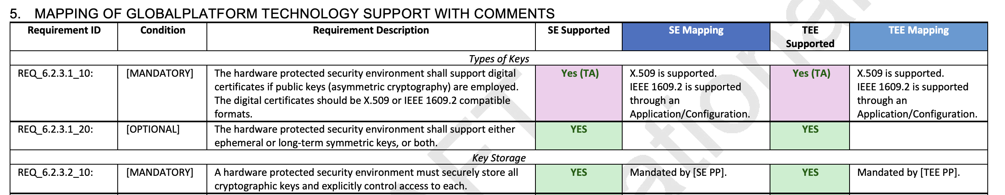
Mapping Conducted for Secure Elements and Trusted Execution Environments

Slide 38

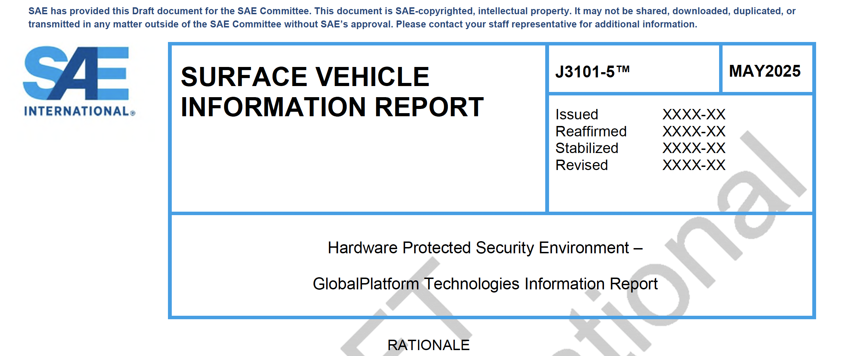
SAE’s Vehicle Electrical System Security Committee – Final Ballot J3101-5
Final confirmation Ballot Concluded
Awaiting SAE Technical Writer Edits and Publication

Slide 39
GlobalPlatform Alignment with
Hardware Protected Security Environments J3101
Complete Alignment with SAE J3101
Trusted Applets/ Applications
Protection Profiles for Secure Components
GlobalPlatform Certified Platform

Slide 40


Going Forward
Will enable vendors to build J3101 compliant solutions
Develop SESIP Profile for J3101 Trusted Application requirements (as the platform requirements are already available)
Meet Industry desire for standardize policy management for key usage
Extend to new use cases?
Define a successor to SHE++/HSM/ EVITA?
“Meeting J3101 using GP”
APIs &
Profiles
J3101
– TEE/SE Analysis

Slide 41

Hardware Protected Security Environments in China: Open Questions
Is SAE's work on J3101 a departure point for discussing Chinese requirements?
Is there interest in standardising a Chinese version?
Would it be useful to cooperate with GlobalPlatform to explore how GlobalPlatform technologies meet eventual Chinese specific requirements?
Would it be useful to provide some educational opportunities on GlobalPlatform technologies?

Slide 42
SESIP Certification:
How it works and its use in Automotive
Francesca Forestieri, Head of Automotive
Gil Bernabeu, CTO

Slide 43
"Security inspection" for electronic systems in modern vehicles
Scalable approach with 5 levels matching different security needs
Industry-standard security certification for connected vehicle components
Smart Vehicle Security Simplified
SESIP:
Security Evaluation Methodology & Certification

Slide 44

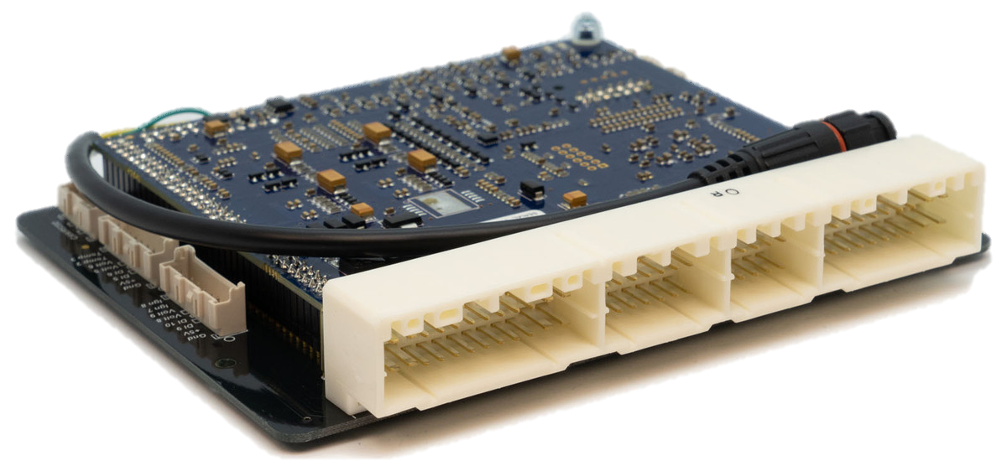

Certification Framework for UNECE Countries
Product Orientation
CS assessment (of 21434 Work Products)
Post-dev. Report
ISO/SAE 21434
P
D
C
A
I
CS-architecture of item / component(s)
CSMS
CEO
21434
Cyber Security
management system (e.g. Policies, Roles & Responsibilities, Governance)
Audit
CSMS
Compliance
Certificate
P1
P2
P3
CS validated
system, ECU, SoC (e.g. Vulnerability Scans, Fuzzing, Pentesting, Common Criteria)
Optional:
CC, RED.…
Component certificate

Slide 45
Cybersecurity Evaluations for ISO 21434: Frequent Rejection of Reports
Unstructured Reporting & Gaps
Inconsistent Vulnerability Context
Absence of Integration with Existing Standards
Lack of Assumptions
Rationale for selection of test cases
Examples of Common Reasons
Notes:
Incomplete Basic Information: Missing key details such as start/end dates, personnel involved, and the scope of the evaluation, making it difficult to assess the context of the findings.
Lack of Testing Procedure Documentation: Reports often focus solely on discovered vulnerabilities without providing a detailed description of the testing methodologies and tools used, limiting the ability to replicate or verify the results.
Absence of Unexecuted Test Explanations: Some reports omit explanations for why certain test cases were not performed, leading to gaps in understanding the scope and potential coverage of the penetration test.
Inconsistent Vulnerability Context: Findings may lack sufficient context or impact analysis, making it challenging to prioritize risks effectively for automotive systems, where safety and security are closely intertwined.
Unstructured Reporting Format: Variability in the structure and format of reports complicates comparison, tracking, and consolidation of findings, especially in complex automotive environments with multiple suppliers and components.
Absence of Integration with Existing Standards: Penetration testing reports may not reference or align with automotive security standards (e.g., ISO/SAE 21434), making it harder to ensure compliance and standardization across the supply chain.

Slide 46
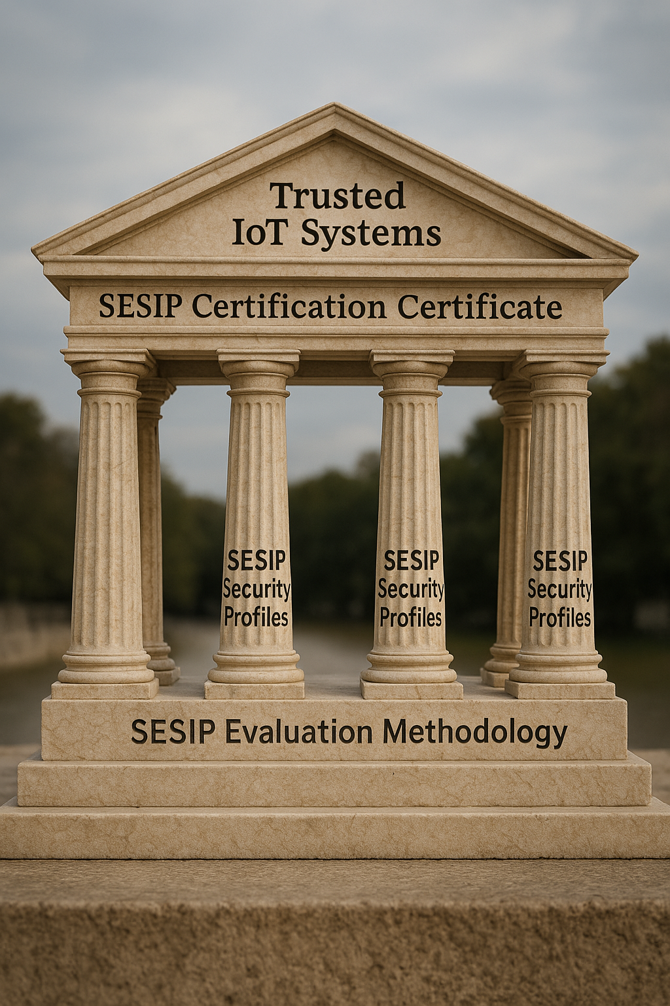
SESIP Overview
Goal-oriented:
It focuses on whether security outcomes are achieved, not just whether processes are followed.
Less emphasis on extensive formal documentation and more on evidence that requirements are met (as compared to Common. Criteria)
Reports are shorter, focused on describing the tested security claims, test methods, and results.
Some aspects (both SFRs and requirements of the standardised protection profiles) are general which:
allows flexibility
requires sufficient “experience” to strategically identify the most appropriate roadmap for the evaluation to meaningfully address the security claims

Slide 47








SESIP Opportunity: Beyond SoCs
Secure ECU
Access/Diagnosis
Cryptographic
Services
Policies
Processes
Awareness
Secure Key Management
Vehicle/
Item
Level
Domain/
System
Level
Secure on/off-board
Communication
Intrusion Detection
Component
Level
SoC
Secure Boot
Integrity Services

Slide 48
SESIP Benefits

Slide 49
Why Certify?
Regulatory Requirements
Structured evidence demonstrates real product achievements
Simplifies procurement with transparency on security characteristics and interoperability functionality
Supports Risk Management
Structured approach to evaluating supplier security capabilities
Regulatory Compliance
Supply Chain Management
Streamlines collaboration through reusable 3rd party certifications
Brand Protection:
Prevents costly and damaging security incidents

Slide 50
SESIP Certification Benefits: OEMs
Enhances trust in vehicle cybersecurity for customers and regulators.
Transparency on security targets achieved
Simplifies Verification and Validation Phase
given composite certification for chips? ECUs? components? etc.
Consistency Across Security Claims

Slide 51
SESIP: Business Benefits
Faster Development:
Cost Efficiency:
Competitive Edge:
Future-Proof:
Pre-certified components speed time-to-market
Test once, use across multiple vehicle platforms
Demonstrates security commitment to customers
Structured approach to managing security updates
Avoid redundant security evaluations across vehicle models

Slide 52
SESIP Implementation

Slide 53
SESIP: Implementation Path for OEMs
Identify priority components (gateways, telematics, OTA systems)
Set appropriate security levels based on risk
Integrate certification into supplier requirements
Build security assurance into vehicle development lifecycle

Slide 54





Certifying to Desired Security Robustness Levels
A complete set of Hardware & Software countermeasures + certification
Software
attack
Board-level
attack
Silicon-level
attack
Network protocols weakness
(weak ciphers, short keys,…)
Flaws in software design / implementation, buffer overflows
Debug interfaces, gaining admin rights
SPA / DPA Power analysis, emission analysis, timing analysis
Fault injection: glitches, laser, light, UV, X-rays, Electro-Magnetic
Memory probing
Device delayering, circuit reverse engineering, micro-probing
Fault injection: Focused Ion Beam
Advanced microscopy
Major attacks
No external debug interface
Hardware secure crypto fast computing
Enhanced security of MCU with physical isolation of security toolbox (secure key storage, secure & trusted execution in secure element)
Randomization
Secured crypto-engines
Design Flow
Power regulation
OS features (MPU)
Jittered Clocks
Data whitening
Physical Shield
Lock-step EDC
Glue Logic Layout
Bus & Memory Scrambling
Bus & Memory Encryption
Anti-reverse
Advanced Lithography
Countermeasures
Hardware & Software
Environment Sensors
Integrity checkers
Code Signature
Internal Clock Integrity
eSE EAL6+
AVA VAN 5
Security level
HSM EAL up to 3
~SESIP 2 or 3
~SESIP 4 or 5
Ex: Side channel 60 to 5k curves robustness
=> hacker in a garage
Ex: Side channel >1M curves robustness
=> BSI or expert lab

Slide 55
SESIP Process for Certification:
Based on Vendor Positioning Market
Detail Security Target
Lab Testing
Developed by Vendor
Definition of Standardised protection profile for product
Definition of the Target of Evaluation (scope of system to be tested)
development of test plan for product
Protection profile,
security targets,
target of evaluation, and
latest rules of implementation of the SESIP methodology, including:
attack, functional tests, process/document verifications, audit etc.
Select a SESIP Certified Lab & Certification Body
provide product and documentation
sign contract with lab
according to
Validation of testing plan by certification body
Issuance of SESIP Certificate with Level for Product X
Validation of testing results by certification body
Select applicable Protection Profiles for product
Certificate indicates which PPs are satisfied
Benefits of Scale
Common Hardware System Requirements for Platform As a basis for SDV

Slide 56
Security Target Definition: Key Decisions
Define TOE Boundaries:
Select Assurance Level:
Document Assets & Threats:
Set Security Objectives:
Select Requirements:
Clearly identify what's in/out of evaluation scope
Choose appropriate SESIP level (1-5) based on risk
Identify what needs protection and potential attacks
Define security goals addressing all threats
Choose appropriate Security Functional Requirements (SFRs):
Authentication
Secure Boot
Communication Security
Cryptographic Support
Secure Storage
Self-Protection

Slide 57
Security Target Definitions: Best Practices
Be Specific:
Ensure Traceability:
Balance Detail:
Address Standards:
Include implementation details for each security feature
Clear links between threats, objectives, and requirements
Technical enough for evaluators, clear enough for stakeholders
Include relevant Protection Profile conformance
The Security Target is your security blueprint—comprehensive enough to guide evaluation while precisely defining what security claims you're making about your product."

Slide 58
Protection Profiles in SESIP:
Industry-Standard Security Templates
Protection Profiles (PPs) define consensus-based security expectations for specific product categories, creating:
a common foundation for security evaluation.
Protection Profiles transform SESIP certification:
from a custom evaluation process into a standardized framework that balances security rigor with evaluation efficiency, creating:
  recognizable security benchmarks for IoT and embedded systems across industries.

Slide 59
Role of Protection Profiles in SESIP
Setting Standardized Requirements
Establish baseline security requirements for product categories
Represent industry consensus on necessary security features
Create common security language across manufacturers
Define appropriate security level based on product risk
Streamlining Security Target Development
Provide ready-made template for Security Target creation
Reduce effort for product developers and evaluators
Ensure consistent security approach across similar products
Simplify conformance demonstration through structured requirements
Enabling Consistent Evaluation
Create uniform evaluation criteria for certification laboratories
Establish standard test methodologies for specific product types
Reduce subjective interpretation of security requirements
Support repeatable evaluation outcomes across different labs
Facilitating Market Comparability
Enable "apples-to-apples" security comparison between products
Create recognizable security profiles for procurement
Establish clear security expectations for specific product categories
Support security differentiation while ensuring baseline protection

Slide 60
Standardised SESIP Profiles Exist can be point of Departure for Product Specific Profiles
Secure MCU/MPU
Secure External Memories
Code Update Mechanism
WPC Qi Secure Storage Subsystem
Edge Compute Node
Lowest level building block of platforms with immutable root of trust
Please Download @ https://globalplatform.org/specs-library/?filter-committee=sesip

Slide 61
SAE J3101: Protection Profile

Slide 62
SAE J3101 Demonstrating Compliance with SESIP Profiles for GlobalPlatform Secure Components
GlobalPlatform Protection Profiles (~76/81% of requirements)
J3101 Trusted Application/ Applet Protection Profile (~19/22% of requirements)
J3101 Full Compliance for Secure Components
TBD
Detailed Implementation Guidelines have been Defined by GlobalPlatform as well as How to Test
No Implementation Guidelines have been Defined by GlobalPlatform nor How to Test

Slide 63
SAE J3101: Application-Level Protection Profile
Scope
Challenges
Application nature (boundaries, granularity, …)
Lifecycle management
Composition
Self test vs Crypto validation
Intent and range of variables (minutes vs. years)
Industry Expectations / Annex of Current Best Practice
Reference Parameters
Utility of defining specific testability requirements for key elements
Clearly define :
Ensure the profile addresses both:
mandatory and
optional application-layer requirements
scope of the protection profile to cover application-specific requirements

Slide 64
Secure Elements: Topics of Interest in Automotive
Gil Bernabeu, CTO

Slide 65

Benefits of embedded Secure Elements in Automotive
Tamper resistant⁽¹⁾
Execution of
crypto service and business logic
Separated resources
a secure execution environment
Standardized protocols & mechanisms
interoperable⁽²⁾ & upgradable applications
standardized, proven,
mass-produced
Well-defined
certification schemes
with high assurance
(EAL4+)
Agile
More than 1Mbytes available
with interesting complementary properties
Good performances
boot time / crypto operations
Low consumption
  ⁽¹⁾ Resistant to physical attacks, AVA.VAN.5
  ⁽²⁾ Interoperability of the binary level
Notes:
Applications: Crypto Services, Secure Storage, Digital Car Key, ISO 15118, Key distribution, Secure Access, Secure Update, Secure V2C communication, Anti-tampering, Key distribution, Subscription right management, etc.
Mechanisms: to set up Secure Channels, manage Keys, deploy applications over the air, securely personnalize sensitive data. You can upgrade these applicatiosn. Thanks to javacard you have interoperability at the binary level. Various certification schemes exist, one is Common Criteria and you have a well-defined methodology to evaluate the product.
Performance (crypto operation measured on DK eSE at Javacard API a priori non tampered crypto lib):
- Boot time to be ready to handle command on UART / SPI 4 ms
- Signature(secp256r1).sign([… 256 bytes]) 20,01 ms
- Signature(secp256r1).verify([… 256 bytes]) 7,18 ms
- Signature(secp521r1).sign([… 256 bytes]) 54,21 ms
- Signature(secp521r1).verify([… 256 bytes]) 65,63 ms
- Cipher(AES).doFinal([… 256 bytes]) 9,07 ms
- RandomData.generateData([… 256 bytes]) 3,13 ms

Slide 66



Use cases with embedded Secure Elements in Automotive
eSE
Host Device
Key management life cycle
  Personalize eSE during its production
  Ease transition phases from development to production
  Allow secure key provisioning at Tier1 manufacturing and OEM assembly line
Business logic control
  Business logic implemented eSE
  Enforce control of key and crypto engine usage
Crypto agility
  Provide secure key provisioning on-field, at repair
  Tackle circular economy
  Support OS and Applet upgrade
  Ensure PQC readiness
Notes:
What does it mean concretely? Where concretely can you use an embedded Secure Element?
Business logic control
An ECU designed in a way its HSM (resp. TEE) is limited to crypto toolbox usage for protecting keys confidentiality generally inherits resistance level of the host device.
Prerequisites for successful PQC migration
Secure Key Provisioning (add keys, renew keys)
Crypto Engine Update (add algorithm, fix vulnerability)
Manage OS/Applet upgrade with rollback
Smart anti downgrade logic triggered externally fitting balance between cybersecurity and OEM constraints
PQC readiness
Secure channel based upon AES256 crypto as update channel
OS upgrade ability of certified component
Selection of the right post quantum crypto or hybrid approach to be deployed
Bcp de mécanismes sont basés sur la crypto assymétriques dont on sait qu’ils ne sont pas résistants au PQC
A 2030, il faut des mécanismes résistants en particulier sur des éléments sensibles (FOTA, connectivité mTLS) en mode hybride

Slide 67
Use cases with embedded Secure Elements in Automotive
Automotive ECUs are more and more challenged to address risks with higher level of security robustness
with sometimes unclear visibility about strategy to setup and how to maintain it “state of the art” over a decade
ECUs can rely on AUTOSAR CSM APIs to answer most of cybersecurity challenges
BUT higher level of security (>SESIP 3 or EAL4+/5+) is sometimes required
eSE must be understood as a complementary solution on top of ECU HSM used in AUTOSAR with CSM APIs
Any customer who wants to keep going using AUTOSAR for practical and legacy reason and just delegate specific tasks to eSE as a companion chip.
eSE standardized APIs is likely to address generic services :
Key management
Secure Storage
Certificates management
Complementary crypto services (if some could miss, or if some could require higher security)
Remote provisioning
Possible ROT improvement scheme
Capability to maintain state of the art security robustness on the field

Slide 68
Opportunity for Standardised APIs?
  Today eSE are mainly used with proprietary solutions that is a mainstream adoption drawback
  So even if some eSE are used for a specific use cases (Digital Key, Qi …) It is not easy to extend it for generic services, especially for AUTOSAR
  GP could be the way to develop such “Applet” offering a generic a set of standardized APIs to be run on top of an “eSE with JVC OS”
USER APPLICATION
GP Automotive Applet
to be created with future standardized APIs
CSP
Complementary services
Java Card 3.x + GP 2.3 (Amd CDEFH)
HW eSE ( GP T=1 SPI/I2C) EAL6+

Slide 69
eSE: Additional Use Cases Compatible with the eSE used for the Digital Car Key
Many cars are already equipped at least with on eSE for DigitalKey,
and most the eSE used for DK could propose additional room for complementary use cases:
=> All these use cases can be addressed by classic HSM integration approach ….
But could take benefit of eSE with GP already present with JVC applet to reinforce it
Qi
Car BlackBox
Specific parts serial number check
Specifics car settings check
- Driver Biometrics credentials management
- Car driver preference settings record
User applicative and dynamic rights management

Slide 70
Secure Elements: Extending HSM

Slide 71

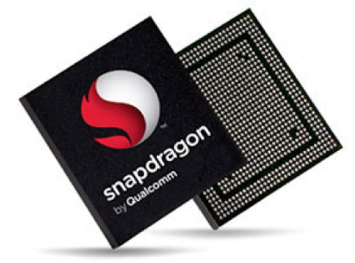




NEXT SLIDES FOCUS
µProcessor A-Class
(TEE, TZ)
µController
(HSM)
Examples:
  Telematic
  Central HPC
  Infotainment
  ADAS Supervisor
  …
Examples:
  VHL Access
  VHL Health
  EV Charging
  Anti Chip Tuning
  Zonal Controller
  …
Notes:
May be some don’t know exactly what a Secure Element is.

Slide 72

Lack of clarity on how/where crypto services are implemented
As many implementations as actors to fit given security goal.
Supported features are vendor (HW and FW) specific
No resistance to hardware attacks
Maturity is difficult to evaluate
Frozen capabilities, no agility
Huge costs and planning impacts each time a change is required
Limited cryptographic algorithms
No or low capability to fix vulnerability after deployment
Today’s CSM Implementations
Notes:
Devil is in the details of AUTOSAR Crypto Service (alt. Complex Driver) adaptation implementation.
Distributed knowledge leading a lot of confusion
Nightmare to understand how things are really working
HW Crypto Capabilities and associated interfaces are chipset specific.
HSM FirmWare (when relevant) capabilities and API are vendor specific.
HW Crypto Capabilities and HSM FirmWare are not designed to be tampered resistant.
Maturity is difficult to evaluate and induces energy-consuming during pentest.
Capabilities are frozen, no agility.
Huge impact (cost / planning) each time evolution (change request) is needed.
Low (if not no) capability to fix vulnerability after deployment (antagonist with long term key protection).
As many implementations as actors to fit given security goal.
e.g. secure boot relying on symmetric crypto largely deployed with risk induced signature computation capabilities, some peace of code may not be verified such as upgradable part of HSM FirmWare or calibration, signature verification request performed after release from reset are driven by main core (and not by HSM FirmWare), application launched whereas signature verification computation not computed…
Some crypto algorithms are missing:
e.g. Diffie-Hellman key exchange, secp521r1, Ed448, Key derivation functions, PQC readiness…)

Slide 73
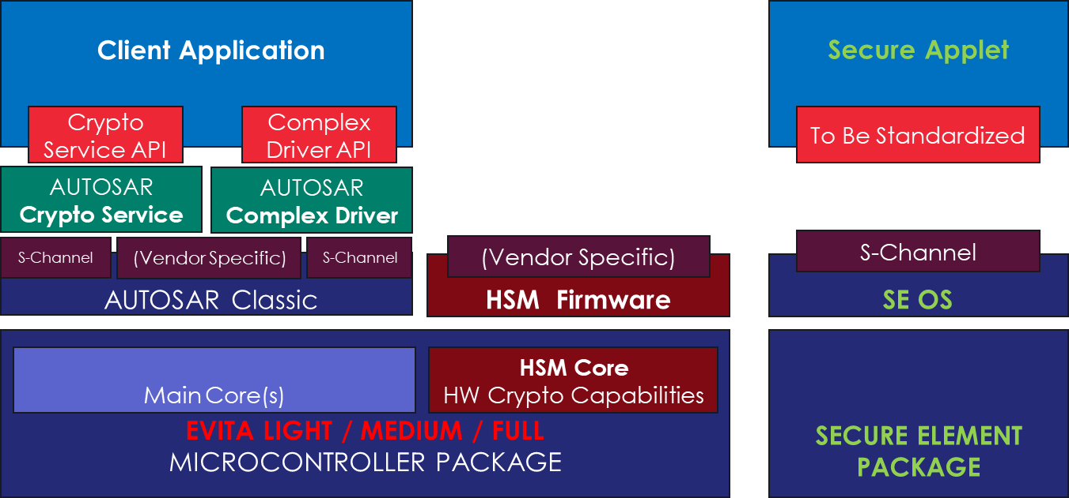

Extension of HSM capabilities with Secure Elements
HSM
Legacy implementation
Access to internal resources
eSE
Tamper resistance
Certification
Advanced crypto algorithms
Diffie Hellman, miscellaneous ECC curves, etc.
Crypto agility.
Upgradable, PQC readiness
Key Management Life Cycle
Business logic
  Leverage Capabilities of both HSM and Secure Element.
  Crypto services always running in secure environment (HSM or SE)
Notes:
May be some don’t know exactly what a Secure Element is.

Slide 74
USECASE
HSM ROLE
eSE ROLE
Secure binding between MCU and eSE
Secure storage of SCP¹ Key / MCU side
Secure storage of SCP¹ Key / eSE side
Secure Channel Protocol implementation
¹ Secure Channel Protocol (e.g. SCP03)
Secure Boot of MCU
Before releasing from reset, CMAC signature verification of immutable boot area
Hash computation
Asymmetric signature verification of updatable area(s) against pre-defined Root Of Trust
MACSec between 2 ECUs
GMAC computation/verification using Secure Association Key
CAK¹ provisioning/learning
MACSec key agreement and SAK² creation
¹ Connectivity Association Key ² Secure Association Key
Vehicle to Cloud mTLS
Not supported
Manage critical steps during mTLS handshake
Digital Key (DK)
Not relevant in DK protocol
Secure transfer of UWB keys to UWB sub-system
Digital Key storage
Implementation of the CCC protocol between vehicle and device
Notes:
MACSec
CAK is pre-shared on both links at OEM assembly line / ECU replacement at repair center
MKA is periodically (*) run on both ends to determine which link becomes a key server
Key server link generates SAK using TRNG
SAK is encrypted with CAK and passed to link partner
(*) SAK is updated periodically
SAK is used to compute GMAC on transmitter link / to verify GMAC on receiver link
Secure Boot (example only)
ROMed code within µC performs CMAC signature of (generally) immutable boot area covering i) immutable part of boot loader ii) immutable part of HSM Firmware and release µC from Reset
Immuable part of boot loader starts, request immutable part of HSM to read SCP key and establish secure channel with eSE
Immuable part of boot loader calculate hash covering next step upgradable area and request eSE to verify signature against calculated hash
If signature is valid, immuable boot loader starts next step upgradable area
mTLS
Generate Client nonce using TRNG
Verify server certificate chain of trust under genuine Root CA
Provide Client certificate
Generate ECDHE key pair
Compute signature for certificate verify message
Compute pre-master secret from Client ephemeral ECDH private key and server ephemeral ECDH public key

Slide 75
Wrap-Up
Francesca Forestieri

Slide 76
GlobalPlatform Automotive Topics Under Exploration
Guidelines
Secure Boot
Technical Requirements
Embedded Se as an Extension to HSM
SESIP to Generate Artefacts for UNECE 155
Managing Mixed Criticalities for Safety
Standardisation of TEE Non-Security Attributes (e.g. performance, profile, memory usage, start up time, etc.)
Supporting HPC ADAS functionality
Virtualisation of multiple TEEs
Isolation: Work Items in RISCV
Applicability of SAE's Hardware Protected Security Environments to Other Regions
PQC migration across regions

Slide 77
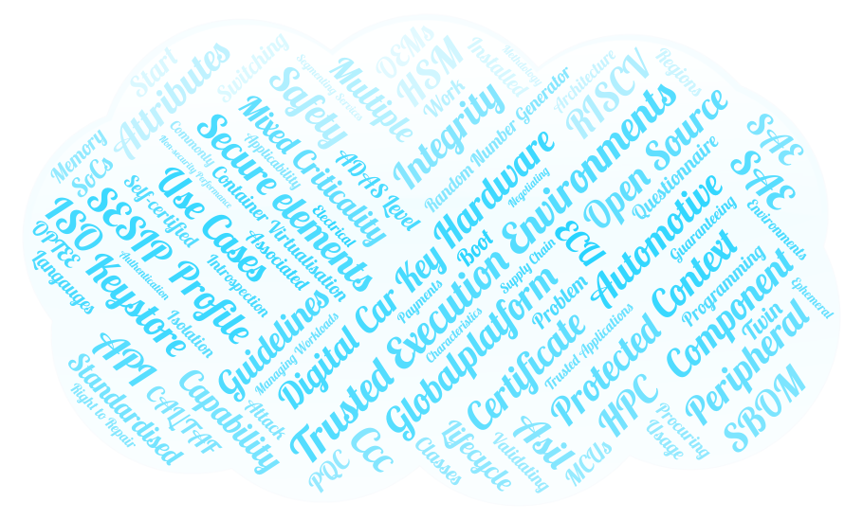
Topics Discussed in GlobalPlatform
Automotive
&
Cybersecurity Vehicle Forums

Slide 78
Join Us: Cooperation for Security Specifications
Standardise minimum common interoperable security services that allow service providers to develop applications for SDVs
Determine how product certification can provide evidence for the CSMS (UNECE 155/156) process

Slide 79

If you are interested in joining in on the fun…
https://www.cartoonstock.com/cartoon?searchID=EC326385

Slide 80


Slide 82
Automotive in GlobalPlatform
GlobalPlatform
Technical Committees
Secure Element
Trusted Execution and Platform Services
SESIP Committee
Internal Input
Regional Task Forces (Japan, China)
Automotive Task Force
Industrial Alliances
Cybersecurity Vehicle Forum
Security Task Force
Ext. Input
SBOM Task Force
Attack Expert Working Group

