Slide 1
CSVF Wrap-Up & Next Steps
22nd May 2025
Richard Hayton, GlobalPlatform
Francesca Forestieri, GlobalPlatform

Slide 2
皆様ありがとうございました Minasama arigatōgozaimashita
Thank you ALL so much
Special Thank You for
Speakers
Translators
Audio Persons
Kahala Staff

Slide 3
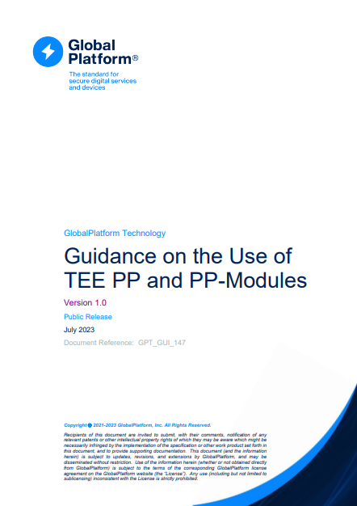
Driving Requirements into GlobalPlatform
What
Inside GlobalPlatform
Automotive Task Force
Security Task Force
Regional Task Forces
Today’s Input
Thank you!
Whitepapers
Trusted Environments & Services Committee
Secure Element Committee
Specifications
Protection
Profiles
SESIP Committee
Nov
June
Sept
Oct
Nov
June
Oct
Nov
Mar
May
May
2022
2023
2023
2023
2023
2024
2024
2024
2025
2025
2025
Munich
Detroit
Tokyo
Beijing
Hamburg
Detroit
Tokyo
Berlin
New Orleans
Shanghai
Yokohama

Slide 4
Topics Discussed in GlobalPlatform
Automotive
&
Cybersecurity Vehicle Forums

