Slide 1
Global Platform ATF GP JVC Applet for Automotive
STMicroelectronics
3rd of April 2025

Slide 2
How to classify security robustness?
A complete set of Hardware & Software countermeasures + certification
Software attack
Board-level attack
Silicon-level
attack
Network protocols weakness (weak ciphers, short keys,…)
Flaws in software design / implementation, buffer overflows
Debug interfaces, gaining admin rights
SPA / DPA Power analysis, emission analysis, timing analysis
Fault injection: glitches, laser, light, UV, X-rays, Electro-Magnetic
Memory probing
Device delayering, circuit reverse engineering, micro-probing
Fault injection: Focused Ion Beam
Advanced microscopy
Major attacks
No external debug interface
Hardware secure crypto fast computing
Enhanced security of MCU with physical isolation of security toolbox (secure key storage, secure & trusted execution in secure element)
Randomization
Secured crypto-engines
Design Flow
Power regulation
OS features (MPU)
Jittered Clocks
Data whitening
Physical Shield
Lock-step EDC
Glue Logic Layout
Bus & Memory Scrambling
Bus & Memory Encryption
Anti-reverse
Advanced Lithography
Countermeasures
Hardware & Software
Environment Sensors
Integrity checkers
Code Signature
Internal Clock Integrity
eSE EAL6+ AVA VAN 5
Security level
HSM EAL up to 3
~SESIP 2 or 3
~SESIP 4 or 5
Ex: Side channel 60 to 5k curves robustness => hacker in a garage
Ex: Side channel >1M curves robustness => BSI or expert lab

Slide 3
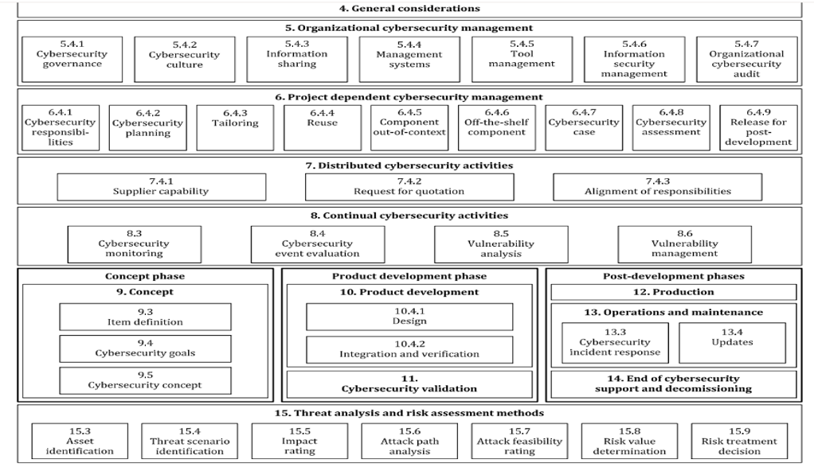
ISO21434 and TARA analysis : where is executed my function?
How is it possible to cope with security functions execution place uncertainty: HSM HW or CPU ? There is a fundamental need to identify the real level of security robustness needed to be reach Which functions have to be bake or harden from security point of view ? For exemple, could you accept an ECDSA-256 signature generation perfomed on a standard CPU (without demonstrated robustness) ?

Slide 4
GP Automotive security convergence for MCU
Use cases functions convergence
HSM or Secure Enclave
GP JVC Automotive applet security APIs, functions & services
+ testsuite compliancy
ANY APPLICATION
+ eSE on top of
HSM to remain the solution when priority is given to performances
eSE on top of HSM (with GP JVC Automotive Applet) as a proxy to extend HSM capabilities

Slide 5
GP Automotive JVC Applet
Automotive ECUs are more and more challenged to address risks with higher level of security robustness with sometimes unclear visibility about strategy to setup and how to maintain it “state of the art” over a decade
ECUs can rely on AUTOSAR CSM APIs to answer most of cybersecurity challenges BUT higher level of security (>SESIP 3 or EAL4+/5+) is sometimes required
eSE must be understood as a complementary solution on top of ECU HSM used in AUTOSAR with CSM APIs Any customer who wants to keep going using AUTOSAR for practical and legacy reason and just delegate specific tasks to eSE as a companion chip.
eSE standardized APIs is likely to address generic services :
Key management
Secure Storage
Certificates management
Complementary crypto services (if some could miss, or if some could require higher security)
Remote provisioning
Possible ROT improvement scheme
Capability to maintain state of the art security robustness on the field

Slide 6
GP Automotive JVC Applet
Many cars are already equipped at least with on eSE for DigitalKey, and most the eSE used for DK could propose additional room for complementary use cases:
Qi
Car BlackBox
Specific parts serial number check
Specifics car settings check
- Driver Biometrics credentials management - Car driver preference settings record
User applicative and dynamic rights management
=> All these use cases can be addressed by classic HSM integration approach …. But could take benefit of eSE with GP JVC applet to reinforce it

Slide 7
GP Automotive JVC Applet
Why does not already exist today ? Today eSE are mainly used with proprietary solutions that is a mainstream adoption drawback So even if some eSE are used for a specific use cases (Digital Key, Qi …) It is not easy to extend it for generic services, especially for AUTOSAR
GP could be the way to develop such “Applet” offering a generic a set of standardized APIs to be run on top of an “eSE with JVC OS”
USER APPLICATION
GP Automotive Applet to be created with future standardized APIs
CSP
Complementary services
Java Card 3.x + GP 2.3 (Amd CDEFH)
HW eSE ( GP T=1 SPI/I2C) EAL6+

Slide 8
Next possible step ?
Valuable solution having CSM APIs + CSM APIs “bake” ? Mainstream APIs to keep on going with today CMS APIs executed by HSM BUT…sometimes TARA could identify some potential opportunities to reinforce the security (or to use eSE) eSE could propose on top of HSM same APIs but more “robust” from security point of view.
Having inside AUTOSAR “CSM APIs ” (executed by HSM) and “CSM_bake APIs” (executed by eSE) could be valuable
AUTOSAR top services
CSM + (CSM_Bake) APIs
Legacy
“Bake” attribute
Slower but EAL5+
Classic HSM execution
Harden by eSE execution
Crypto functions execution

Slide 9
Autosar CSM-extended HSM + eSE
Improve AUTOSAR CSM APIs “used today” using HSM with extended and harden capability (from security robustness point of view) to address all the use cases and security robustness challenges

Slide 10
BACKUP SLIDES

Slide 11
GP Automotive JVC Applet
Why JavaCard (JVC) and Cryptographic Service Provider (CSP) ? JVC is the well-known solution for eSE applications, and It can take also advantage of CSP CSP (defined by the BSI) is the way to expose CSP-API that will offer some default useful services “Applet on top of” will be “Business Logic only” : most of security guidance are included inside CSP API CSP prevents applet to be certified for each specific platform type and version they will be used on
CSP advantages :
Mostly static, few code-changes
Requires EAL4+/VAN.5
Ensure critical operation are secure
Reuse existing mechanism (crypto-lib, GP mechanisms…)
Manage applications having different roles and access rules
CSP is offering services like :
Securely store Keys
Provide Cryptographic operations
Key Management
Full crypto Protocols (Authent, signing, etc…)
Key-Provisioning for Protocols
USER APPLICATION
GP Automotive Applet to be created with future standardized APIs
CSP
Complementary services
CSP API
EAL 4+
Composite certification
Java Card 3.x + GP 2.3 (Amd CDEFH)
EAL 4+
HW eSE ( GP T=1 SPI/I2C) EAL6+
EAL 6+

