Slide 1
CRA for Device Makers
May 22, 2025
Applicability for Components, Devices, and Systems
Carlos Serratos
NXP – Security Certification Expert
GlobalPlatform – Chairman SESIP Ecosystem Adoption WG

Slide 2
Agenda
What’s the CRA
CRA Principles
CRA Conformance
CRA & Automotive
Key takeaways

Slide 3
What is the Cyber Resilience Act (CRA)
Scope: Europe
Goal: “To harmonise cybersecurity requirements for products with digital elements in all Member States”
Horizontal regulation, touching:
RED
NIS2 for critical infrastructure
AI Act for AI
eIDAS for wallets/eIDs
GDPR for data protection
Liability Act
Safety Act
Machinery Directive
Cybersecurity Act
Mandatory for CE mark from December 2027:
Access to the EU market
Penalties:
For non-complying essential requirements, it can amount to €15 million or 2.5% of the annual turnover, whichever is higher.
Applicability
Finished products with digital elements (SW/HW), except products that have an existing European regulation in place:
Ground Transportation
Air transportation
Medical for human and in-vitro diagnostic
Commercial Software
HW/SW subcomponents, including MCUs, MPUs, Crypto Processors and Secure Elements used in ANY application, including those above

Slide 4
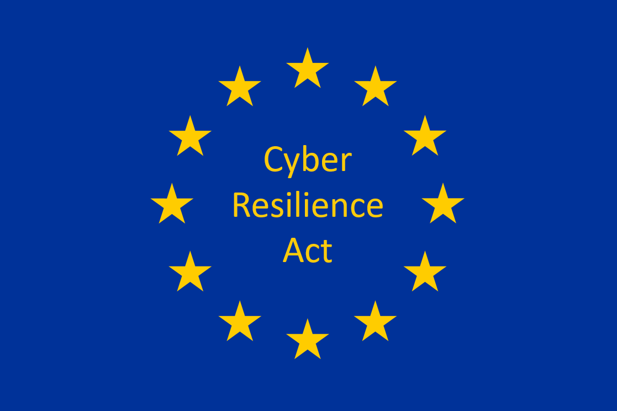
CRA principles
If it’s ”smart”, maybe it is not
It applies to every “connected” vertical and application
(minus medical & automotive systems and vehicles)

Slide 5
CRA principles
If it’s ”smart”, maybe it is not
It applies to every “connected” vertical and application
(minus medical & automotive systems and vehicles)
“Everything” is a potential backdoor
It applies to any HW and SW
End devices, components, and remote services alike

Slide 6
CRA principles
If it’s ”smart”, maybe it is not
It applies to every “connected” vertical and application
(minus medical & automotive systems and vehicles)
“Everything” is a potential backdoor
It applies to any HW and SW
End devices, components, and remote services alike
Risk first, and last
Documented risk-based decisions
User guidance
Secure technology and processes

Slide 7
CRA principles
If it’s ”smart”, maybe it is not
It applies to every “connected” vertical and application
(minus medical & automotive systems and vehicles)
“Everything” is a potential backdoor
It applies to any HW and SW
End devices, components, and remote services alike
Risk first, and last
Documented risk-based decisions
User guidance
Secure technology and processes
Risk is contextual
Security problems might have several solutions (SOTA)

Slide 8
CRA principles
If it’s ”smart”, maybe it is not
It applies to every “connected” vertical and application
(minus medical & automotive systems and vehicles)
“Everything” is a potential backdoor
It applies to any HW and SW
End devices, components, and remote services alike
Risk first, and last
Documented risk-based decisions
User guidance
Secure technology and processes
Security is not a one-off
Vulnerability management
Support period & Surveillance
Risk is contextual
Security problems might have several solutions (SOTA)

Slide 9
CRA principles
If it’s ”smart”, maybe it is not
It applies to every “connected” vertical and application
(minus medical & automotive systems and vehicles)
“Everything” is a potential backdoor
It applies to any HW and SW
End devices, components, and remote services alike
Risk first, and last
Documented risk-based decisions
User guidance
Secure technology and processes
Security is not a one-off
Vulnerability management
Support period & Surveillance
Risk is contextual
Security problems might have several solutions (SOTA)
You can never be 100% sure
Secure supply chains,
Beyond secure products, secure suppliers

Slide 10
CRA principles
If it’s ”smart”, maybe it is not
It applies to every “connected” vertical and application
(minus medical & automotive systems and vehicles)
“Everything” is a potential backdoor
It applies to any HW and SW
End devices, components, and remote services alike
Risk first, and last
Documented risk-based decisions
User guidance
Secure technology and processes
Security is not a one-off
Vulnerability management
Support period & Surveillance
Risk is contextual
Security problems might have several solutions (SOTA)
Trust, and verify
Different conformance mechanisms for products based on impact
You can never be 100% sure
Secure supply chains,
Beyond secure products, secure suppliers

Slide 11
CRA Conformance mechanisms
START
Class I Products
Class II Products
Critical Products
Default Category
Is the product listed in Annex III as Class I?
Is the product listed in Annex III as Class II?
Is the product listed in Annex IV?
Are there Harmonized standards available?
Are there certification schemes from the CSA available?
Use Class II mechanisms
Use Class II mechanisms
Class I Mechanism
Critical Product Mechanism
Use Self-declaration with harmonized standards
OR
Class II mechanisms
Use a CSA scheme certification (e.g. EUCC)
[No harmonized standards required]
Class II Mechanism
Default Product Mechanism
Use 3rd party assessments by Notified Bodies
[No harmonized standards required]
For Product Testing, Inspection & Certification (Module B+C)
OR
Full Quality Assurance System (Module H)
OR
Use a CSA scheme certification (e.g. EUCC)
[No harmonized standards required]
Self-declaration
[No harmonized standards required]
OR
Class I mechanisms
The answer is “No”
The answer is “Yes”

Slide 12
UN Regulation No 155
Reference in Annex II, D4
Reference is possible, but discussion open
By Delegated Act
Regulation 2019/2144
(motor vehicles)
Regulation 168/2013
(2/3-wheel vehicles, microcars)
Regulation 167/2013
(agricultural and forestry vehicles)
Type approval
(homologation)
Vehicle Categories
M
N
O
L
T
C
R
S
cars, buses
vans, trucks
trailers
motor bikes
tractors (tires)
tractors (tracks)
trailers
towed equipment
CRA
Out of scope: Vehicles and systems
Out of scope
ISO 21434
ISO 24882
X
Vehicle Category that must follow UN R155

Slide 13
The most important element from the CRA: If there is something you need to remember…
The CRA doesn’t mandate compulsory or mandatory functionality
Manufacturers “own” the risk, the obligation to mitigate the risk, and communicate it to the users
The conformance Classes only represent the conformance mechanisms: there is no basic, minimum, or entry-level security, even in the default category
The essential requirements are the baseline that needs to be addressed. It doesn’t mean it needs to be implemented
What and how is implemented is up to the manufacturer but always, always, always: risk-based (documented) decisions
Always,
always,
always:
risk-based (documented) decisions
CRA

