Slide 1
SAE J3101: Opportunity for Synergies in Japan?
22nd May 2025
Francesca Forestieri, GlobalPlatform

Slide 2
Hardware Protected Security Environments
SAE J3101-5

Slide 3


Same Words Meaning Different Things:
Reason Why SAE’s J3101 Was Created
Automotive Market uses different names
BUT
Each vendor means something different
Same name has different characteristics
No framework to compare across products
HSM
General term used for dedicated security hardware in vehicles
SHE/SHE++
Developed 2004-2005 / Maintained by the AUTOSAR consortium
EVITA
EVITA Project (2008-2011):

Slide 4
SAE J3101: A Common Reference for Hardware Protected Security Environments
Establish trustworthiness
Resilience to a wide range of attacks
A hardware root of trust
beyond software-only security mechanisms.
hardware-based security primitives
for connected and highly or fully automated vehicles.
device identity
sealing
attestation
data integrity
availability
Basic characteristics
Requirements
Source: SAE, Surface Vehicle Recommended Practice, Hardware Protected Security for Ground Vehicles J3101™ FEB2020, Issued 2020-02

Slide 5


Role of J3101 in Cybersecurity Compliance: Framework for Product Security
Relevant for 64 Countries
ISO /SAE 21434 and 24089
Cybersecurity Vehicle Management
Compliance with UNECE 155 & 156
Demonstration of Best Practices
SAE J3101 Hardware Protected Security Environments
Process
Product
Compliance
ISO/PAS 5112:2022 - Road vehicles — Guidelines for auditing cybersecurity engineering. Security, safety & risk
ISO/SAE PAS 8475 Road vehicles - Cybersecurity Assurance Levels (CAL) and Targeted Attack Feasibility (TAF) (under development)
ISO/SAE PWI 8477 Road Vehicles Cybersecurity Validation and Verification (under development)

Slide 6
Hardware Protected Security Environments (J3101): Application Use Cases
IPR Protection
Secure Diagnosis at the ECU Level
Secure Logging
Satisfying the requirements of the IP protection use case requires implementation of the base confidentiality profile (7.1).
Implementation of the secure ECU diagnostics use case requires implementation of the following profiles:
Base Confidentiality (7.1):
Additionally, the following profiles should be considered depending on the system implementation:
Base Availability (7.3):
To satisfy the minimum, fundamental secure logging requirements of authentication and non-repudiation, three profiles are required:
Base Confidentiality (7.1)
Base Integrity (7.2)
Non-Repudiation (7.5)
To satisfy additional security objectives which could be specified for certain usages of secure logging, the following additional profiles may be required and should be considered based on the context provided above:
Base Availability Profile (7.3)
High Assurance Level Profile (7.7)
Base Integrity (7.2):
Access Control (7.4):
Assurance Level (7.7):

Slide 7
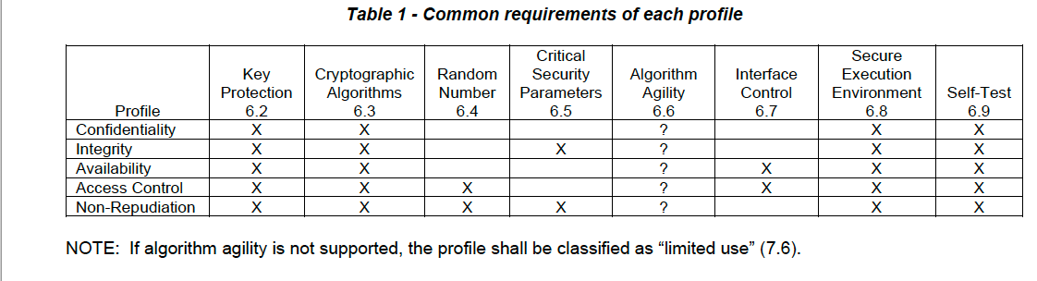
SAE J3101
Hardware Protected Security Environments
Source: SAE, Surface Vehicle Recommended Practice, Hardware Protected Security for Ground Vehicles J3101™ FEB2020, Issued 2020-02

Slide 8
Collaboration
By leveraging GlobalPlatform technologies, a large proportion of the requirements can be met by the platform (TEE or SE) reducing cost and complexity of J3101 compliance
✓
J3101 Compliance

Slide 9
Collaboration
By leveraging GlobalPlatform technologies, additional benefits of standardised specifications support SDV requirements
✓
Detailed specifications and Implementation guidelines
Cover these HPSE requirements and more
Globally relevant
Certification of components by SE or TEE providers to:
Ensure interoperability/portability
Proven security robustness (protection against attack) obtained
Possibility of composite certification
J3101 Compliance

Slide 10
Methodology –
GlobalPlatform Specifications Assessed
GP TECHNOLOGY | DOCUMENT REFERENCE | TITLE | VERSION | REFERENCE LINK
SE | GPC_SPE_034 | Card Specification [GPCS] | 2.3.1 | https://globalplatform.org/specs-library/card-specification-v2-3-1/
 | GPC_SPE_174 | Secure Element Protection Profile [SE PP] | 1.0 | https://globalplatform.org/specs-library/secure-element-protection-profile/
 |  | GlobalPlatform Card API | 1.7.1 | https://globalplatform.org/specs-library/globalplatform-card-api-org-globalplatform/
TEE | GPD_SPE_009 | TEE System Architecture [TEE Sys Arch] | 1.3 | https://globalplatform.org/specs-library/tee-system-architecture/
 | GPD_SPE_010 | GPD TEE Internal Core API [TEE Core] | 1.3.1 / 1.4 | https://globalplatform.org/specs-library/tee-internal-core-api-specification/
 | GPD_SPE_021 | TEE Protection Profile [TEE PP] | 1.3 | https://globalplatform.org/specs-library/tee-protection-profile-v1-3/
 | GPD_SPE_025 | TEE TA Debug Specification [TEE Debug] | 1.0.1 | https://globalplatform.org/specs-library/tee-ta-debug-specification-v1-0-1/
 | GPD_SPE_120 | TEE Management Framework (TMF) including ASN.1 Profile [TMF] | 1.1.2 | https://globalplatform.org/specs-library/tee-management-framework-including-asn1-profile-1-1-2/
 | GPD_GUI_069 | TEE Initial Configuration [TEE Config] | 1.1 | https://globalplatform.org/specs-library/tee-initial-configuration-v1-1/
 | GPD_GUI_089 | TMF Initial Configuration [TMF Config] | 1.0 | https://globalplatform.org/specs-library/tmf-initial-configuration-v1-0/
SE and TEE | GP_TEN_053 | Cryptographic Algorithm Recommendations [Crypto Rec] | 2.0 | https://globalplatform.org/specs-library/globalplatform-technology-cryptographic-algorithm-recommendations/
 | GP_REQ_025 | Root of Trust Definitions and Requirements [RoT] | 1.1.1 | https://globalplatform.org/specs-library/root-of-trust-definitions-and-requirements-v1-1-gp-req_025/

Slide 11
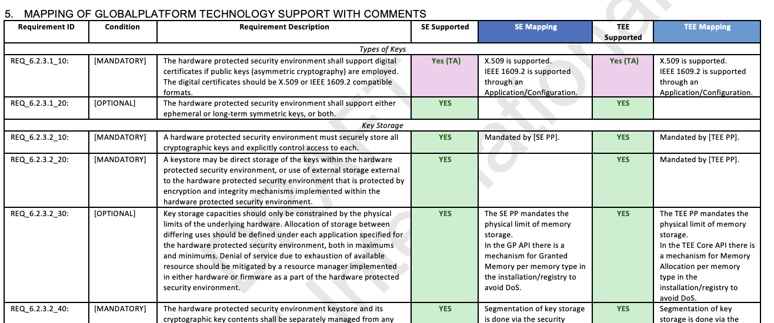
Mapping Conducted for Secure Elements and Trusted Execution Environments

Slide 12
Coverage Definitions
Yes:
Yes by Trusted Application:
Not Covered
Satisfied by Existing GlobalPlatform Specifications
Innate Characteristic Supported by GlobalPlatform
Detailed Implementation Guidelines Exist
This J3101 requirement is Fully covered by GP compliant platform for Secure Elements or Trusted Execution Environments.
Full alignment is achieved through development of Trusted Applet/ Application running on a GlobalPlatform compliant platform.
Only 3 J3101 requirements are not fully met by GlobalPlatform (TEE) specifications.
Hardware Tamper resistance is not a basic requirement of the TEE Protection Profile (although implementations may address this aspect).
Furthermore, firmware update of the TEE itself is outside the scope of the TEE protection profile but Trusted Application (TA) update is covered by TMF protection profile.

Slide 13

Analysis Results: GlobalPlatform Specifications
YES-TA
YES - Platform
Notes:
Not Covered
Only 3 J3101 requirements are not fully met by GlobalPlatform (TEE) specifications.
Hardware Tamper resistance is not a basic requirement of the TEE Protection Profile (although implementations may address this aspect).
Furthermore, firmware update of the TEE itself is outside the scope of the TEE protection profile but Trusted Application (TA) update is covered by TMF protection profile.

Slide 14

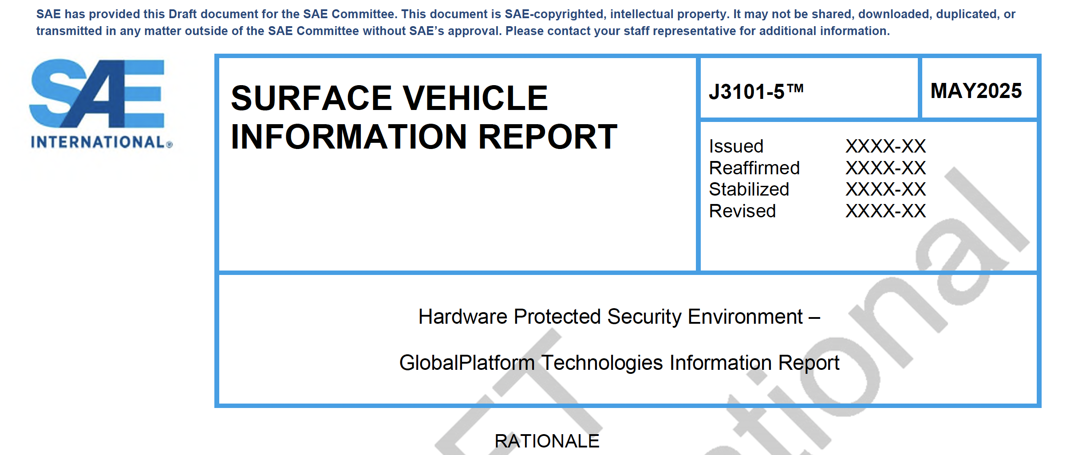
SAE’s Vehicle Electrical System Security Committee – Final Ballot J3101-5
Final confirmation Ballot Concluded
Awaiting SAE Technical Writer Edits and Publication

Slide 15
What is the importance of J3101-5?
A way to demonstrate "compliance" with SAE J3101 for
AND
flexibility in developing secure services
GP provides
certified security assurance levels
functional interoperability
RFPs
ISO/SAE 21434

Slide 16
What do We Have?
GlobalPlatform is developing SESIP Profile for J3101 Trusted Application requirements
Meet Industry desire for standardize policy management for key usage
Extend to new use cases?
Would a standard trusted application be useful?

Slide 17

Next Steps: How SESIP Profiles Support Demonstrating Compliance for J3101
GlobalPlatform Protection Profiles
J3101 Trusted Application/ Applet Protection Profile
J3101 Full Compliance for Secure Components
Detailed Implementation Guidelines have been Defined by GlobalPlatform
Existing Protection Profiles
GlobalPlatform is developing SESIP profiles with interpretations on implementation
Example of Potential Acceptance Criteria

Slide 18

Next Steps: Open Questions
Is SAE's work on J3101 a departure point for discussing Japanese requirements?
  Through JasPar
  Through JSAE

Slide 19
PQC: How does GlobalPlatform Help?
22nd May 2025
Beatrice Peirani, Thales
Yves-Emmanuel Le Bobinnec, Thales

