Slide 1
SESIP CEN/CLC standardization history and status

Slide 2
Table of Contents
CEN/CLC/JTC 13 “Cybersecurity and Data Protection”
What is this?
Who to blame
Scope
Key issues
Partnerships
Supporting EU legislation
WG 3 Security evaluation and assessment
What is this?
Who to blame
WG 3 international adoptions
Projects from WG3
EN 17640 Fixed time cybersecurity evaluation methodology for ICT products
Requirements for Conformity Assessment Bodies certifying Cloud Services
Guidelines on Sectoral Cybersecurity Assessment
Security Evaluation for IoT Platforms (SESIP).
Q&A
Many thanks!

Slide 3
CEN/CLC/JTC 13 “Cybersecurity and Data Protection”

Slide 4
What is this?
Joint technical committee (JTC) of CEN and CENELEC
Established November 2017
120+ European experts on cybersecurity and data protection
6 dedicated working groups
3 plenary meetings/sessions per year
Annual outreach events

Slide 5
Who to blame
Chairperson: Walter Fumy, Bundesdruckerei (Germany)
Secretariat: DIN German Institute of Standardization (Germany)
Secretary: Martin Uhlherr (DIN)
CEN-CENELEC Management Centre Programme Manager: Laurens Hernalsteen

Slide 6
Scope
Development of horizontal standards in the field of cybersecurity and data protection for vertical applications domains
Horizontal security & privacy topics of the evolving interconnected society, driven by the European market in domains such as ICT, eHealth, transport, smart cities, automotive, IOT
Identification and adoption of published documents by ISO/IEC JTC 1, other SDOs, international bodies and industrial fora
Development of CEN/CENELEC publications for safeguarding information

Slide 7
Key issues
‒ Management systems, frameworks, methodologies
‒ Data protection and privacy
‒ Services and products evaluation standards suitable for security assessment for large companies and small and medium enterprises
‒ Competence requirements for cybersecurity and data protection
‒ Security requirements, services, techniques and guidelines for ICT systems, services, networks and devices, including smart objects and distributed computing devices

Slide 8
Partnerships
‒ International (ISO, IEC, ITU)
‒ European (ETSI)
‒ National Standardization bodies relevant to our work, on international level e.g. NIST, JISC, SAC etc.

Slide 9
Supporting EU legislation
Contribution to ICT rolling plan, EU standardisation strategy, EU rolling working plan (RWP) of the EU Cybersecurity Act (Regulation (EU) 2016/679)
Provide support to EU regulations such as
eIDAS (Regulation (EU) 910/2014),
General Data Protection Regulation (EU) 2016/679 (GDPR),
NIS (Regulation (EU) 2016/1148),
EU Cybersecurity Act (Regulation (EU) 2016/679),
Activation of RED cybersecurity articles.
CEN webpage of CEN/CLC/JTC 13
Business Plan

Slide 10
WG 3 Security evaluation and assessment

Slide 11
What is this?
A Working Group covering aspects related to security engineering, with particular emphasis on, but not limited to standards for IT security specification, security evaluation, testing and certification of IT products, services and processes.
The following aspects may be distinguished:
security evaluation criteria taking into account the level of risk, criticality of the target of evaluation;
methods for applying the criteria;
security specification of IT products, services and processes;
testing methods for conformity assessment.

Slide 12
Who to blame
Convenor: Miguel Bañón, ES
Secretariat: UNE Spanish Association for Standardization (Spain)

Slide 13
WG 3 international adoptions
EN ISO/IEC 15408 Information technology - Security techniques Evaluation criteria for IT security. (adoption of current revision in progress)
EN ISO/IEC 18045 Information technology - Security techniques - Methodology for IT security evaluation. (adoption of current revision in progress)
EN ISO/IEC 19790 Information technology - Security techniques - Security requirements for cryptographic modules.

Slide 14
EN ISO/IEC 29147 Information technology - Security techniques - Vulnerability disclosure.
EN ISO/IEC 30111 Information technology - Security techniques - Vulnerability handling processes.
EN ISO/IEC 19896 Competence requirements for information security testers and evaluators.
EN ISO/IEC 23532 Information security, cybersecurity and privacy protection — Requirements for the competence of IT security testing and evaluation laboratories.

Slide 15
Projects from WG3
EN 17640 Fixed time cybersecurity evaluation methodology for ICT products
This document describes the cybersecurity evaluation methodology for ICT products. It is intended for use for all three assurance levels as defined in the Cybersecurity Act (i.e. basic, substantial and high). The methodology is comprised of different evaluation blocks including assessment activities that comply with the evaluation requirements of the CSA for the three levels.

Slide 16
Requirements for Conformity Assessment Bodies certifying Cloud Services
This TS provides requirements and ISO/IEC 17065 interpretations for Conformity Assessment Bodies (CABs) assessing Cloud Services This TS is intended to be used by the National Accreditation Bodies (NABs), as well as CABs.

Slide 17
Guidelines on Sectoral Cybersecurity Assessment
This document describes an approach that is designed to be used in drafting requirements of cybersecurity certification schemes for sectoral ICT services and systems.
The sectoral cybersecurity assessment process includes all steps necessary to define and implement such requirements in a cybersecurity certification scheme.

Slide 18
Security Evaluation for IoT Platforms (SESIP).
Project leader: Eve Atallah
Project co-leader: Olivier Van Nieuwenhuyze
This document describes a cybersecurity evaluation methodology, named SESIP, for platforms and platform parts of connected IoT products. Security claims in SESIP are made based on the security services offered by those platforms. Platform parts can be in hardware and software.
SESIP aims to support comparability between and reuse of independent security evaluations. SESIP provides a common set of requirements for the security functionality of platform parts which apply to the foundational platforms of devices that are not application specific.
The methodology describes the re-use of evaluation results.

Slide 19
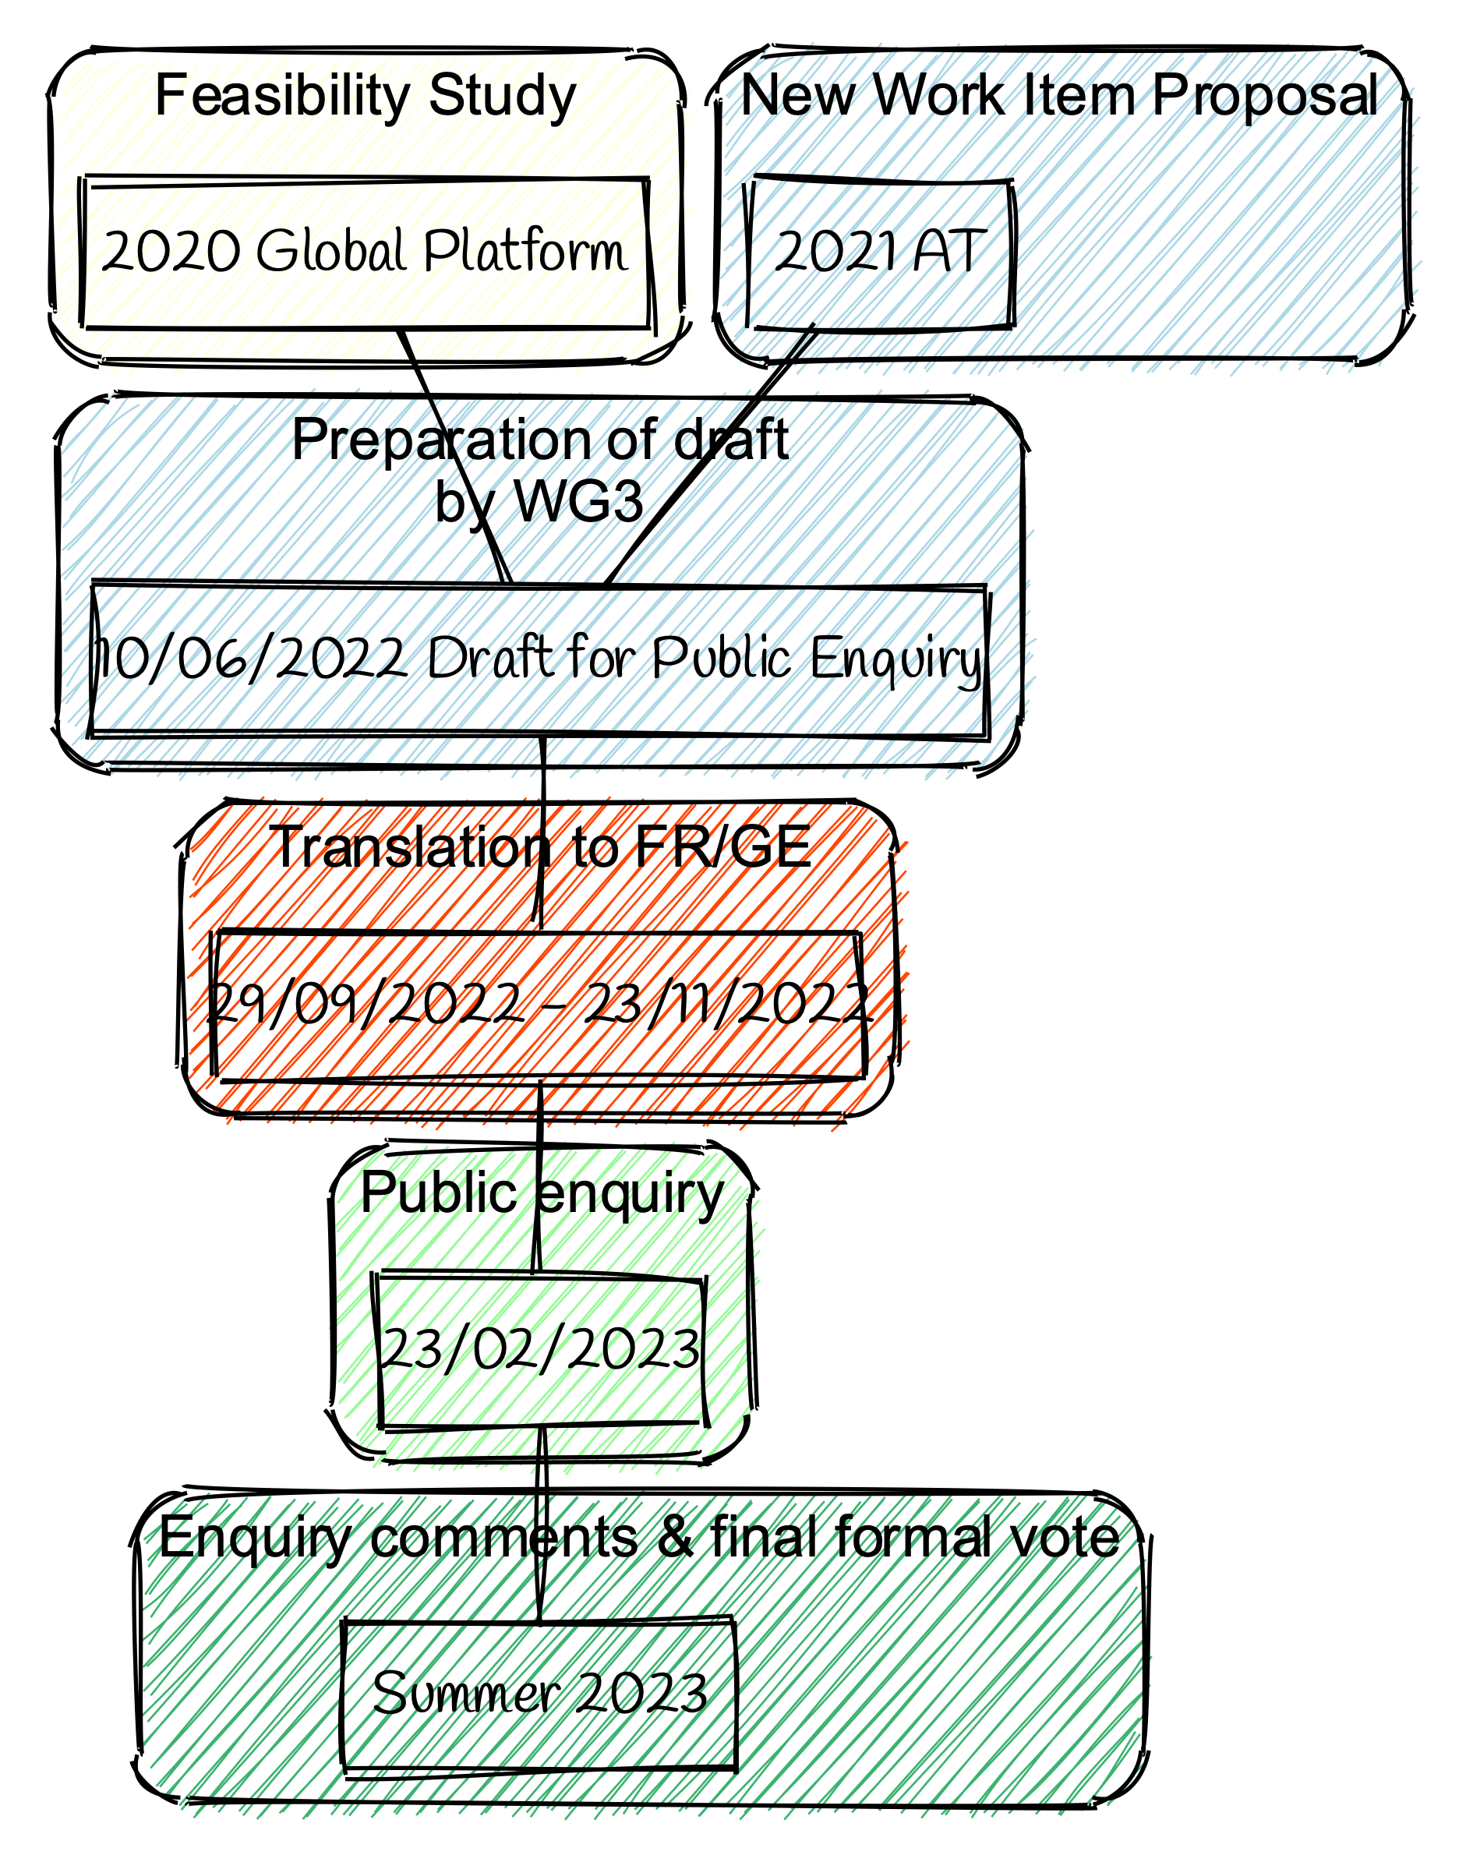
Project history within JTC 13

Slide 20
Q&A

Slide 21
Many thanks!

