Slide 1
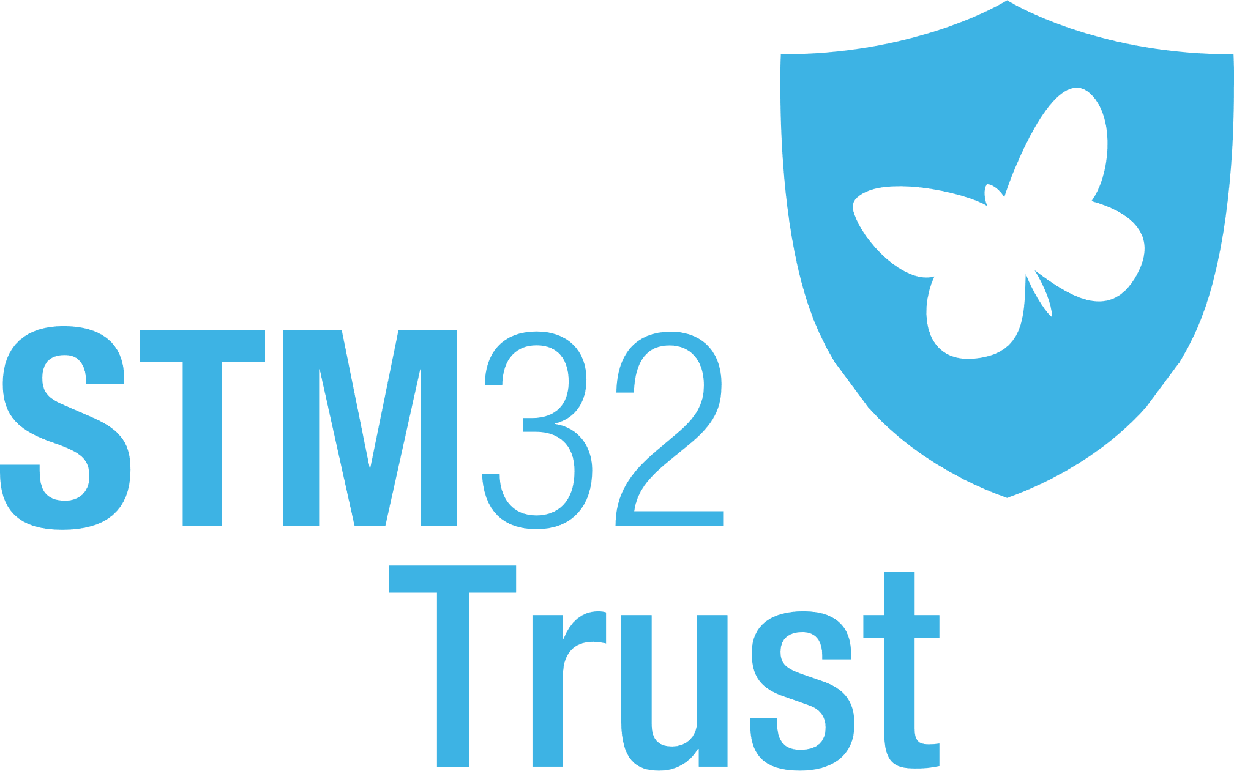
The Microcontroller Journey: From Basic Security to ARM PSA L3 and SESIP3
ST GPM Security Marketing
19-oct-22 / Bruno Mussard

Slide 2
Revision History
Revision | Issue Date | Author | Section | Nature of Amendment
V1.0 | 11-oct-22 | Bruno Mussard
V1.1 | 13-oct-22 | Bruno Mussard

Slide 3
Agenda
1
Introduction
2
IoT Security & STM32Trust
3
The STM32 Journey: From Basic Security to L3
4
Q & A

Slide 4
Introduction

Slide 5
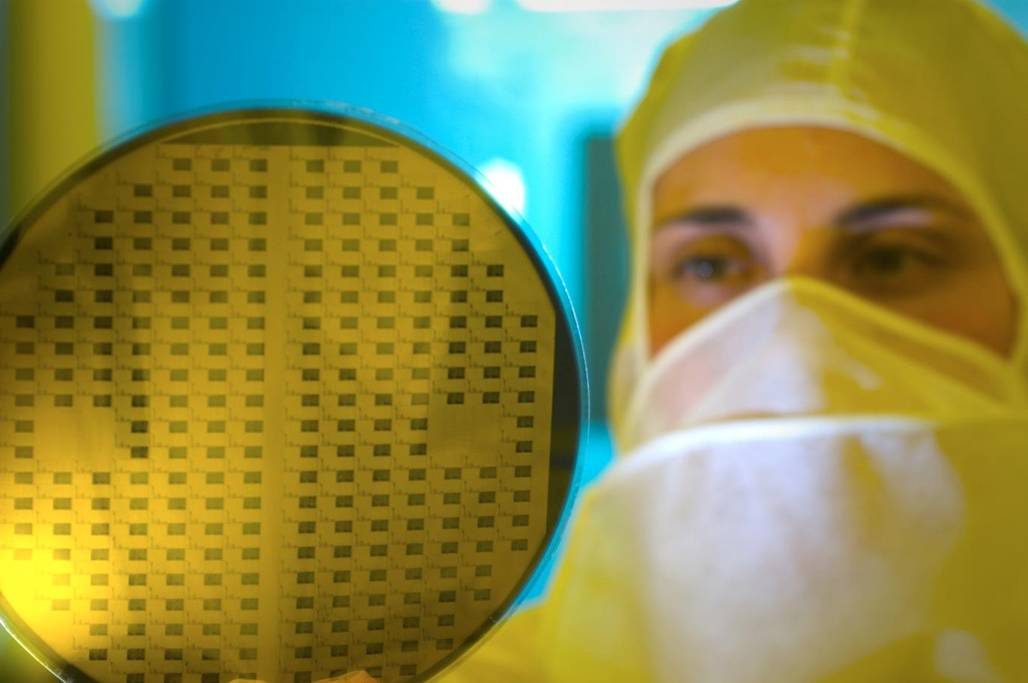
We are creators and makers of technology
One of the world’s largest semiconductor companies
48,000 employees of which 8,400 in R&D
$12.8 B revenues in 2021
Over 80 sales & marketing offices serving over 200,000 customers across the globe
13 manufacturing sites
Signatory of the United Nations Global Compact (UNGC) Member of the Responsible Business Alliance (RBA)
As of December 31, 2021
Notes:
ST is a large semiconductor manufacturing selling mass market silicon devices:
Automotive, consumer, industrial…
Now

Slide 6
The STM32 Offer
Notes:
STM32 is the ST offer around microncotrollers and microcontroller
Based on ARM architecture and making good use of the ARM architecture and ecosystems

Slide 7
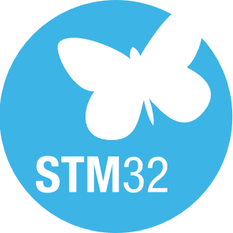
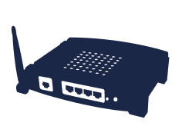
A Broad Product Portfolio
A Leader in Arm® Cortex®-M 32-bit General Purpose MCU
MPUs
STM32-MP1
STM32-MPx
High Perf
MCUs
STM32-F2
STM32-F4
STM32-F7
STM32-H7
STM32-Vx
+
Mainstream
MCUs
STM32-F0
STM32-G0
STM32-F1
STM32-F3
STM32-G4
STM32-Hx
STM32-Gx
+
Ultra-low Power
MCUs
STM32-L0
STM32-L1
STM32-L4
STM32-L4+
STM32-L5
STM32-U5
STM32-Ux
+
Wireless
MCUs
STM32-WB
STM32-WL
STM32-WBx
Network Processors | Wi-Fi
 | Ultra Wide Band
 | Cellular
A7+ M4
Axx + M33
Arm® Cortex® core
M0 / M0+
M3 / M4
M33
M7
M55
Notes:
A wide range of core with from entry-level Cortex M0 to asymmetric dual cores.
Meaning different security challenges

Slide 8
IoT Security & STM32Trust

Slide 9
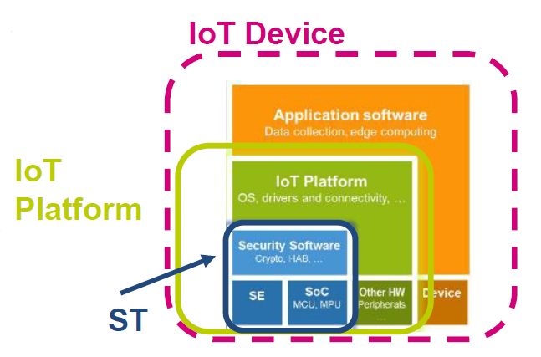
Security for IoT Devices
A challenge for WW security certification:
► Much progress but offer still fragmented
► Driven by Private Sector & Public Sector
► Alignment at stake: WW recognition vs National sovereignty
ST challenges:
► Define the best approach for certified foundations
► Explain re-use, composition & mapping for OEMs

Slide 10
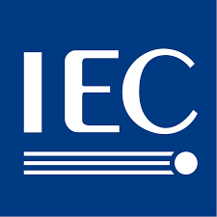
Security for IoT Devices Customer expectations
► ST Customer Survey in 2022:
► >60% security is important to address the market
► >75% security certification
► Platform security as the cornerstone to connected device security
► A standardized approach with explicit Security Functions & “Security Guarantees”
► Coverage of OEM level certification schemes
► Security components as enablers for OEM Application & Services
► Seamless and secure provisioning & connection to the cloud
► Assets protection (keys, ID) at boot & runtime
►
EUCC
IEC 62443-4
EN 303 645

Slide 11
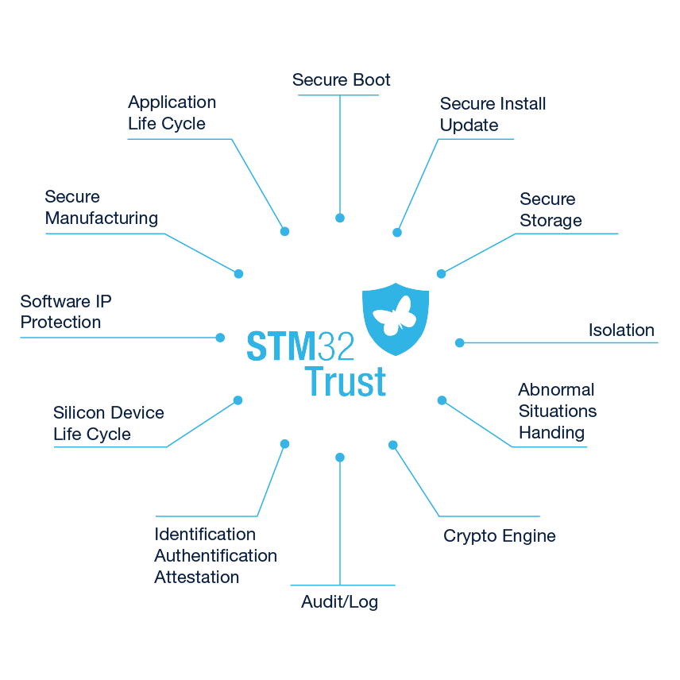
How to address customer demand for security ? The STM32Trust Framework
What
A high-level Security Framework
Why
Protect customer assets
How
Fulfill Security Functions
To reach
IoT Security Assurance Levels
www.st.com/STM32Trust
Notes:
STM32Trust is a high-level security evaluation framework that has 2 objectives:
Build security awareness on the customers side
Map some embedded security functions as the 1st step to security evaluation with IoT schemes at the Platform or OEM level

Slide 12
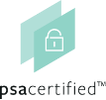
From STM32Trust to IoT Security
► STM32Trust meeting 2 IoT certification schemes:
Security Evaluation Standard for IoT Platforms (SESIP)
A security evaluation framework for silicon-based platform
ARM® Platform Security Architecture (PSA)
A security framework around ARM ecosystem
Notes:
At chip level, STM32Trust meets 2 established IoT security evaluation schemes:
SESIP for security evaluation at the platform level, agnostic scheme, re-usability for customers
ARM PSA a comprehensive security solution with the key elements to develop a secure solution with a RoT next to a security evaluation scheme, PSA Certified

Slide 13
The SESIP value
► The de-facto standard for MCUs
► Derived from CC but w/o the heaviness
► Flexible and accessible evaluation framework
► “Kill 2 birds with one stone” approach at L3
► Endorsed by the industry key players & GlobalPlatform
► Meet OEMs expectations
► Re-use & composition
► Ease the IoT certification process
► Reduce IoT fragmentation. Mapping with ETSI TS 303 645, IEC 62443, CSA/Matter…
Notes:
CC: the reference security evaluation approach. Established for decades and widely accepted
Flexible : List of security functions can be tailored to meet the product features
Accessible: A comprehensive and documented methodology
ARM PSA L3 & SESIP3 : 1 single Security Target + 1 evaluation report
GlobalPlatform: more than 100 member companies

Slide 14
The STM32 Journey: From Basic Security to L3

Slide 15
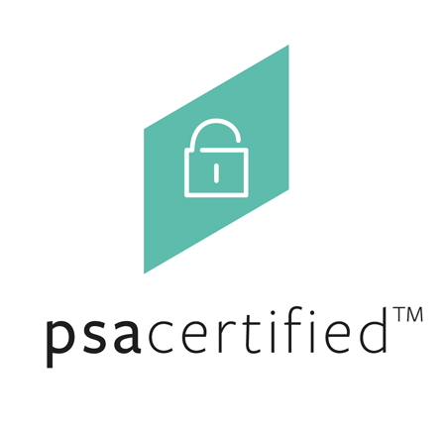
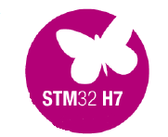
STM32 Journey
L3
Level of Assurance
Ultra Low Power MCU
1st Product with Physical Attack Resistance
L2
Low Power MCU
Product with Logical Attack Resistance
L1
Low Power MCU
Legacy MCUs
2019 | 2020 | 2021 | 2022
Notes:
Journey started in 2018:
ARM PSA L1: STM32L4 XCUBE-SBSFU Feb-19
ARM PSA L2:STM32L5 w/TF-M
SESIP L1: STM32L4 XCUBE SBSFU L1 Feb-20
SESIP L3 : STM32L4 XCUBE-SBSFU L3 with logical attacker resistance Feb-20
SESIP L3: STM32L5 with logical attacker resistance Aug-20
SESIP L3: STM32U5 w/TF-M and MCUboot Jul-21 with physical attacker resistance Jul-21
/!\ STM32U5 is the only MCU that has passed ARM PSA L3 and SESIP3 with physical attack resistance.
/!\ There is one Winbond product that has passed SESIP3 with physical attack resistance. The same device passed CC certification with AVA_VAN.5
https://www.trustcb.com/iot/sesip/sesip-certificates/

Slide 16
Lesson Learned From Basic to L3
► Security Awareness
► Security from the ground up for new product development
► Affecting HW, FW, MW and Ecosystem development @ST
► Expertise ➔ Better understanding of major security pitfalls
► Boot process & Lifecycle
► Security-impacting IPs development: Crypto, physical isolation…
► Crypto operations handling: key protection…
Notes:
Improved ST security awareness
Security from the ground up : Definition of the security function at the Marketing level
Extension to FW, MW and tools
Expertise:
ST MCD develops GP MCUs addressing thousands of customers. Security is one of the features (contrary to Secure Element business)
Need for additional expertise to reach L3 on multiple components
Products sold to millions with multiple compilers/debuggers ➔ Community can hack easily !

Slide 17
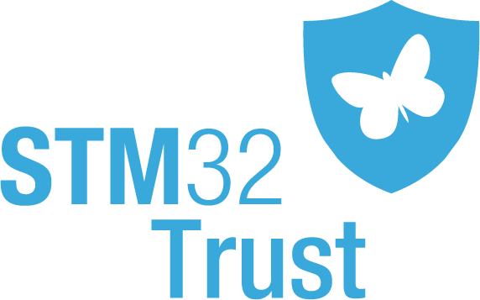
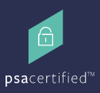
STM32 Security Roadmap
Scaling security offer with L3 as the baseline
Security
robustness
L3
L3
IP Protection
IoT / Cloud
IP Protection
IoT / Cloud
(shared resources)
L3
Firmware code protection
L1
Basic IoT
Crypto
Hardware
Secure Hardware
Open-Source Software
SoC Security SW
Legacy
Mid. term
Services & Assets protections

Slide 18
What matters to ST for SESIP
► A valuable security evaluation framework
► Extension to OEM schemes recognition of SESIP
► Extension to entry-level products covered by SESIP3 / JIL >21
► Enhance the standard with services coverage
► Secure Programming
► Cloud Registration (Zero-touch provisioning & commissioning)
Notes:
Beyond coverage of OEM schemes with SESIP ➔ Need to address the cloud security evaluation.
Q: Will SESIP propose a scheme for cloud servers beyond existing standards (PCI DSS…) ?
One ST customer even asking for cloud server and mobile application evaluation.

Slide 19
Q&A

Slide 20
For further support in creating a PowerPoint presentation, including graphic assets, formatting tools and additional information on the ST brand
you can visit the ST Brand Portal https://brandportal.st.com

