Slide 1
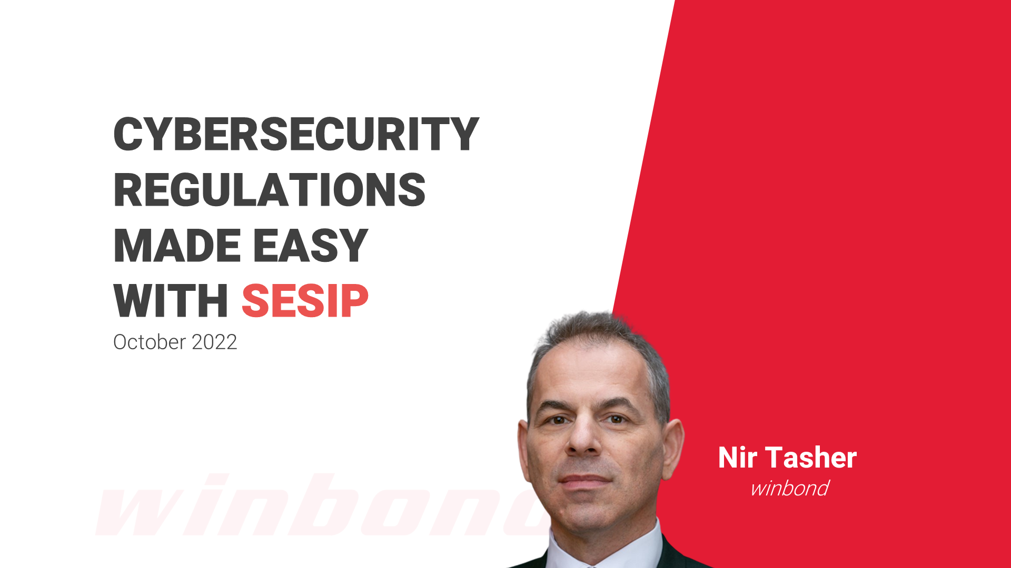

Slide 2
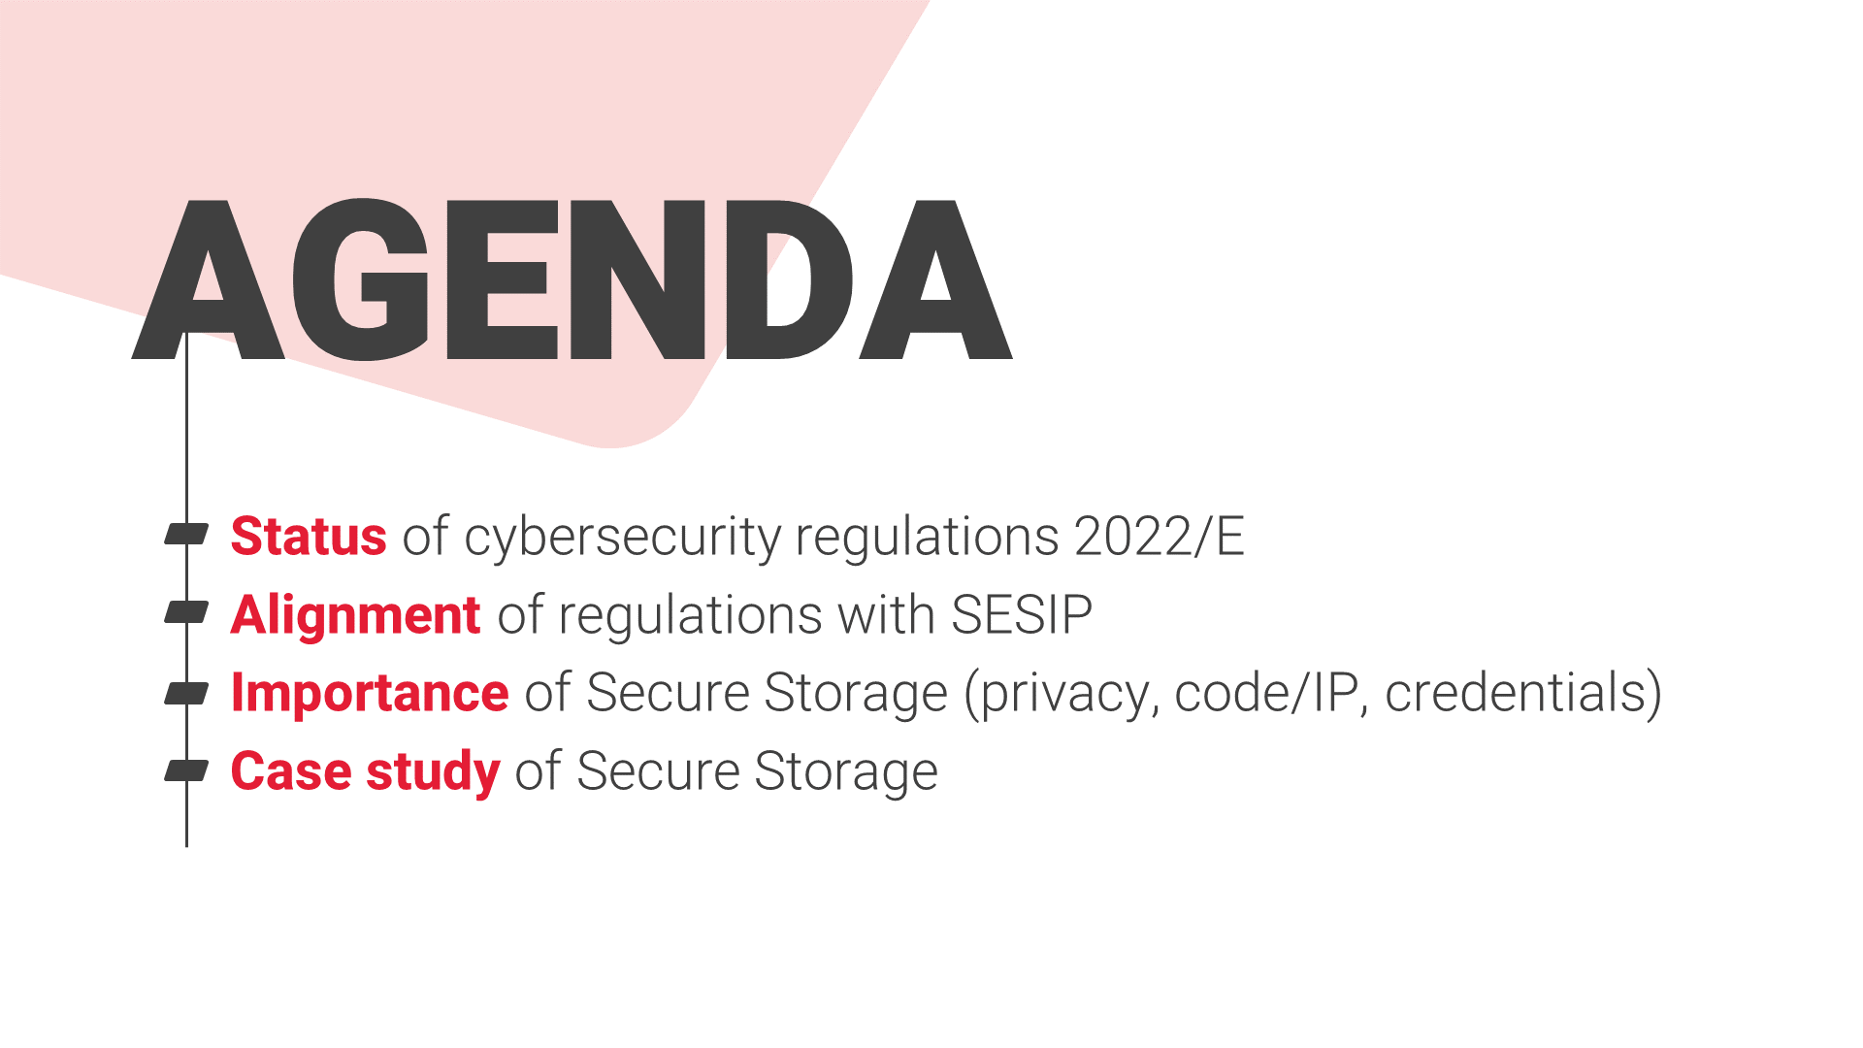

Slide 3
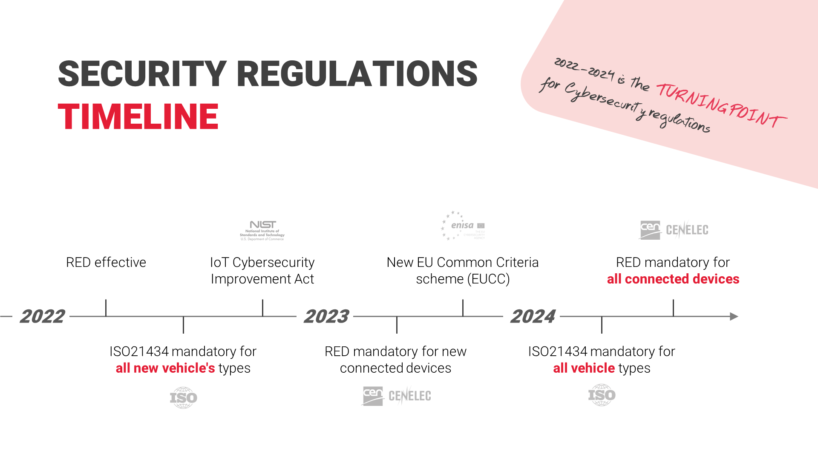

Slide 4
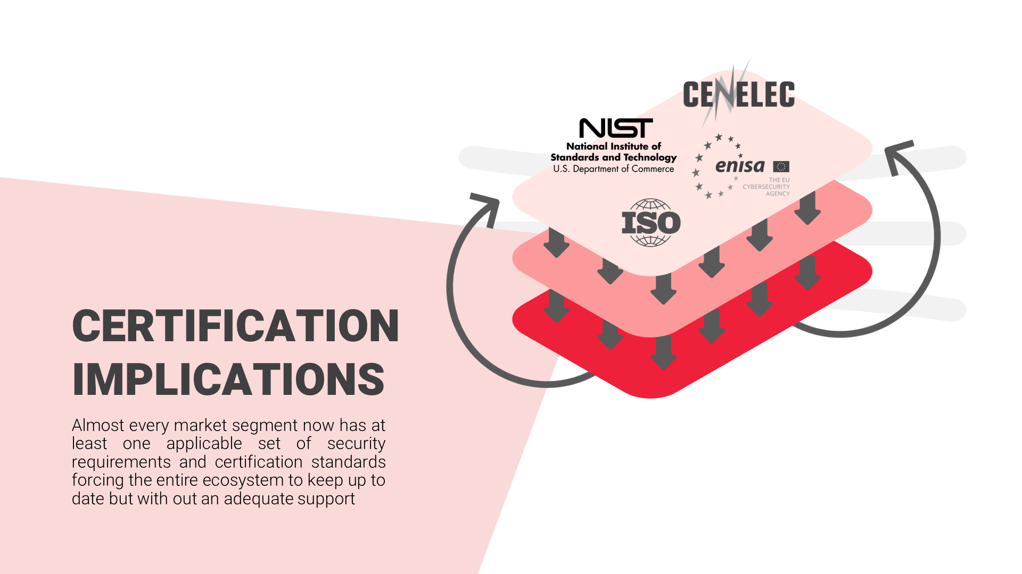
Notes:
Regulations are pushing the markets and in turn push vendors
Some 1st tier vendors are security savvy and have already established the needed background
Other tiers are scrambling to find adequate solutions. Many vendors cater to more than one market segment and need to figure out how to address multiple standards

Slide 5
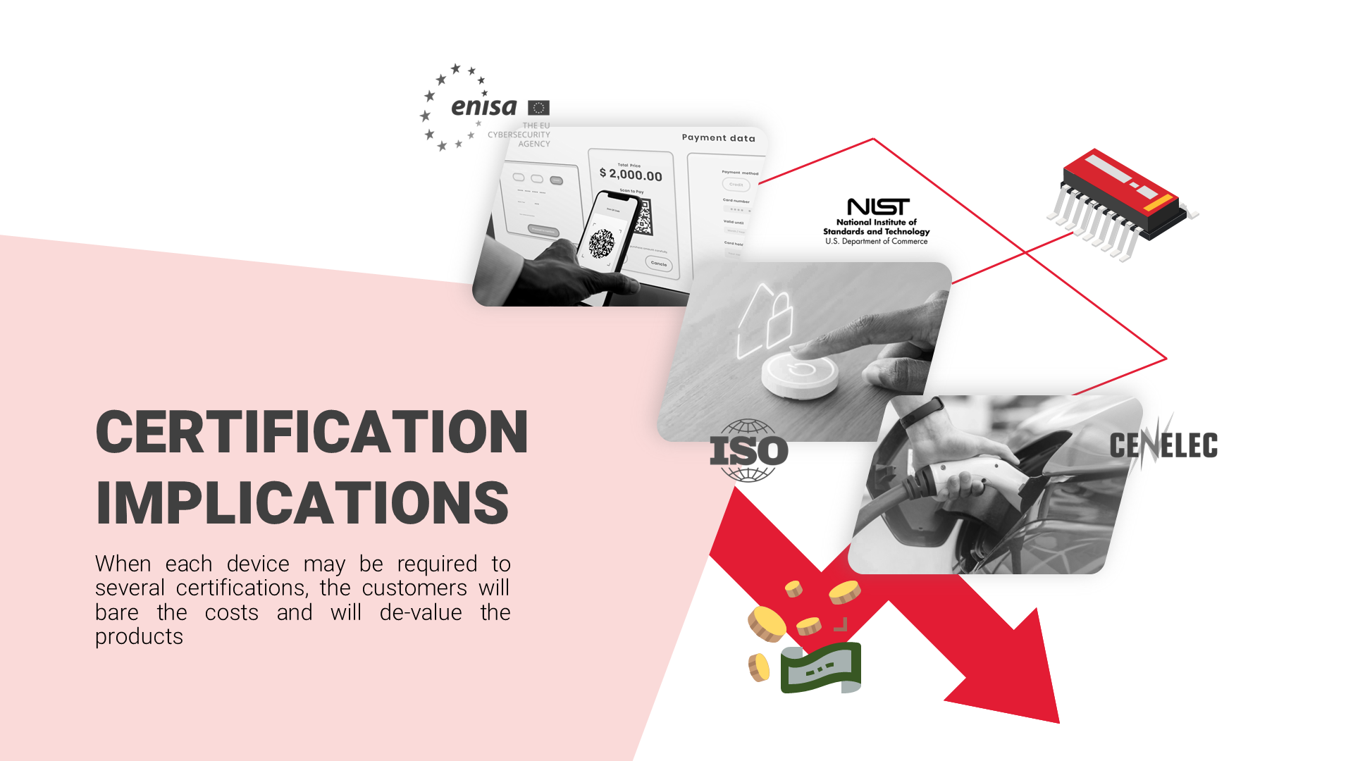
Notes:
Component makers face a challenging situation. The same devices can go into several types of end products, each with its own security requirements and certification needs
The cost of certification is eventually passed on to the customer
This can de-value the more secure products since security is a hidden feature
The effort invested in the initial security certification must pay off in subsequent certifications and products
As market leaders in secure products, we must ensure we make these more accessible and reasonably priced

Slide 6


Slide 7
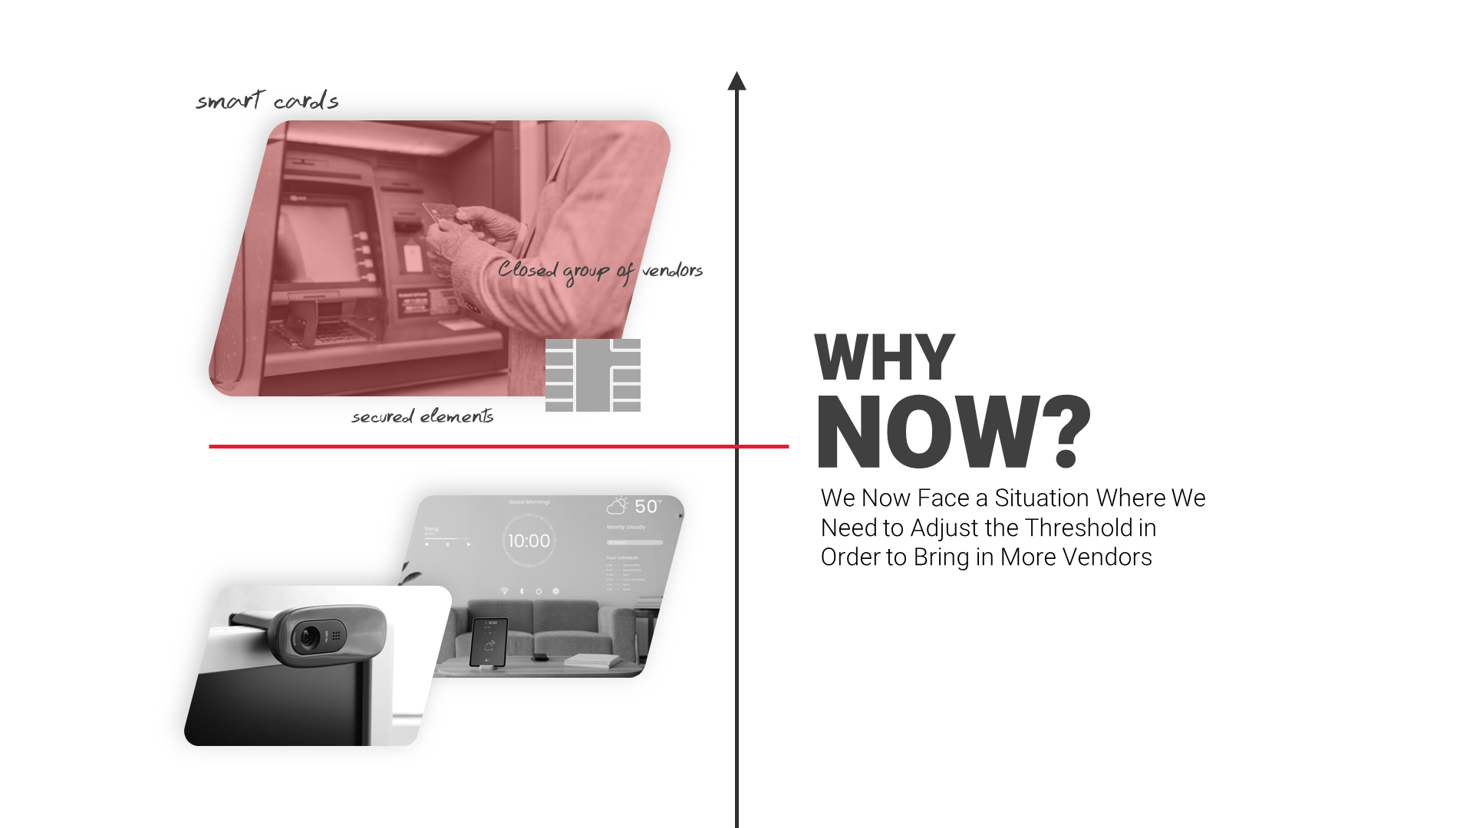
Notes:
Over the course of many years, the entry barrier was set very high
It helped marketing niche products such as smart cards and secure elements
It created a tightly closed group of vendors who can cater to these security markets
It drove away many vendors and customers
We now face a situation where we need to bring in those other vendors

Slide 8

Notes:
Simplicity is the key for onboarding new vendors and customers
Clear and simple wording in standards
Achievable security goals
Tiering to onboard the more basic products

Slide 9
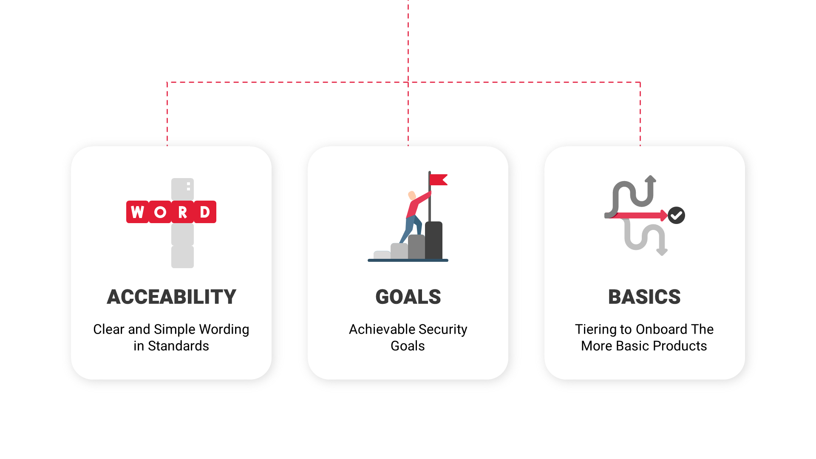

Slide 10
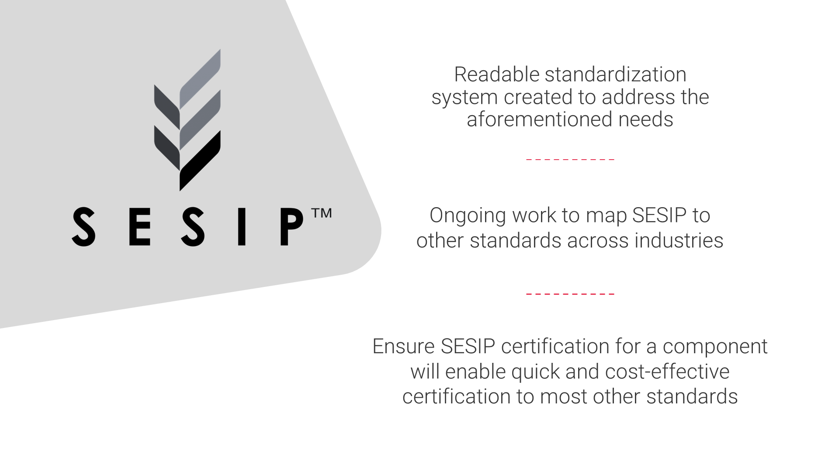

Slide 11
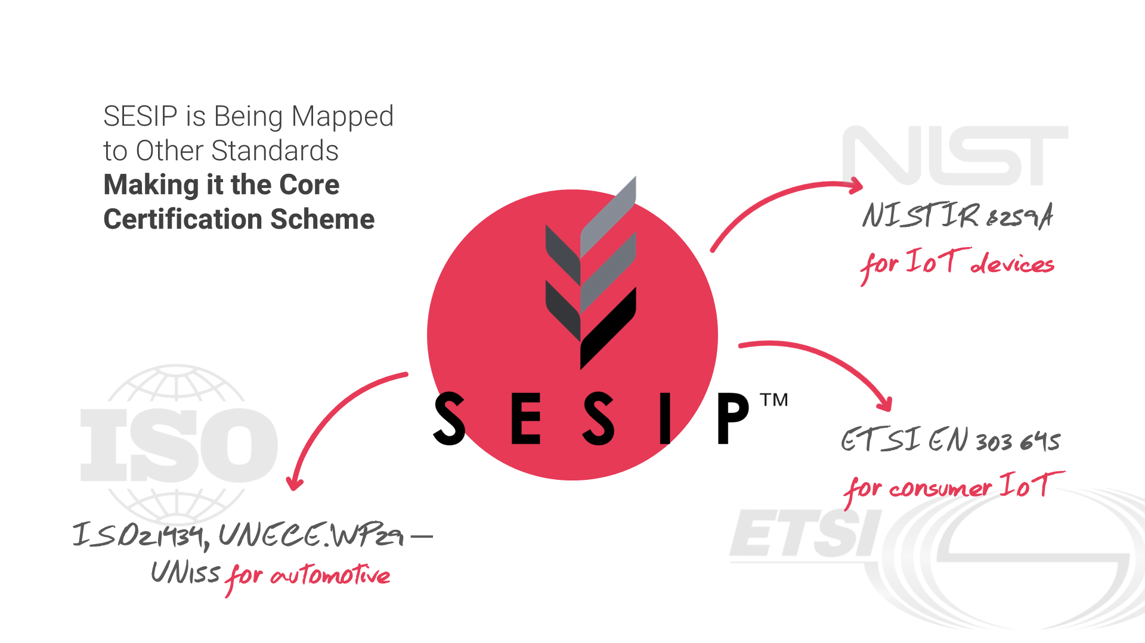
Notes:
Mapping to other standards
SESIP is being mapped to other standards making it the core certification scheme
ETSI EN 303 645 for consumer IoT
NISTIR 8259A for IoT devices
ISO21434, UNECE.WP29 – R155 for automotive
More to come

Slide 12
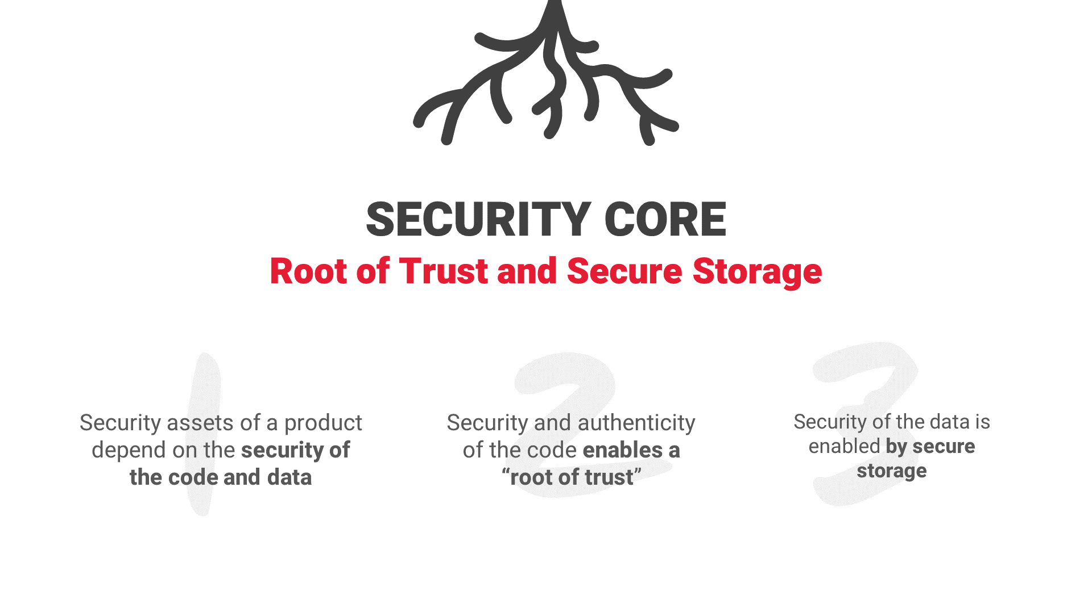

Slide 13


Slide 14
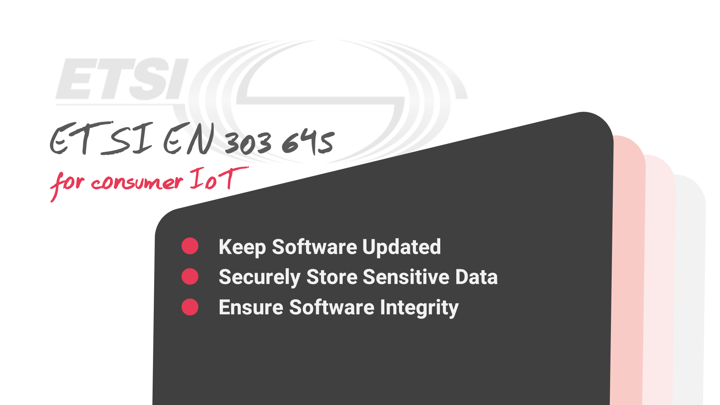

Slide 15
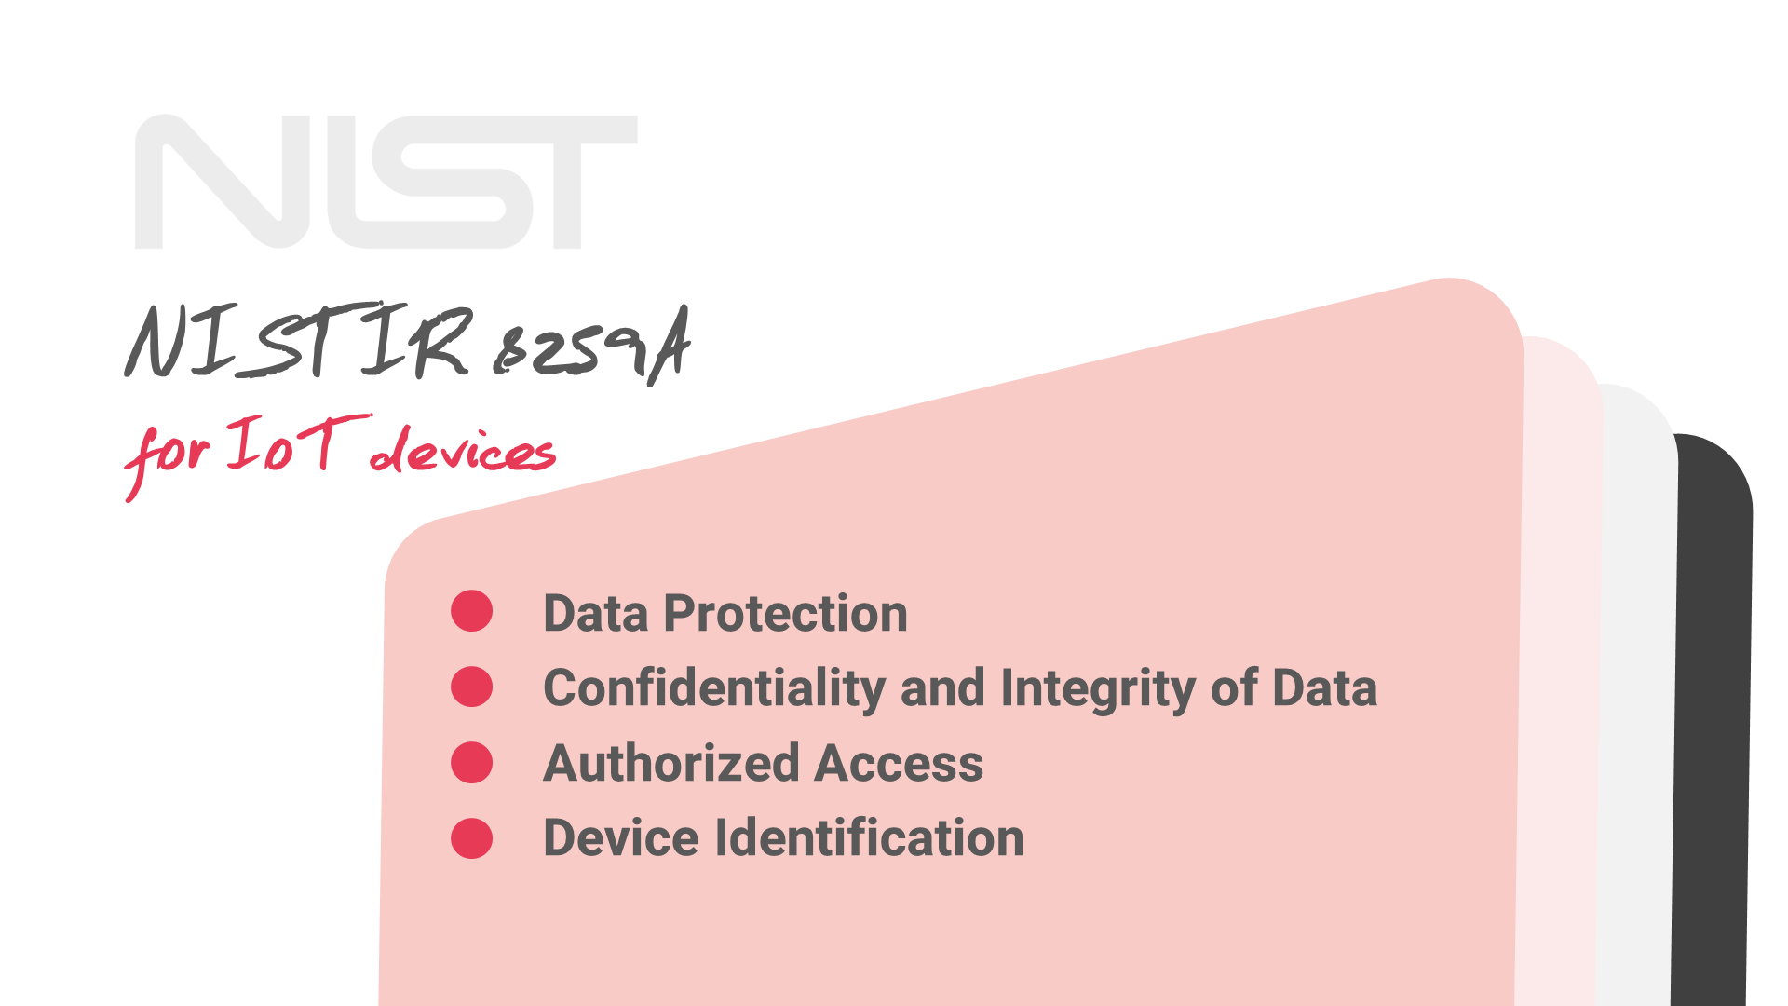

Slide 16
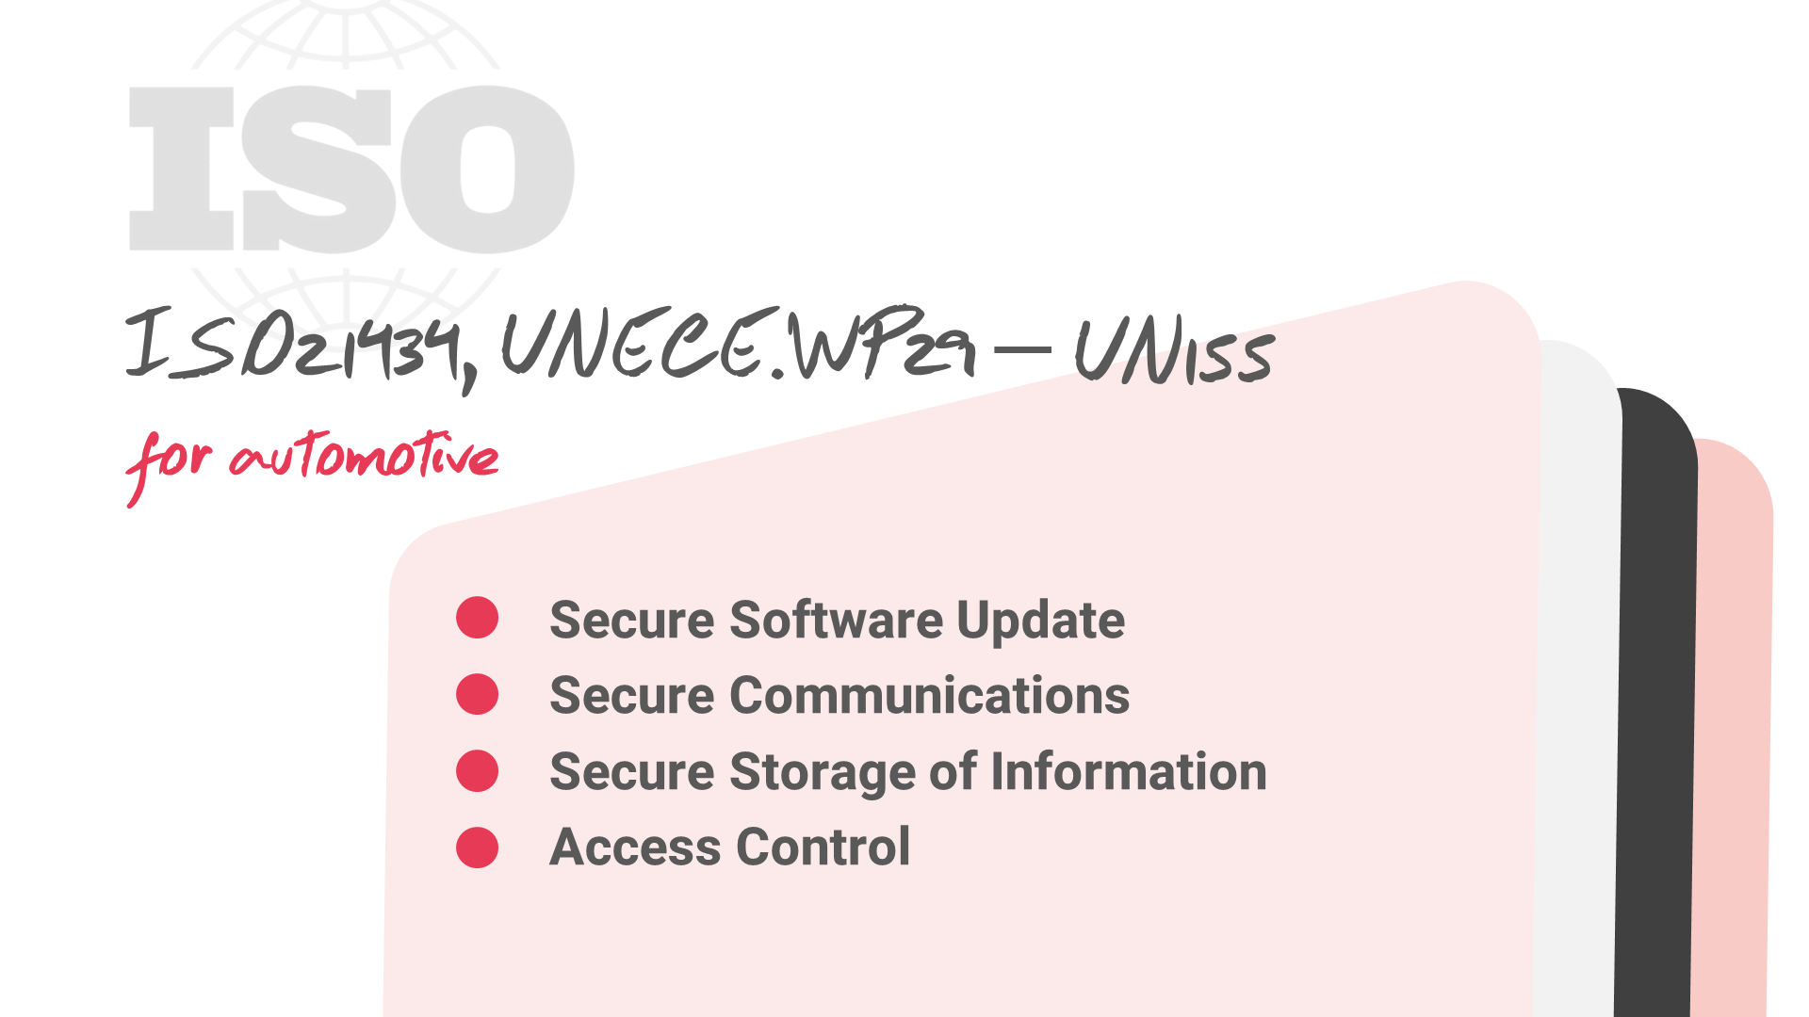

Slide 17
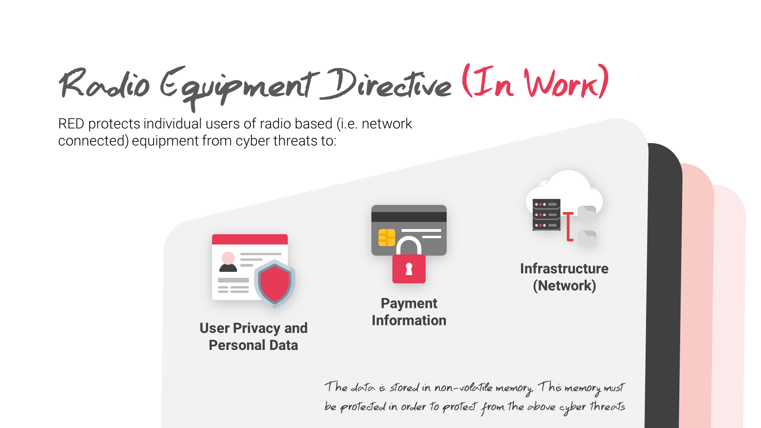
Notes:
The importance of secure storage – RED
RED – Radio Equipment Directive, is set to protect individual users of radio based (i.e. network connected) equipment from cyber threats to:
User privacy and personal data
Payment information
Infrastructure (network)
The data is stored in non-volatile memory. This memory must be protected in order to protect from the above cyber threats

Slide 18
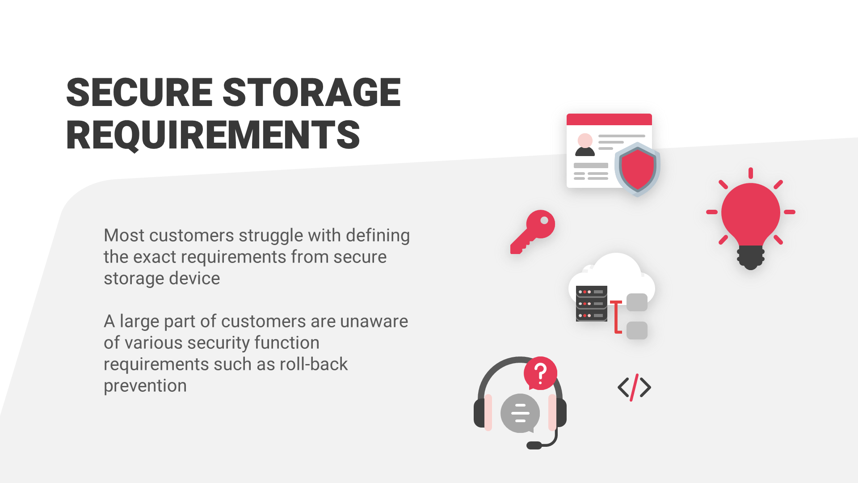
Notes:
Secure Storage Requirements
All secure applications call for the security of the storage element
Keys
User data
Intellectual property
Vendor/infrastructure data
Code Autenticity and freshness
Support for secure software update
Most customers struggle with defining the exact requirements from secure storage
A large part of customers are unaware of various security function requirements such as roll-back prevention

Slide 19
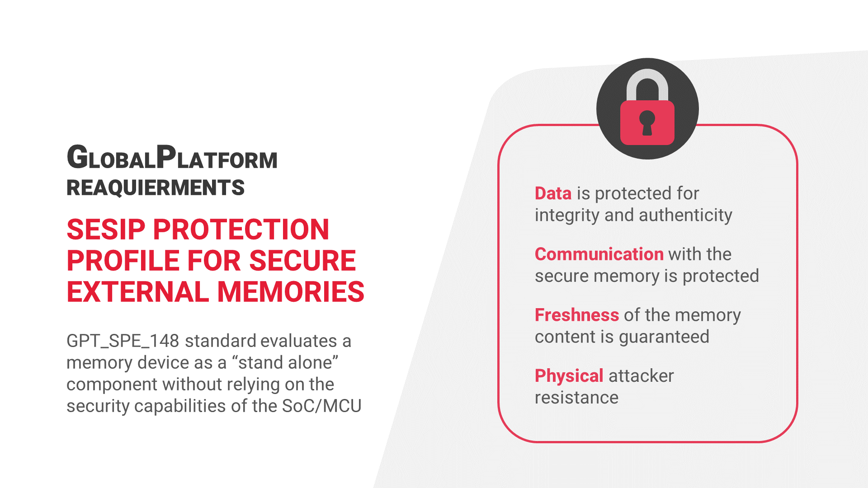
Notes:
GlobalPlatform SESIP Protection Profile
For Secure External Memories
GlobalPlatform published SESIP profile for Secure External Memories (GPT_SPE_148)
Evaluate a memory device as a “stand alone” component without relying on the security capabilities of the SoC/MCU
Required main security features
Data is protected for integrity and authenticity
Communication with the secure memory is protected
Freshness of the memory content is guaranteed
Physical attacker resistance

Slide 20
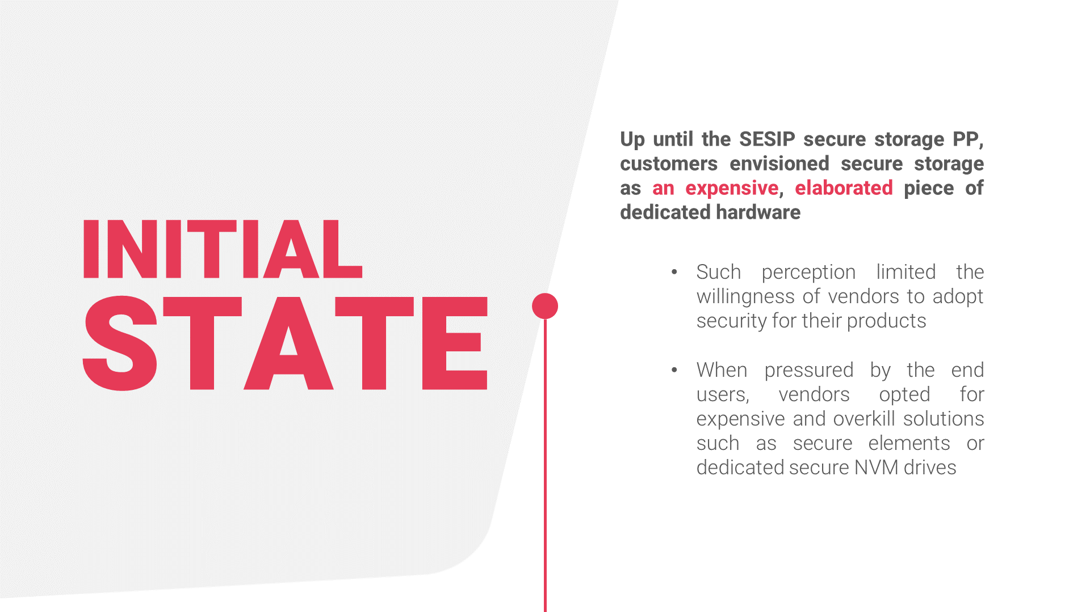

Slide 21
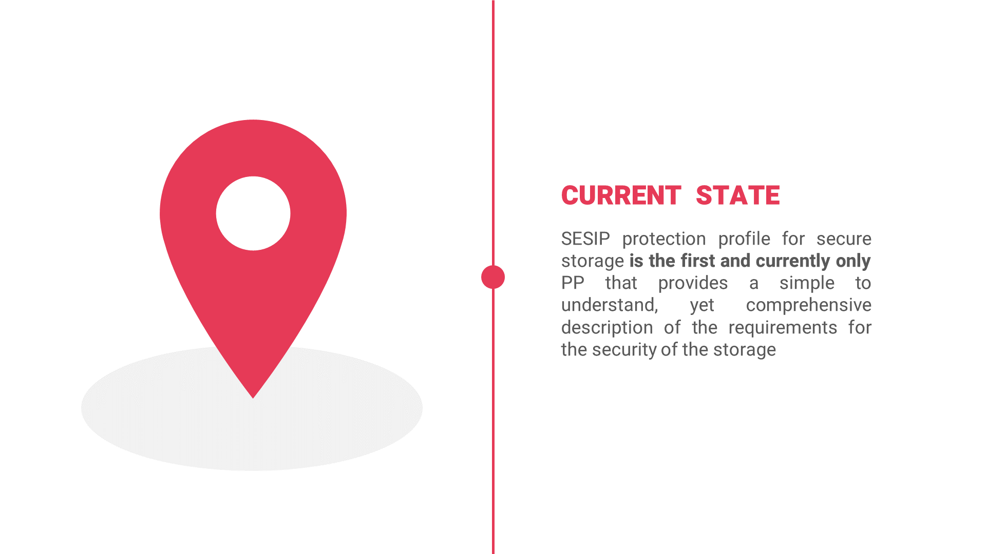

Slide 22
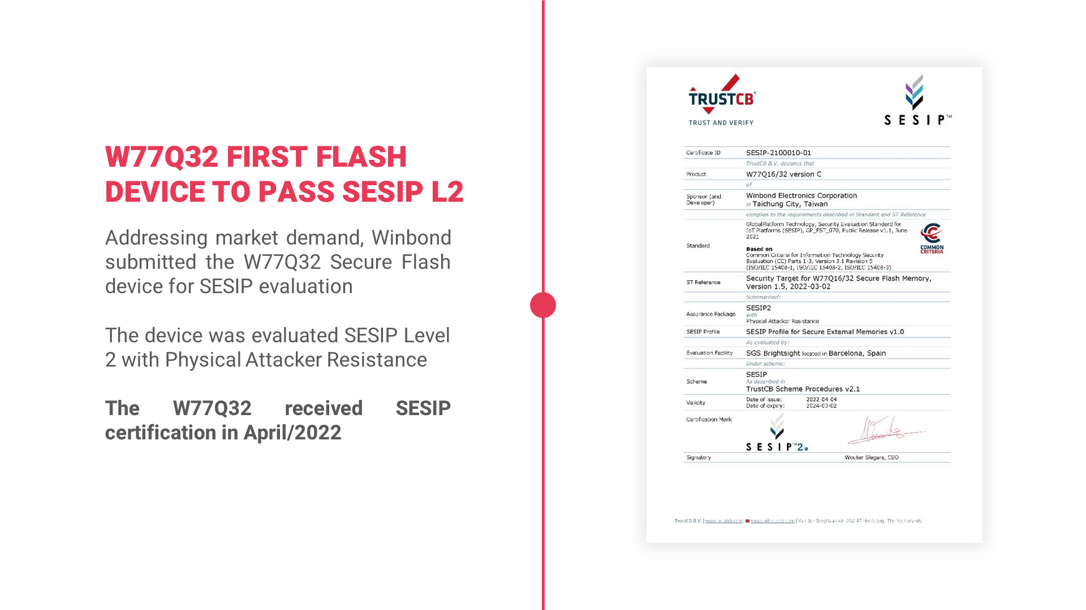

Slide 23
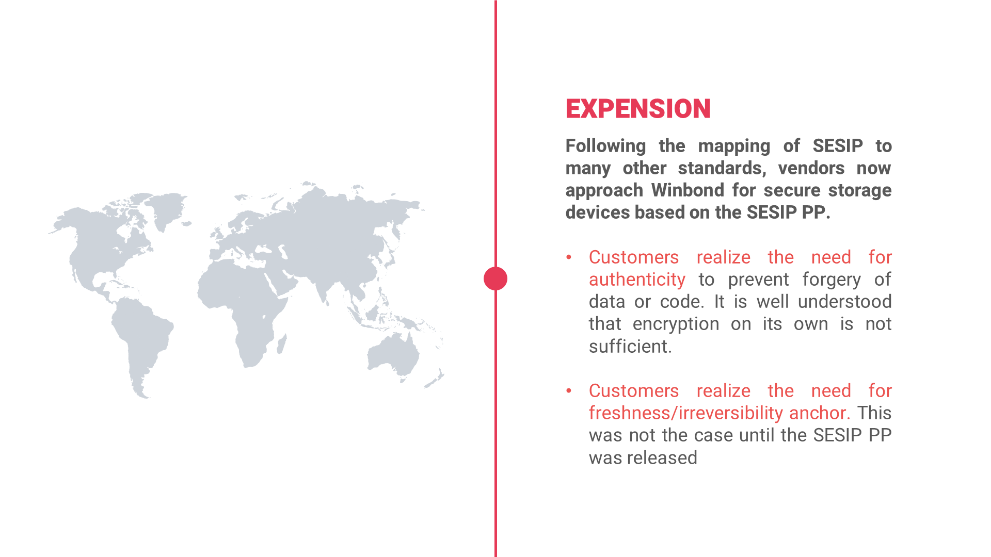

Slide 24
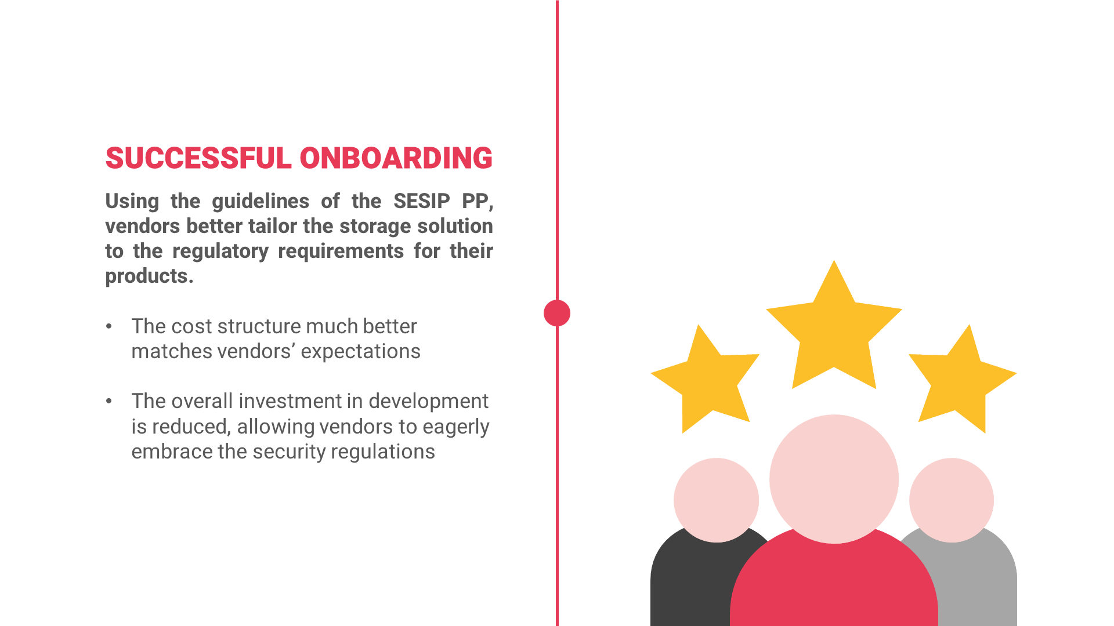

Slide 25
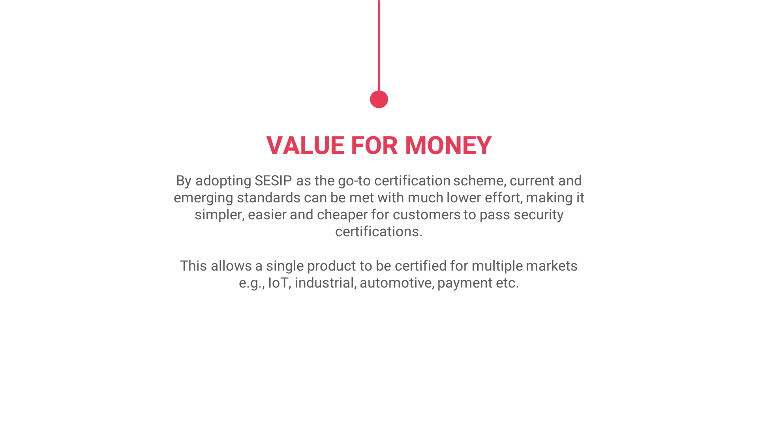

Slide 26


